Slide 1



Prosperity Fund Board
11 June 2026

Slide 2
Agenda
10am Welcome and Introductions
        Declarations of interest
        Minutes/Action Log
10:15am Programme funding summary
        UK Shared Prosperity Fund
          Alignment with fund priorities
          Projects supported
        Rural England Prosperity Fund
          Alignment with fund priorities
          Projects supported
        Additional impact and lessons learned
          Geographical distribution
          Publicity
11:45am Final items
12 noon Close
Cllr Lucille Thompson
Camilla Sharp
Camilla Sharp
Cllr Lucille Thompson

Slide 3
Funding distribution 2022 to 2026
 | UKSPF | REPF | Total
Allocated | £1,327,146 | £968,489 | £2,295,635
Awarded 2022-2026 | £1,216,110 | £966,034 | £2,168,998
Underspend returned to UK Gov 2025 | £7,630 |  | £7,630
Management and Administration | £77,242 |  | £77,242
Underspend | £26,164 | £2,455 | £28,619
TOTALS | £1,327,146 | £968,489 | £2,295,634
In the period 2022-2025, 99.9% of the funds were awarded, leaving an underspend of £7,630
In the period 2025-2026/7, we have an underspend of £29,000 from projects that were completed without using their full budget allocation. We plan to spend this full sum on one final project.
Notes:
In the period 2022-2025, 99.9% of the funds were awarded, leaving an underspend of £7,630
In the period 2025-2026/7, we have amassed an underspend of £22,248 from projects that were completed without using their full budget allocation. We plan to spend this full sum on one final project.

Slide 4
UK Shared Prosperity Fund 2022-2026

Slide 5
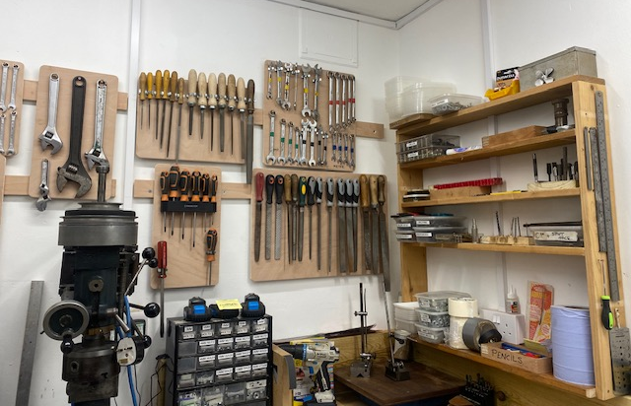
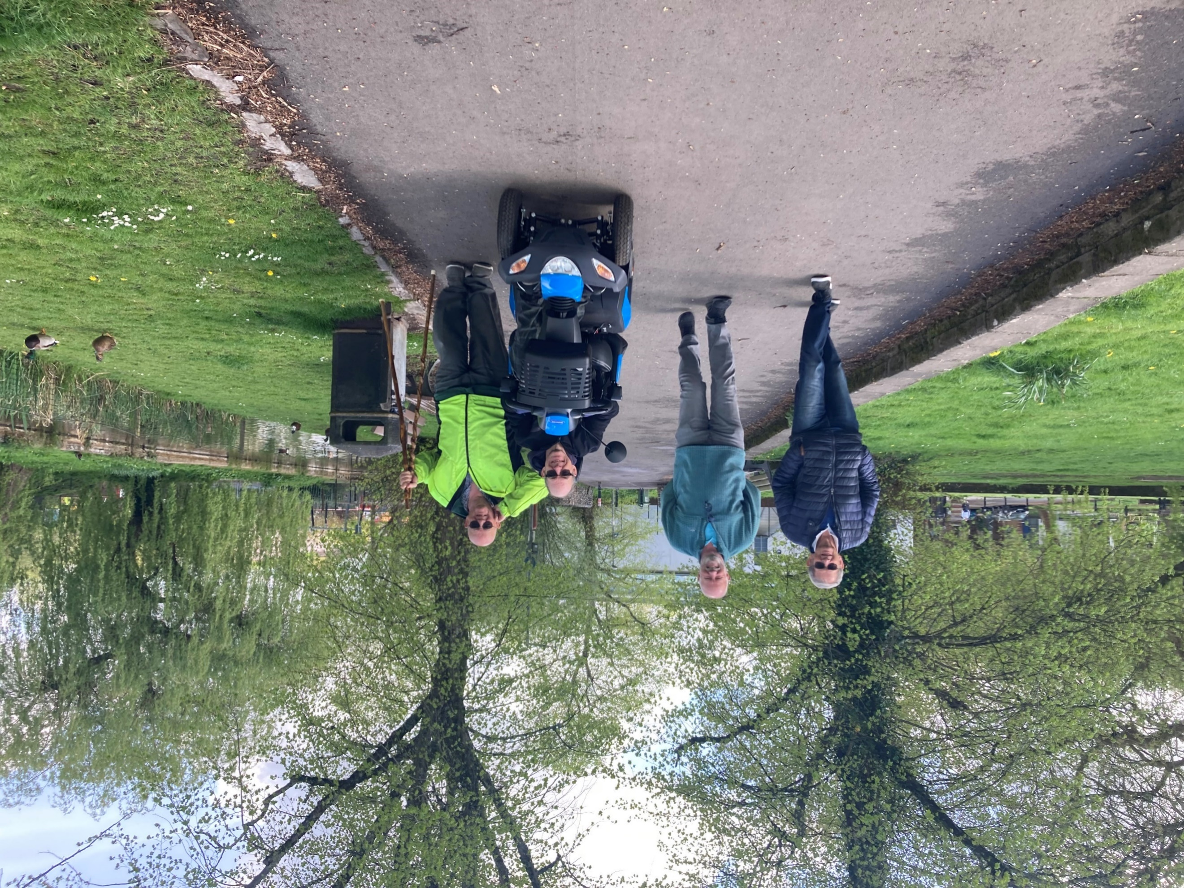

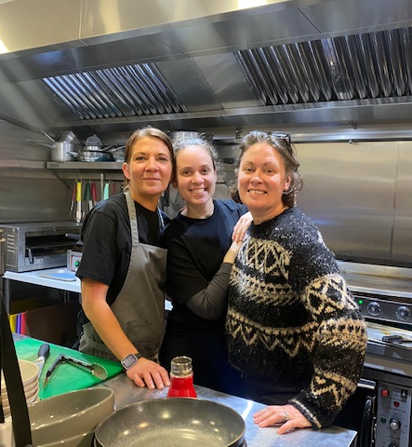
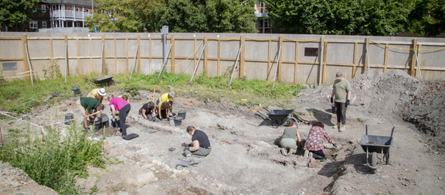
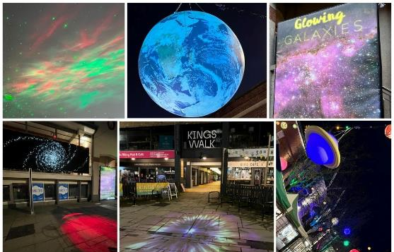
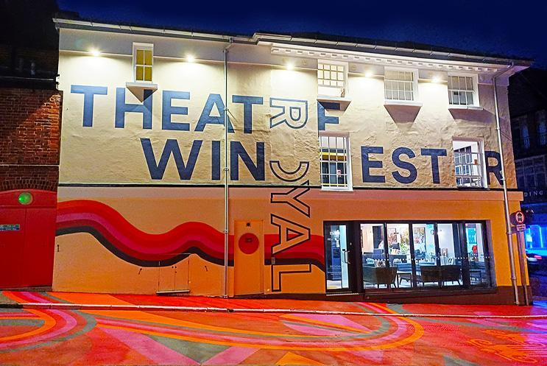
Projects supported through UKSPF
Tools for Bishop’s Waltham Men’s Shed
Winchester Health Walks
Energy efficient ventilation for South Downs Social
Sustainable Tourism
Archaeology event during the transformation of the Friarsgate area
Bearface Theatre’s inclusive project studying perceptions of safety and crime
Light Festival
Hearing loop for Theatre Royal
Notes:
Bearface Theatre’s inclusive project studying perceptions of safety and crime

Slide 6
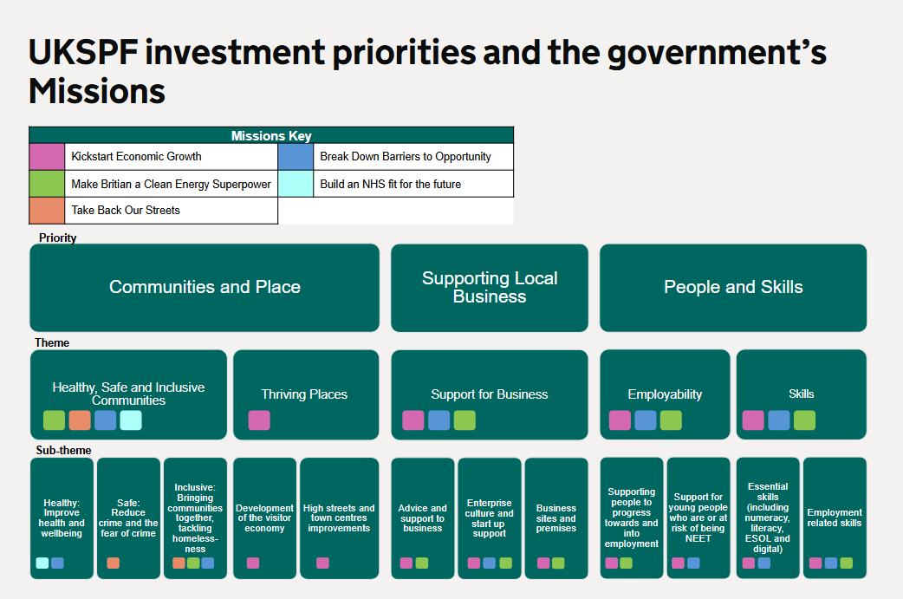
UK Government investment priorities

Slide 7
WCC investment priorities
Communities and place
  Pockets of deprivation across the district
  The need to enhance and increase community infrastructure and access to green space
  Improvements to local high streets
  Developing greater social and community participation in local life
  Supporting and facilitating cultural and wellbeing provision
Supporting local business
  Support high street businesses and street markets
  Developing digital capability in businesses
  Supporting land-based businesses/ farmers to diversity
  Support and growing creative businesses, entrepreneurs and freelancers
Skills and people
Increasing:
  Residents’ digital skills
  green / low carbon skills
  employability skills

Slide 8
Award alignment with our investment priorities
Notes:
Inclusive and healthy communities: £831,328

Slide 9
Award alignment with our investment priorities
Communities and place
 | 30 | Volunteering opportunities created
 | 12 | Economically inactive people acquiring new skills
 | 700 | Residents engaging in sport
 | 21 | New events supported
Addressing pockets of deprivation
 | 40,000 | M2 of green space recovered
 | 3,392 | M2 public realm improved and/or made accessible
 | 150 | M2 of new foot and cycle path
 | 70,000 | Trees planned for planting
Social and community participation, development of green space
Pockets of deprivation across the district

Slide 10
Award alignment with our investment priorities
Supporting local businesses
 | 22 | Digital projects supported
Developing digital capability in businesses
 | 650m2 | Commercial space improved
 | 93 | Businesses supported
Supporting local economic growth
 | 100 | Creative entrepreneurs engaged
 | 50 | Events supported
Support for creative businesses and freelancers

Slide 11
Award alignment with our investment priorities
People and skills
 | 21 | Residents achieving qualification
Increasing residents’ digital skills
 | 307 | Residents achieving qualification
 | 25 | Farms adopting new technologies
Increasing green / low carbon skills
 | 852 | Residents attending training workshops and sessions
Increasing employability skills

Slide 12
37 external projects supported (1 of 2)
Total expenditure = £739,153
Organisation | Project | Expenditure
Bearface Theatre | 14 events with HMP Winchester | £18,500
Bishops Waltham Men's Shed | Tool purchase | £2,973
Bishops Waltham Parish Council | Priory car park extension | £49,000
Colden Common Parish Church | Under-pew heating and LED lighting | £5,226
CPRE | Meadow management training | £5,000
Durley Parish Council | Car park improvement including EV chargers | £2,695
Fairthorne YMCA | Solar-powered battery packs for campers | £576
Farming and Wildlife Advisory Group | Feasibility study into shared flock | £3,216
Hampshire County Council | County-wide retrofit construction training courses | £55,000
Hampshire Cultural Trust | Recruitment and training of volunteers | £12,000
Hampshire Cultural Trust | Planters and seating | £34,904
Handmade Cyclist | Retrofit | £30,440
INCA Design | Digital equipment | £1,498
Littleton Village Hall | Additional solar panels | £8,825
Marwell Wildlife | Crayfish and sand lizard habitat | £10,000
Micheldever Village Store | Climatisation | £8,729
Morton Pattison | Tractor and flail attachment | £30,000
Mythic Tabletop Games | Energy efficient refurb | £9,103

Slide 13
37 external projects supported (2 of 2)
Organisation | Project | Expenditure
Northbrook Arms | EV chargers | £1,672
Northbrook Hall | Damp treatment | £2,274
Play to the Crowd | Hat fair promotion and community engagement | £60,400
Play to the Crowd | Enhancement of Winchester festival programme | £31,000
RAC Corbett Holden Farm | Cladding for outdoor café container units | £4,500
Shedfield House Dairy Business Centre | Construction of new business unit | £10,000
South Downs National Park | Carbon offset and tree planting scheme | £61,000
Sparsholt College | Solar panelling and electric vehicle chargers: training for installers | £35,000
Sparsholt College | Digital skills for farmers* | £70,207
Sparsholt College | Farm-specific energy efficiency training | £30,000
SuperReel | Digital training equipment | £8,202
Sustrans | Development of new health walks and training of volunteers | £10,000
The Colour Factory | Energy efficient refurb | £9,785
The Cycle Company | Purchase of 20 e-bikes for individual and commercial lease plans | £24,999
University of Winchester | Open mic night | £9,379
Wickham Estate | Access and energy efficiency improvements | £20,000
Winchester Action on Climate Change | 3 climate action projects | £18,688
Winchester Action on Climate Change | Solar audits on community buildings across the district | £30,000
Wonderseekers | Conservation with children: exhibition materials | £14,362
TOTAL |  | £739,153

Slide 14
15 WCC projects supported
Total expenditure = £476,957
Investment priority | Project | Expenditure
Visitor Economy | Made in Winchester | £19,100
 | Sustainable tourism | £13,000
 | Jane Austen 250th anniversary | £10,000
 | Light festival | £45,000
 | Nunnaminster improvements | £5,420
 | Market improvements | £1,000
Skills training | Business growth factory | £32,923
 | Creative growth programme | £8,960
 | Digital skills for residents | £24,071
Green space improvement | North Walls | £30,000
 | St Giles Hill | £30,000
Other public realm | CWR Friarsgate Kings Walk | £191,319
Community | Sports tournament | £10,178
 | Stanmore community network | £29,373
 | Community and wellbeing strategy | £26,613
TOTAL |  | £476,957

Slide 15
Rural England Prosperity Fund 2025-2026

Slide 16
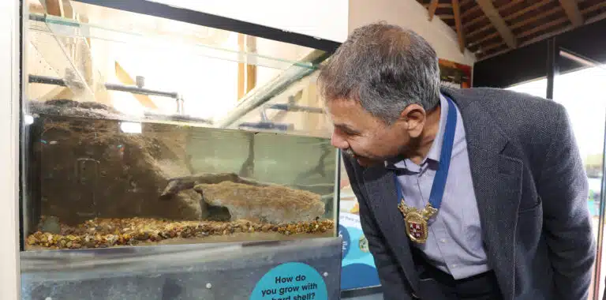
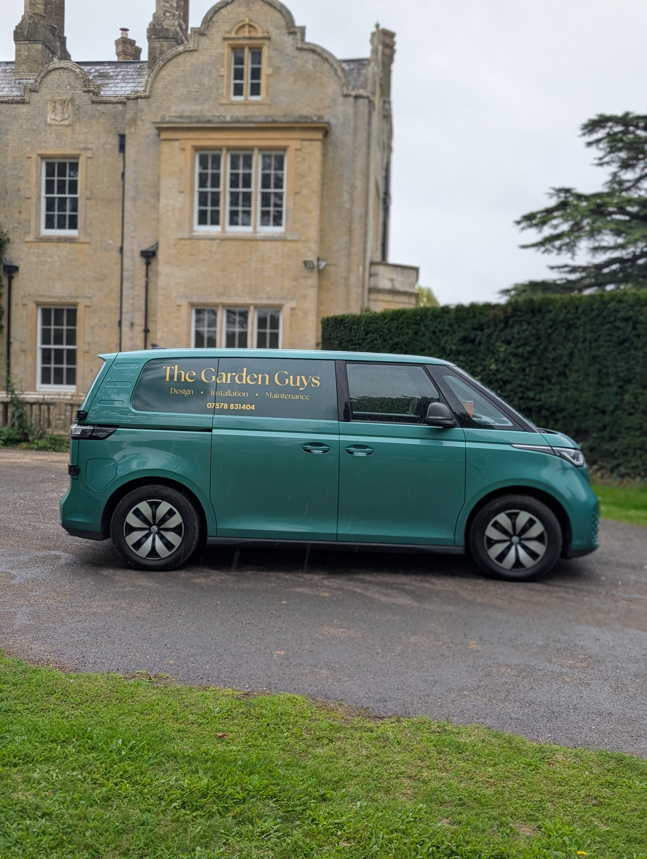
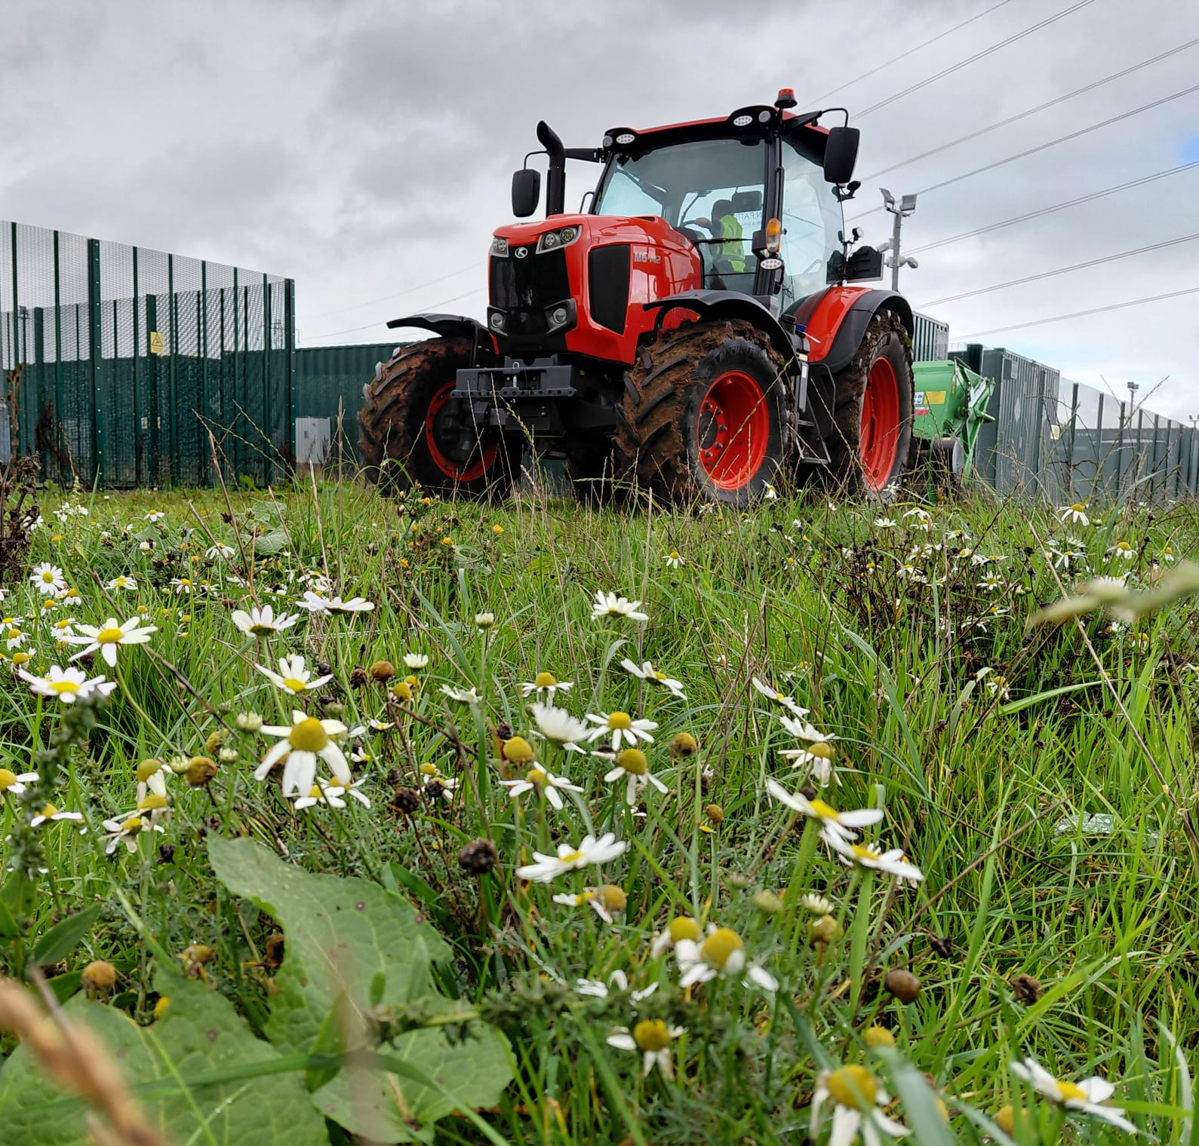
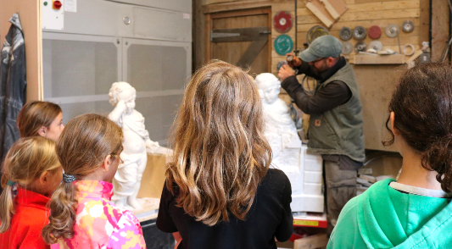
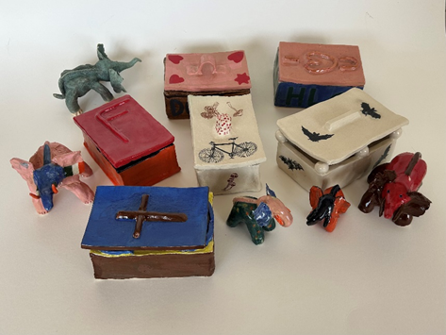
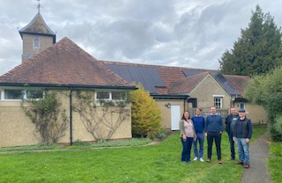
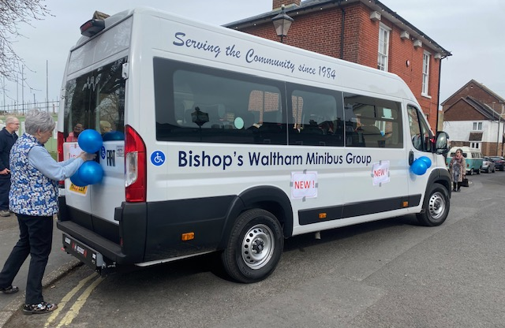
Projects supported by REPF
Sandlizard and crayfish habitat for Marwell Wildlife
Tractor and flail for meadow management
Electric van for local gardeners
Dust extractor enabling local stonemason to teach his craft
Pottery workshops at HMP Winchester
Solar panelling for Victoria Hall, Sutton Scotney
Community bus for Bishops Waltham
Notes:
Dust extractor enabling local stonemason to teach his craft

Slide 17
Our investment priorities
The challenge of meeting net zero carbon and addressing climate impacts
Deprivation and access to services in rural communities and the need for improved / expanded community facilities
  Net zero / climate mitigation
  Community infrastructure and assets improvement
  Green spaces enhancement
  Local business support, culture, arts and tourism development

Slide 18
Award alignment with our investment priorities
Net zero / climate mitigation
 | 7 | EV chargers installed
 | 98 | Tonnes equivalent from 21 projects
 | 65,000 | Tonnes equivalent from one SF6 project
CO2 emissions avoided

Slide 19
Award alignment with our investment priorities
Predicted impact: Improvements to community infrastructure and green space enhancements
 | 10 | Community buildings supported to remain viable
Energy efficiency measures introduced
 | 1 | Safe new play area created
Improvements to community facilities
Notes:
The 21 events are mostly at Swarraton and Northington Village Hall owing to the creation of outdoor space.

Slide 20
Award alignment with our investment priorities
Supporting local business and tourism development
 | 21 | Businesses supported
Enabling local businesses to grow
 | 7 | Jobs created
Increased business productivity requires labour
 | 10 | Visitor economy businesses supported
Improvements to the visitor experience

Slide 21
39 external projects supported (1 of 2)
Total expenditure = £966,034
Organisation | Project | Expenditure
6th Winchester Scout Group | Utilities infrastructure | £32,186
Alexander Graham | Solar panelling | £22,021
Bishops Waltham Minibus | New minibus | £15,000
Colden Common Pavilion | Solar panelling | £18,478
Denmead Community Centre | Solar panelling | £24,999
Durley Car Park | Car park reconfiguration and EV chargers | £24,423
Easton Village Hall | Solar panelling | £25,000
GKCE The Cricketers Easton | Kitchen and bathroom refurb | £25,000
Honey Bee | Electric van purchase | £22,499
Itchen Abbas and Avington Village Hall | Ground source heat pump | £28,000
Marwell wildlife | Crayfish and sand lizard houses | £39,954
Melanie Legge, ceramicist | Potter's wheel and kiln | £14,109
Morton Pattison | Tractor and attachment | £10,000
Northbrook Arms | EV chargers | £4,050
Northbrook Hall | Solar panelling | £10,252
Oakridge Smallholdings | Shepherd's hut and solar panelling | £24,183
OHCO Coffee | Electric tuk tuk | £28,702
RAC Corbett, Holden Farm | New mobile shelters for café visitors | £24,126
Richard Lewis Communications | Solar panelling | £40,000
Notes:
*This project also appears under the UKSPF as it is jointly funded by the two funds. Total award is £90,000

Slide 22
39 external projects supported (2 of 2)
Organisation | Project | Expenditure
River Coffee Roasters Ltd | Larger coffee roaster | £32,713
SF6 Recovery | Purchase of pump | £45,000
Shedfield House Dairy Business Centre | New business unit | £46,250
SN Technologies | Wifi-controlled H&V | £21,600
Sparsholt College | Digital inclusion; skills for farmers | £19,793
Swarraton and Northington | Green space creation | £10,000
Tectonics | Solar panelling | £14,310
The Garden Guys | Electric van purchase | £33,581
Upham New Millenium Hall | Solar panelling | £23,300
Victoria Hall, Sutton Scotney | Solar panelling | £8,845
W Meon VH | Energy efficiency: air source heat pump | £16,463
Wickham Community Association | Mobile staging and A/V equipment | £21,525
Wickham Estate | Windows and track resurfacing | £35,281
Will Davies, stonemason | Dust extractor | £12,863
Winchester District Scout Council | Foundations for new scout barn | £38,000
Winchester Golf Academy | Solar panelling | £24,999
Wonderseekers | Fencing and pathways for new area | £37,478
Woodhams Farm Day Nursery | Baby balcony | £40,000
YMCA Fairthorne Manor | Roof repairs x 4 | £29,991
The Plough, Itchen Abbas | Kitchen and bathroom refurb | £21,060
TOTAL |  | £966,034
Notes:
*This project also appears under the UKSPF as it is jointly funded by the two funds. Total award is £90,000

Slide 23
Additional impact and lessons learned

Slide 24
Prosperity Funds 2022 to 2026
Additional impact
  83 projects supported across the district
  Strong leverage of funding: every £1 of prosperity funding has unlocked a further 92p in match funding, resulting in a total investment of £4.32m over the four-year period
  25 villages or market towns have benefited from grants supporting community facilities or local businesses
  Grant recipients have provided extensive promotion for UK Government and WCC in their marketing activities
  Delivered through a collaborative effort of 11 colleagues from across the Council delivering projects, scoring and many more contributing in other valuable ways
Lessons learned
  Effective promotion is critical: The first funding round was undersubscribed due to limited awareness. By contrast, later rounds, supported by stronger communications were 2.5 times oversubscribed, leading to a significantly higher quality of applications and selected projects
  While a competitive programme is time-consuming and resource-intensive to manage, it is widely perceived as transparent and fair, strengthening stakeholder confidence in the process.

Slide 25
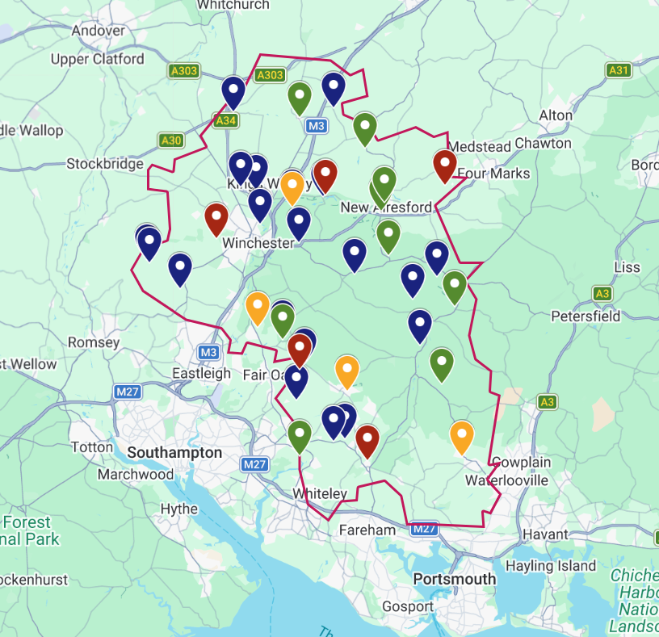
Geographical distribution of REPF 2023 to 2026
Key:
 | 2023-2025 Round 1
 | 2023-2025 Round 2
 | 2023-2025 Round 3
 | 2025-2026

Slide 26
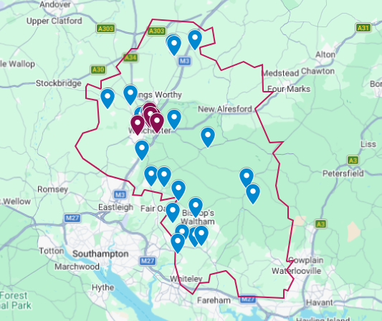
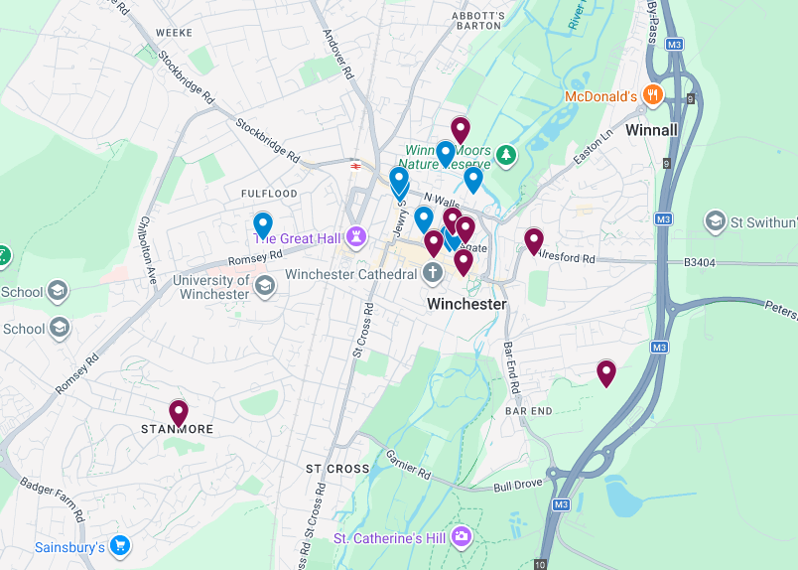
Geographical distribution of UKSPF 2023 to 2026
Key:
District-wide WCC Projects
(not plotted on map)
Made in Winchester
Sustainable tourism
Jane Austen 250th anniversary
Business growth factory
Creative growth programme
Digital skills for residents
Community and wellbeing strategy
District-wide External Projects
(not plotted on map)
Feasibility study into shared flock
Retrofit construction training courses
Recruitment and training of volunteers
Hat fair promotion and community engagement
Carbon offset and tree planting scheme
New health walks and training of volunteers
Climate action projects and solar audits
 | 2023-2026 WCC Projects
 | 2023-2026 External Projects

Slide 27
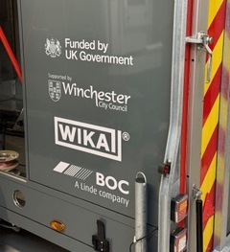



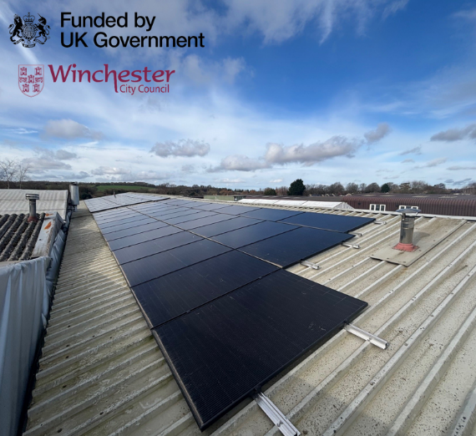
Publicity
Wonderseekers (Winchester Science Centre)
SF6 Recovery
University of Winchester
Bearface Theatre
Tectonics
Notes:
SF6

Slide 28
Final items

Slide 29

And THANK YOU to our Board
  Thank you to the board for your expertise, local insight, and invaluable support in both selection and promotion.

