Slide 1
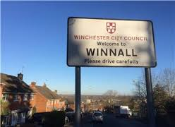
Winnall Planning Framework
Update for Businesses
Thursday 28 January 2016
Eloise Appleby
Assistant Director
(Economy & Communities)

Slide 2
Project Summary
A long term plan (10 years)
Intended to guide policy, investment and planning decisions
Two outcomes specified:

Slide 3
Project Timetable
Front-loading consultation Jan/Feb 2015
Business database research Jan – Mar 2015
Options consultation April 2015
Drafting May/Jul 2015
Local Plan policy development Jul/Sept 2015
Approval of vision & objectives Oct 2015
Local Plan Part 2 consultation Nov/Dec 2015
Final drafting of Framework Jan/Feb 2016
Cabinet approval March 2016

Slide 4
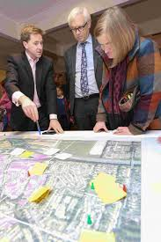
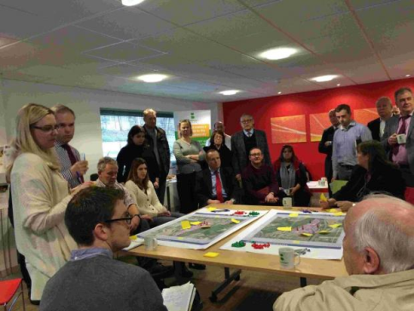
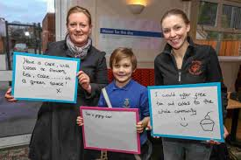
Consultation
Community Jamboree
School competition
Two e-surveys
Two business meetings
Options exhibition (Tesco and Tourist Information Centre)
Stakeholder meetings

Slide 5
Working in Winnall
Living in Winnall
Travelling in Winnall

Slide 6
Vision for Winnall
“Winnall will continue to be a place where people are proud to live and work. It will cater for a range of employment activities, with space for companies to start up, stay and grow. The residential neighbourhood will be known for its high quality green spaces and strong community heart.
Walking and cycling will be encouraged and improved bus services promoted. Parking provision will also be improved. It will be easier to reach the city centre, station and moors. Winnall be an attractive and welcoming gateway to the city, with supporting services for the employment area, such as a café, meeting space and flexible business units located in a new hub on Moorside Road. Winnall will be a place for
continued economic investment and success, and where residential amenity is respected and improved.”

Slide 7
Working in Winnall – Key Issues 1
The nature of the employment area is changing, with more retail and trade activities locating here.
There is a lack of space and premises for small businesses to be able to grow and stay within the area.
There is a need for incubator space to help attract a more diverse employment base and respond to changing economies (including, for example, creative and cultural industries, and those in the low carbon and green sectors).

Slide 8
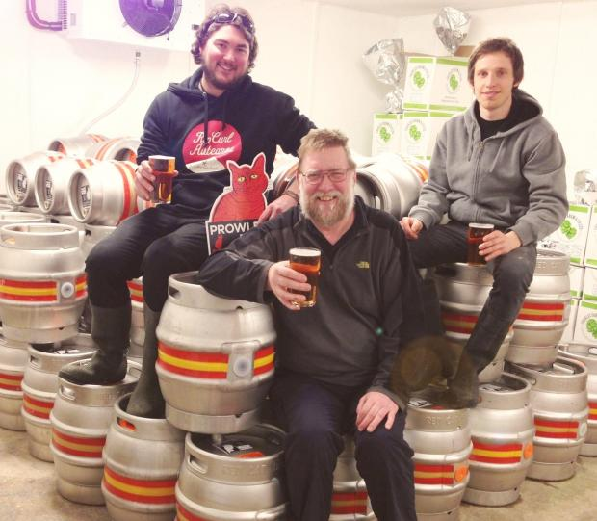

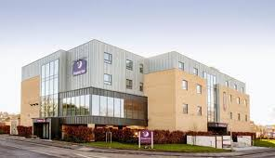
Working in Winnall – Key Issues 2
The employment area suffers from a poor image, limited branding and generally poor quality environment.
There are issues with broadband speed.
Premier Inn
Basepoint
Red Cat Brewing

Slide 9
Working in Winnall: Summary
Winnall Industrial Estate is a thriving and well occupied employment area … People enjoy working in the area, [but] there are a number of ways it could be improved to better support the business function of the area.
These should help reinvigorate the employment area so that it can respond to changing economies, including:
new businesses who want to locate in the area
those who are growing and need space so they can stay in Winnall, and
those already in Winnall whose presence should be retained and continued economic investment encouraged.

Slide 10
Working in Winnall: Objectives
Encourage businesses to start up, stay and grow in Winnall
Provide facilities to support business functions that make this a desirable place to work.
Provide space for creative and cultural start-ups, as well as businesses in low carbon industries.
Establish a cohesive voice for businesses in the area.

Slide 11
Projects Now Under Discussion
Planning policies
Flexible premises
Business forum
Branding/marketing/signage strategy
Faster broadband
Links with universities
Remodelling of Easton Lane

Slide 12
Local Plan Part 2
www.winchester.gov.uk/assets/files/25140/Final-Local-Plan-Part-2-Publication-ver-with-comments-from-Council-and-CAB-22.10.15.pdf

Slide 13
Travelling in Winnall – Key Issues 1
There are high levels of on-street parking,
particularly on Winnall Valley Road, Moorside Road and Garbett Road.
There is limited provision for heavy good vehicles in employment areas, including a lack of turning space.
Poor walking and cycling conditions, particularly along and across Easton Lane, and via the Black Path to Tesco.

Slide 14
Travelling in Winnall – Key Issues 2
There are high levels of on-street parking,
particularly on Winnall Valley Road, Moorside Road and Garbett Road.
There is limited provision for heavy good vehicles in employment areas, including a lack of turning space.
Poor walking and cycling conditions, particularly along and across Easton Lane, and via the Black Path to Tesco.

Slide 15
Travelling in Winnall: Objectives 1
Encourage walking and cycling.
Improve connections to the town centre, particularly by bus, foot and bike.
Improve bus links, particularly to employment areas.
Establish a new approach to parking that aligns with broader City Council strategies.

Slide 16
Travelling in Winnall: Objectives 2
Reduce congestion at key spots.
Make connections to green spaces safe and easy.
Maximise opportunities for investment in Junction 9 of the M3 to create a better entrance into Winnall and to enhance access to the countryside.

Slide 17
Projects Now Under Discussion
Cycle routes
Improve Black Path
Park and Walk
On-street parking in employment areas
Turning space on Moorside Road
Extension of controlled parking zone
Reconfiguring key junctions (safety, congestion)
Enhancement of Easton Lane

Slide 18
“Quick Wins”
Improved signage at strategic sites in Winnall (covering both marketing signage as well as directional signage to help visitors and commercial delivery drivers);
A business forum, providing the business community in Winnall with a unified ‘voice’; to help attract inward investment and to present a unified voice for the employment area;
Continuing educational programmes to demonstrate the benefits of being in close proximity to the moors and surrounding countryside.

Slide 19
Next Steps
February – stakeholder meetings
March Cabinet approval
April onwards… delivery via WCC Portfolio Plans and in longer term partnerships with HCC, LEP, HWT, Winnall Community Forum

Slide 20
Question…
How much do the businesses of Winnall want to influence these projects?

