Slide 1
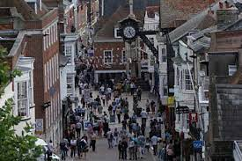

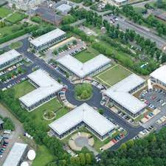

Winchester District Quarterly Economic Intelligence Dashboard
June 2025

Slide 2
Contents
Theme
Indicators
                Business Performance
                Economic Growth
                Business Prices
                Inflation
Business Activity
                E
                Business Activity
                New Orders
Page 1
Business Activity
Page 1
                PAYE Employees
                PAYE Earnings
                Labour Demand
                Demand by Occupation
Jobs and Earnings
Page 2
                Claimant Unemployment
                Local Claimants
                Youth Unemployment
                Local Young Claimants
Unemployment
Pages 3-4
                Business Confidence
                Vacancies & Footfall
                Spending &Consumer
                House sales
Spending and Sentiment
Page 5
Local Business Intelligence and Public Policy News
                Business-specific Intelligence and News
                Public Policy News
Page 6

Slide 3
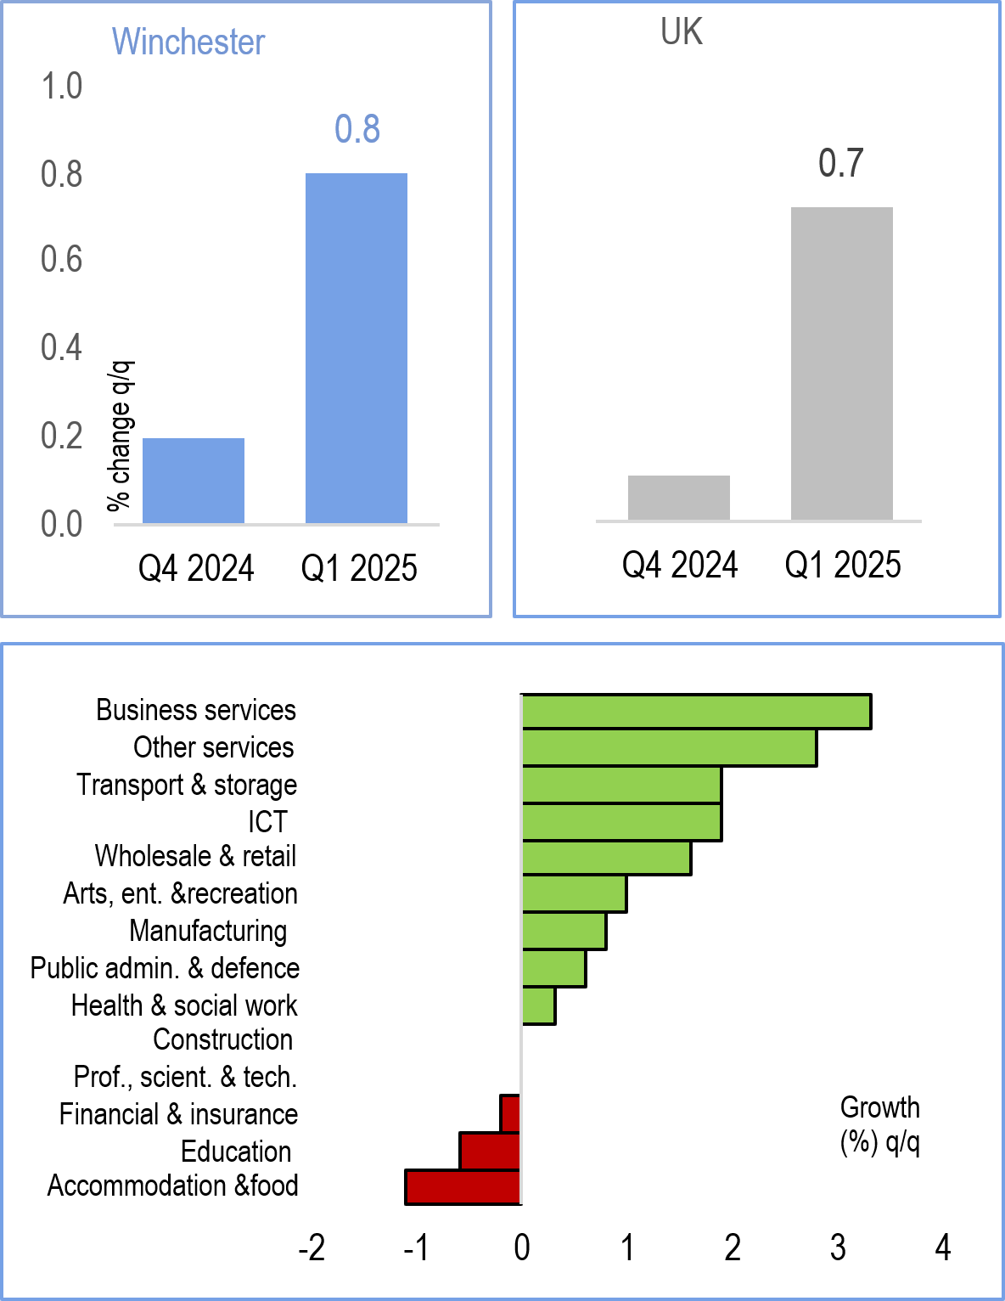
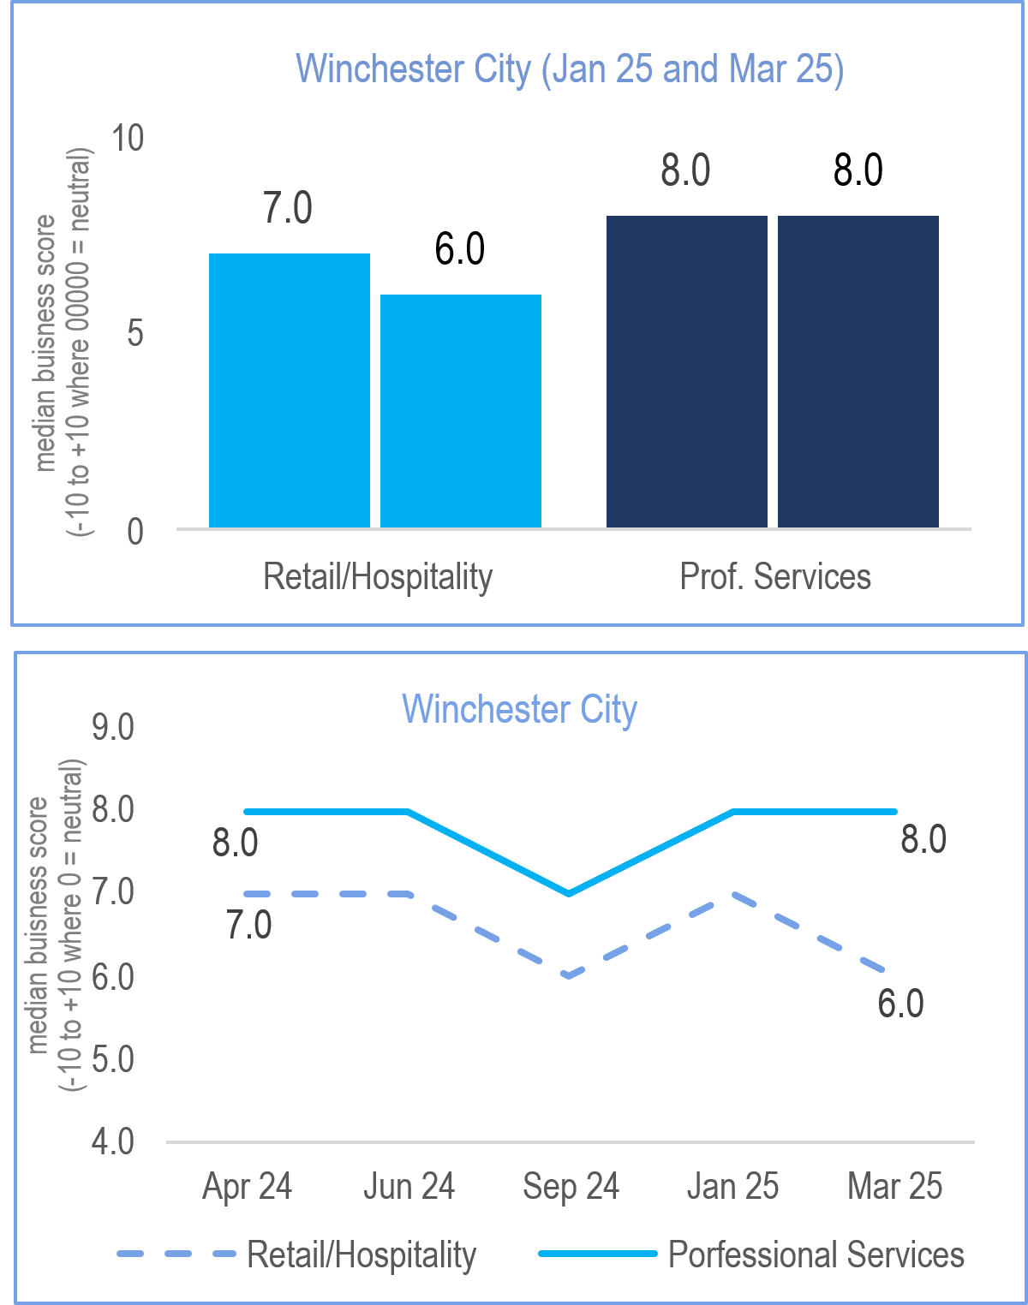
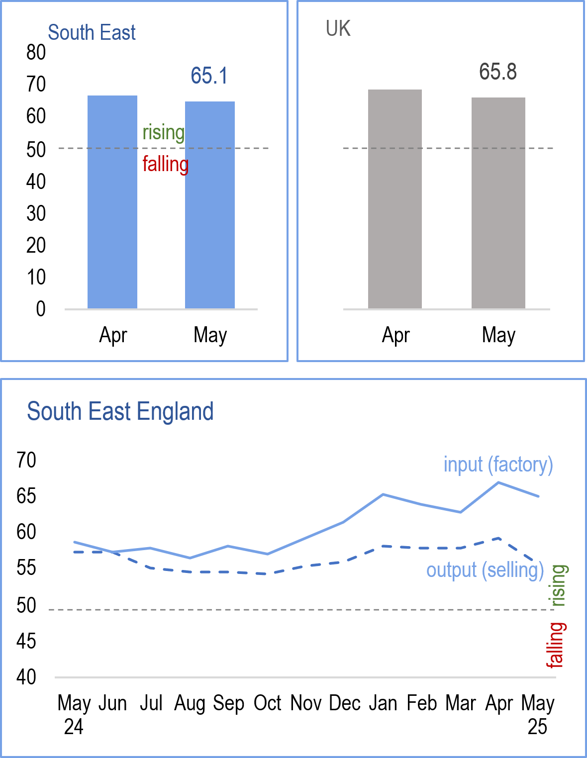
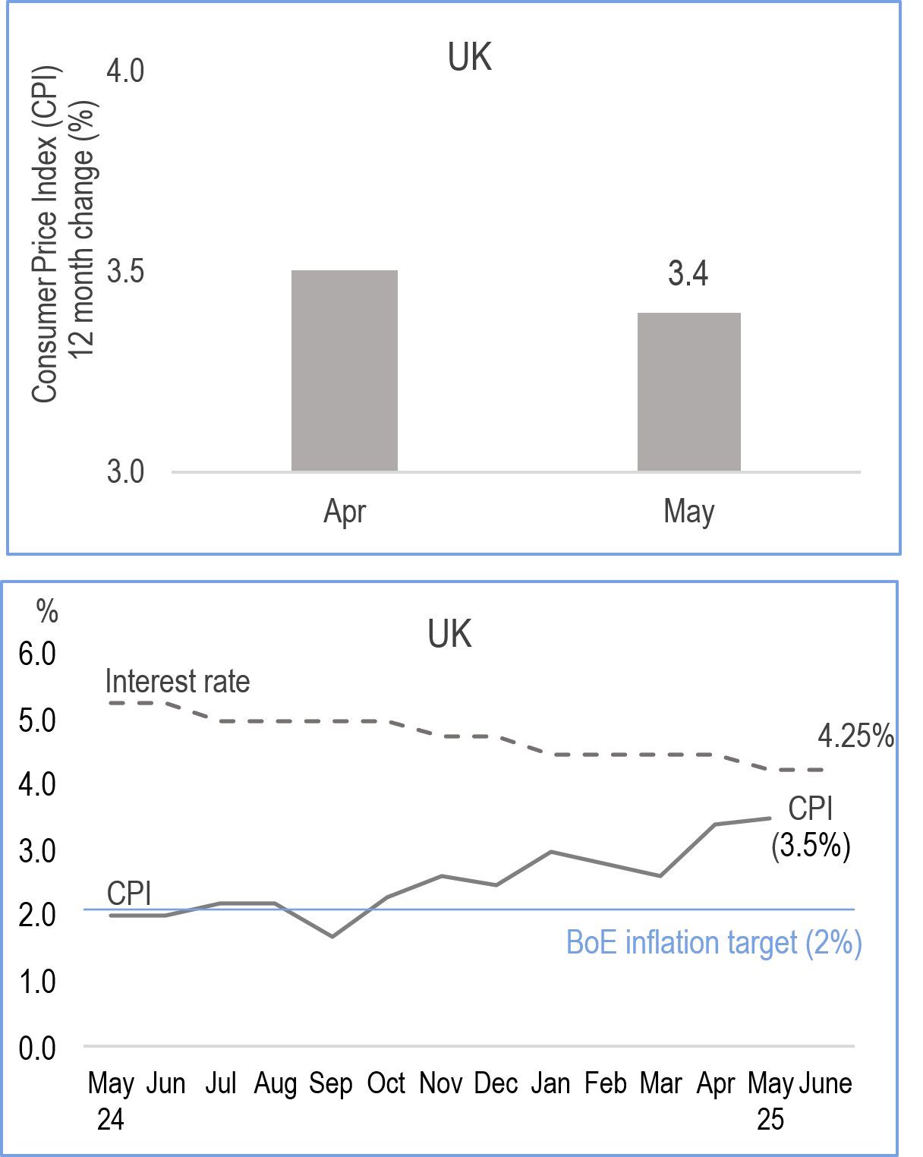
Business Activity
1
1
Economic Growth
Business Performance
Business Prices
Inflation
The UK economy grew faster than expected in 2025 Q1. Our preliminary estimate suggests that Winchester’s economy grew marginally faster than the UK economy in 2025 Q1
Growth was driven by services and production but construction flat in Q1. Business investment and exports made strong contributions to growth in Q1.
Survey evidence from Winchester BID Business Barometer suggest that business performance in March was strong and comparable to Jan-25.
Timelier survey data suggests that business activity in the region contracted in May, but the decline was marginal and considerably smaller than in April.
Survey evidence suggests that business cost pressures remained a substantial and significant headwind, although the pace of the increase receded in May. Anecdotally, strong wage growth and supplier costs still pushing up prices.
Output costs rising but fell to its weakest in six months last month.
Consumer price inflation was 3.4% in May, effectively unchanged from April once the upward effect of an error in the Vehicle Excise Duty (VED) component in April's data is accounted for. Core inflation and services inflation both slowed in May.
As expected, the BoE kept rates at 4.25% in Jun but hinted at a cut in Aug.

Slide 4
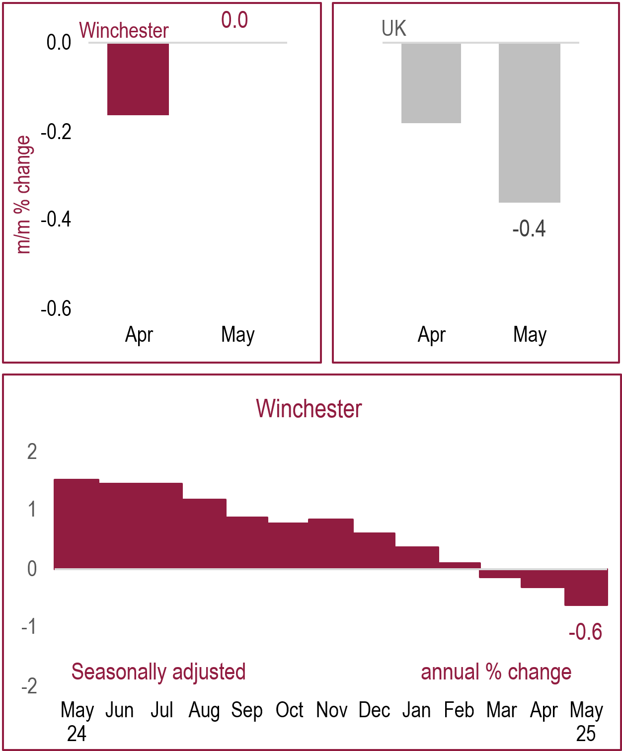
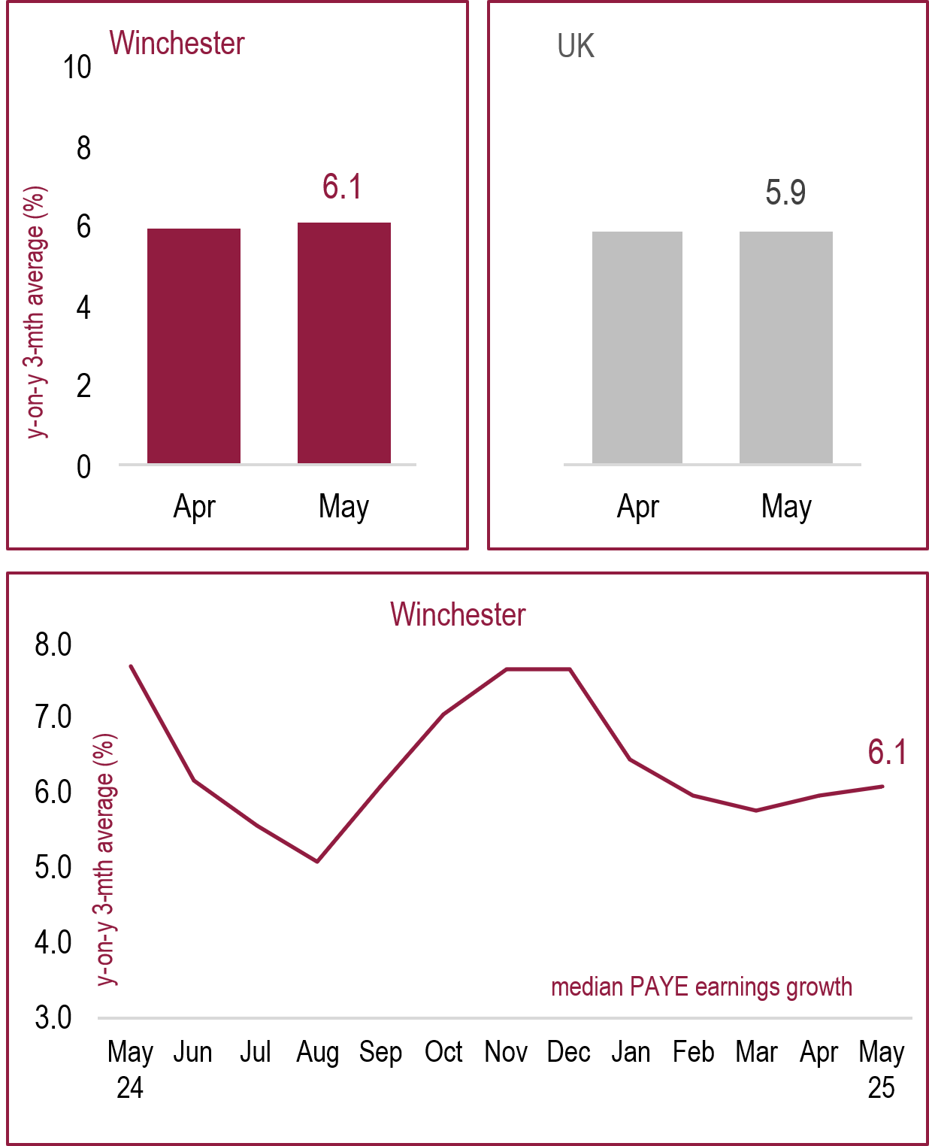
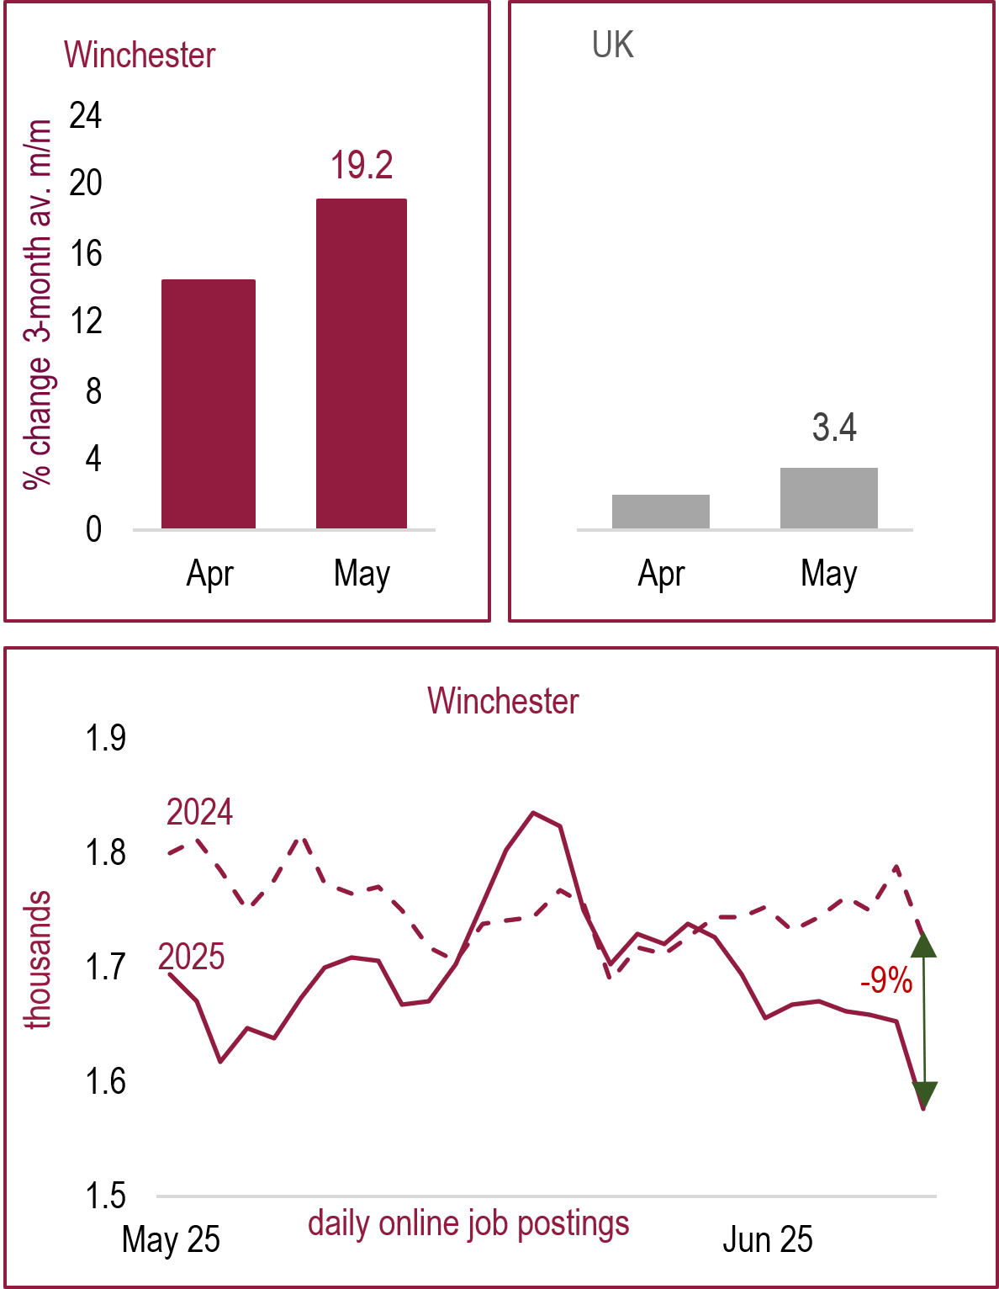
Jobs and Unemployment
2
PAYE Employees
PAYE Earnings
Labour Demand
Demand by Occupation
Timely preliminary estimates from HMRC suggest that PAYE employment in Winchester stalled in May although above the UK, following negative growth in April.
PAYE employment saw flat monthly growth, -0.2% on the quarter, and annual contraction in PAYE employment of -0.5%.
PAYE earnings in Winchester saw the fourth consecutive monthly rise in May and above UK.
Wage data that covers the whole UK economy was strong at 5.3% last month.
Private sector pay grew by 5.1%, slower than 5.6% for the public sector.
Forward looking data suggests that labour demand in Winchester as measured by the number of online job postings have improved robustly and at a much faster pace than the UK.
Timelier daily data points to a slowdown. ONS Vacancy Survey data points to firms not hiring or freezing vacant positions due to wage costs.
Top in-demand skills in Winchester in May compared to previous quarter have risen for cleaners, sales, chefs/kitchen staff, IT workers and SEN professionals..
The top specialised skills: Project Management, Auditing, Finance, Food Safety And Sanitation, Agile Methodology, Restaurant Operations.

Slide 5
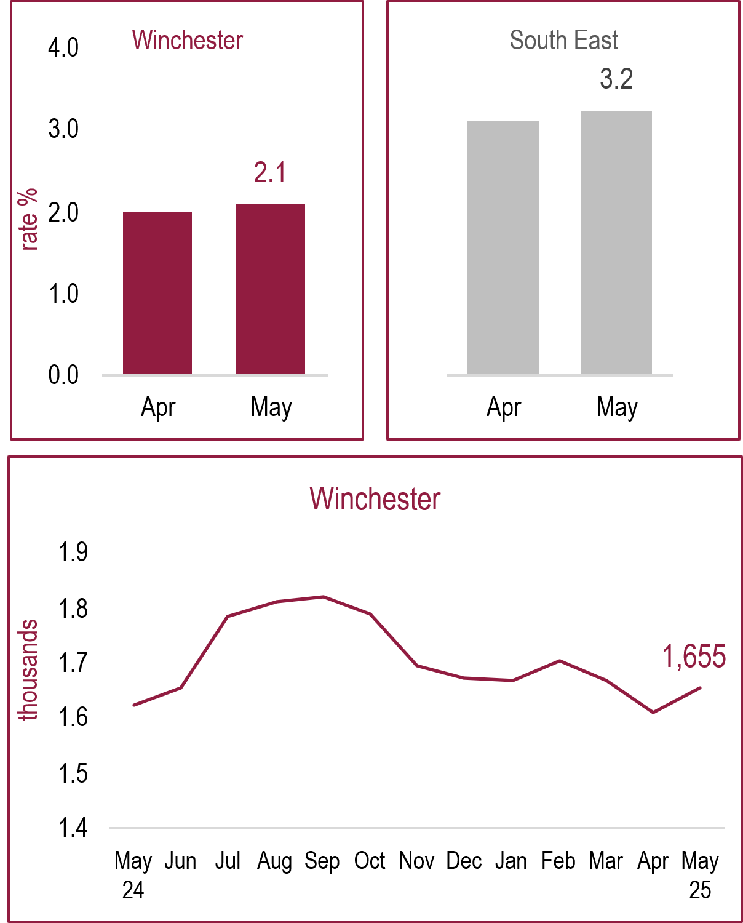
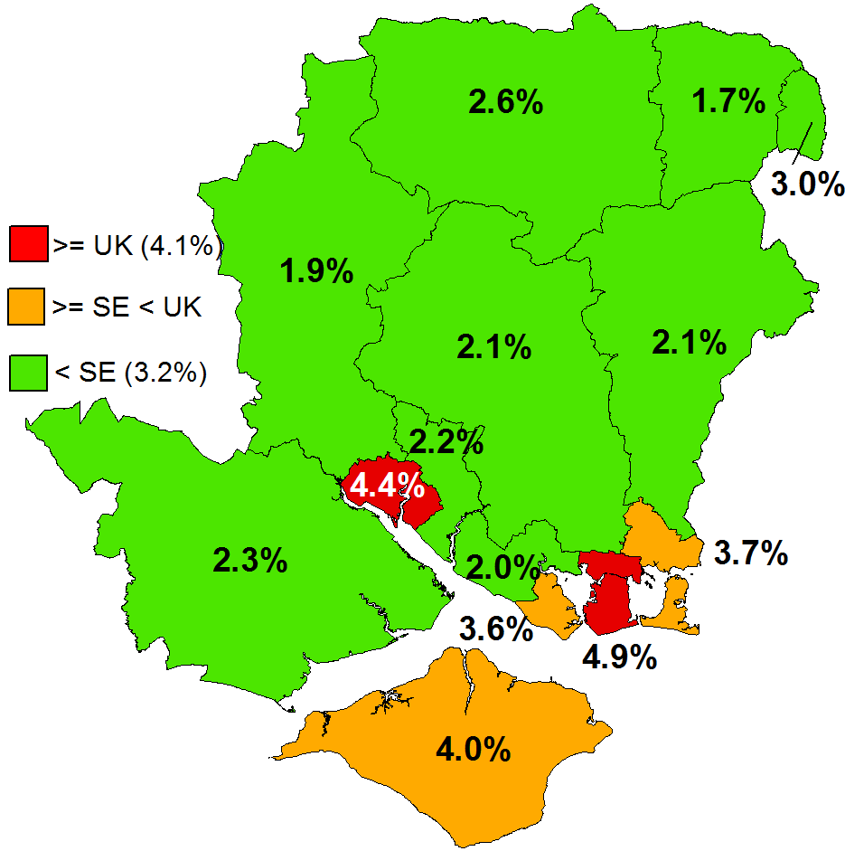
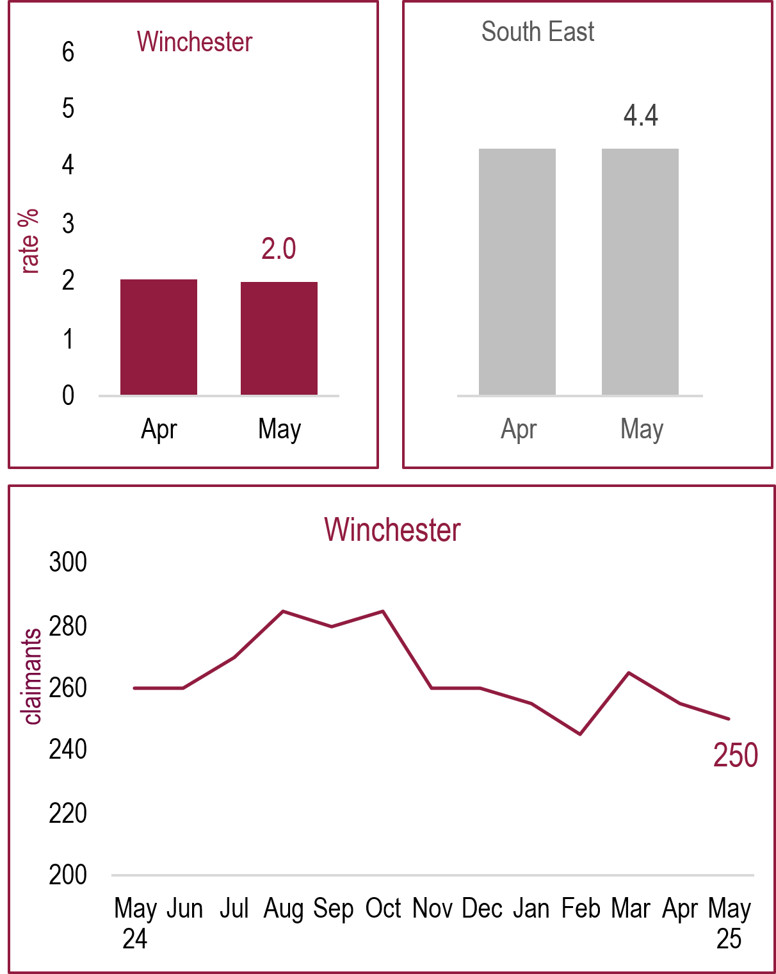
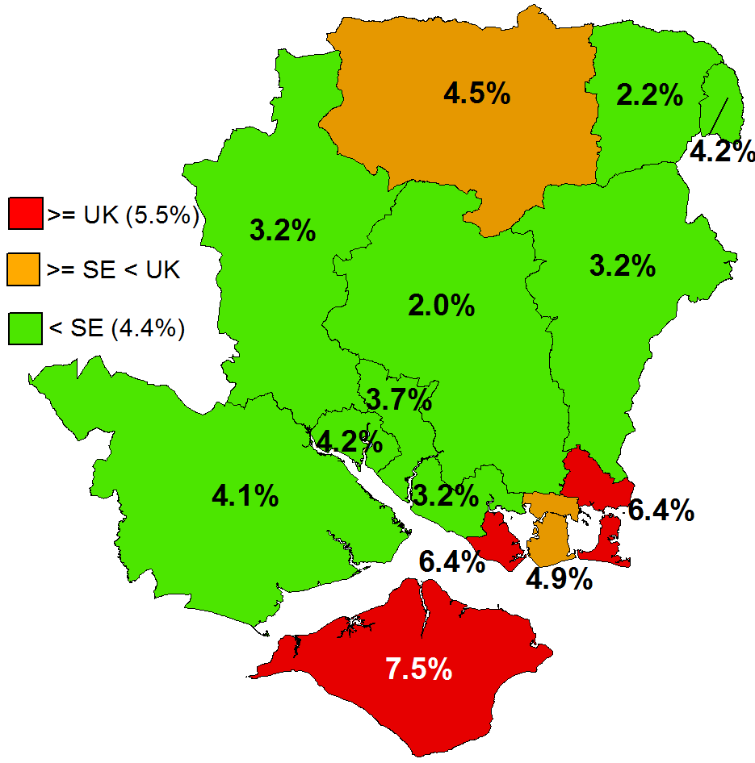
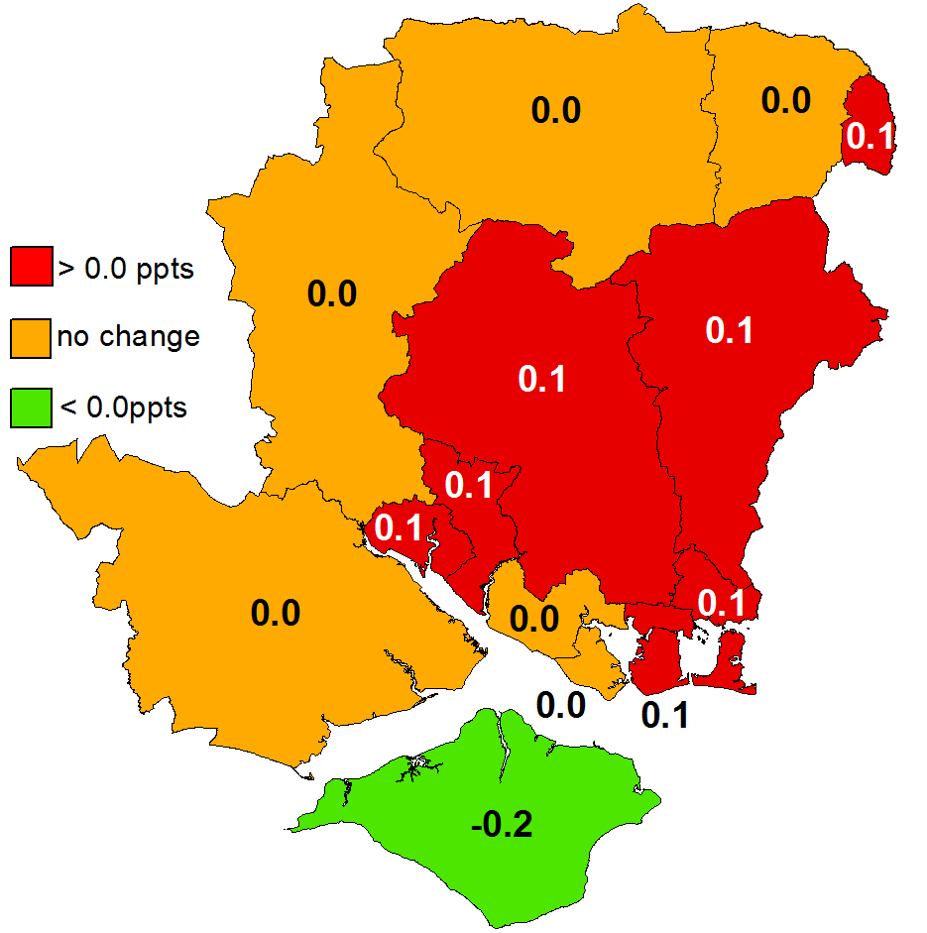
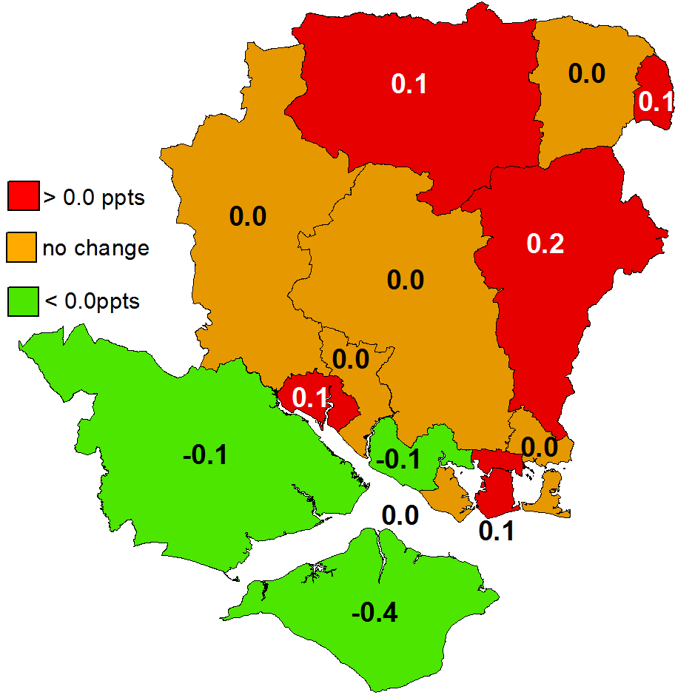
Unemployment
3
Claimant Unemployment
Local Claimants
Youth Unemployment
Young Local Claimants
Rate (%)
Rate (%)
Rate change (ppts, m/m)
Rate change (ppts, m/m)
The number of unemployed claimants in Winchester district (not adjusted for seasonal factors) increased by 45 to 1,655 and higher on the year (+30). Small increases for claimants aged 25 and over.
The rate increased on the month to 2.1% in May, below South East (3.2%) and UK rates (4.1%).
Like most Hampshire & Isle of Wight authorities, Winchester is below the two benchmarks, with the two cities UK rate and Gosport, Havant and IoW above SE.
Winchester district was one of half the local authorities in Hampshire & Isle of Wight to see an increase in the monthly claimant count rate.
The number of young unemployed claimants aged 18–24-year-olds in Winchester district was effectively unchanged (-5) at 250 in May.
The youth claimant unemployment rate was unchanged at 2.0%. The Winchester district 18-24-year-old rate is well below the South East (4.4%) and the UK (5.5%) averages.
Most Hampshire & Isle of Wight districts have rates below the SE and UK rates. Two are above the SE rate with three LAs above the UK.
Winchester one of six Hampshire & Isle of Wight local authority to see no change in unemployment rates for young on the previous month. Five saw increases and three decreased.

Slide 6
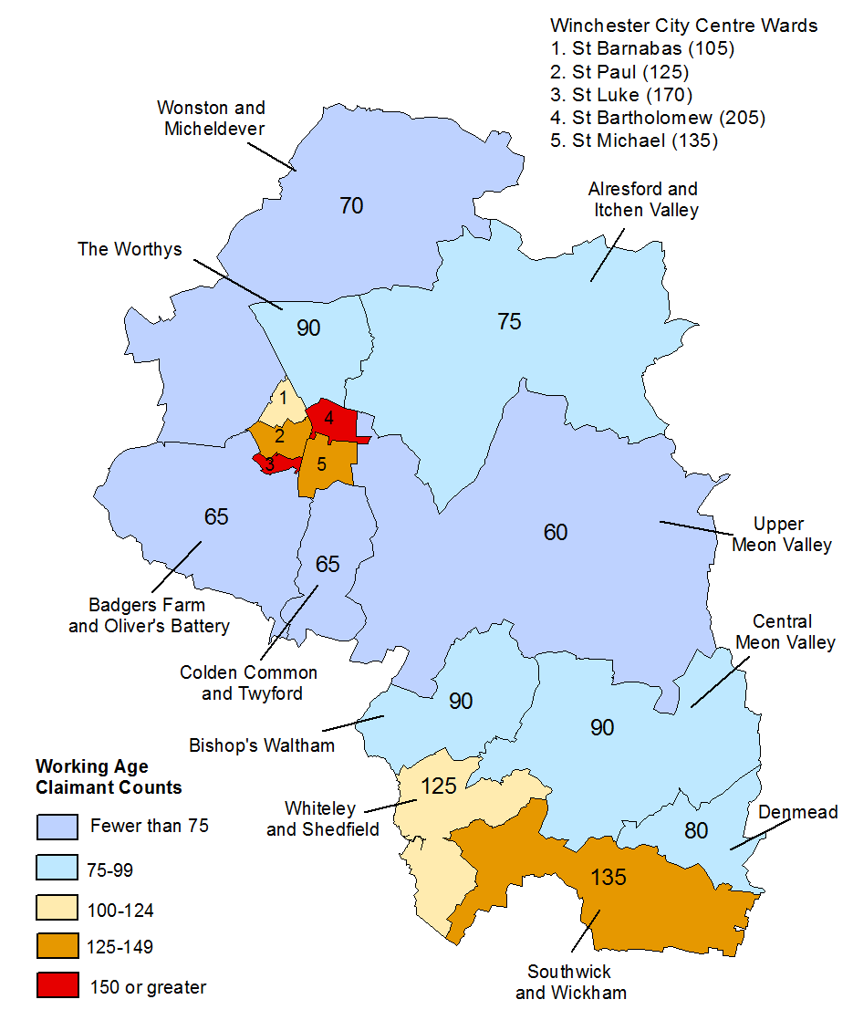
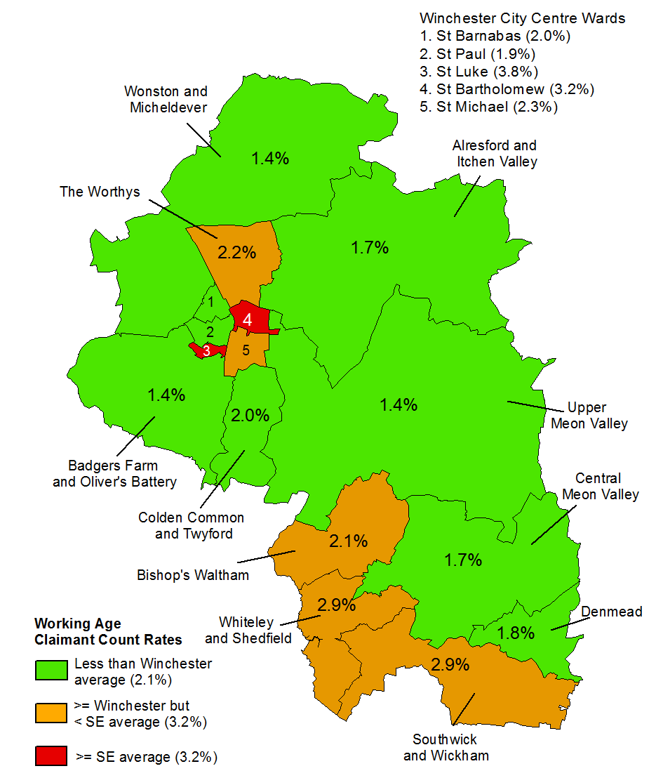
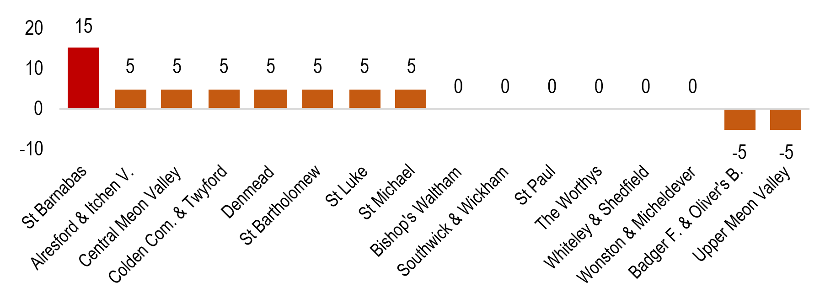
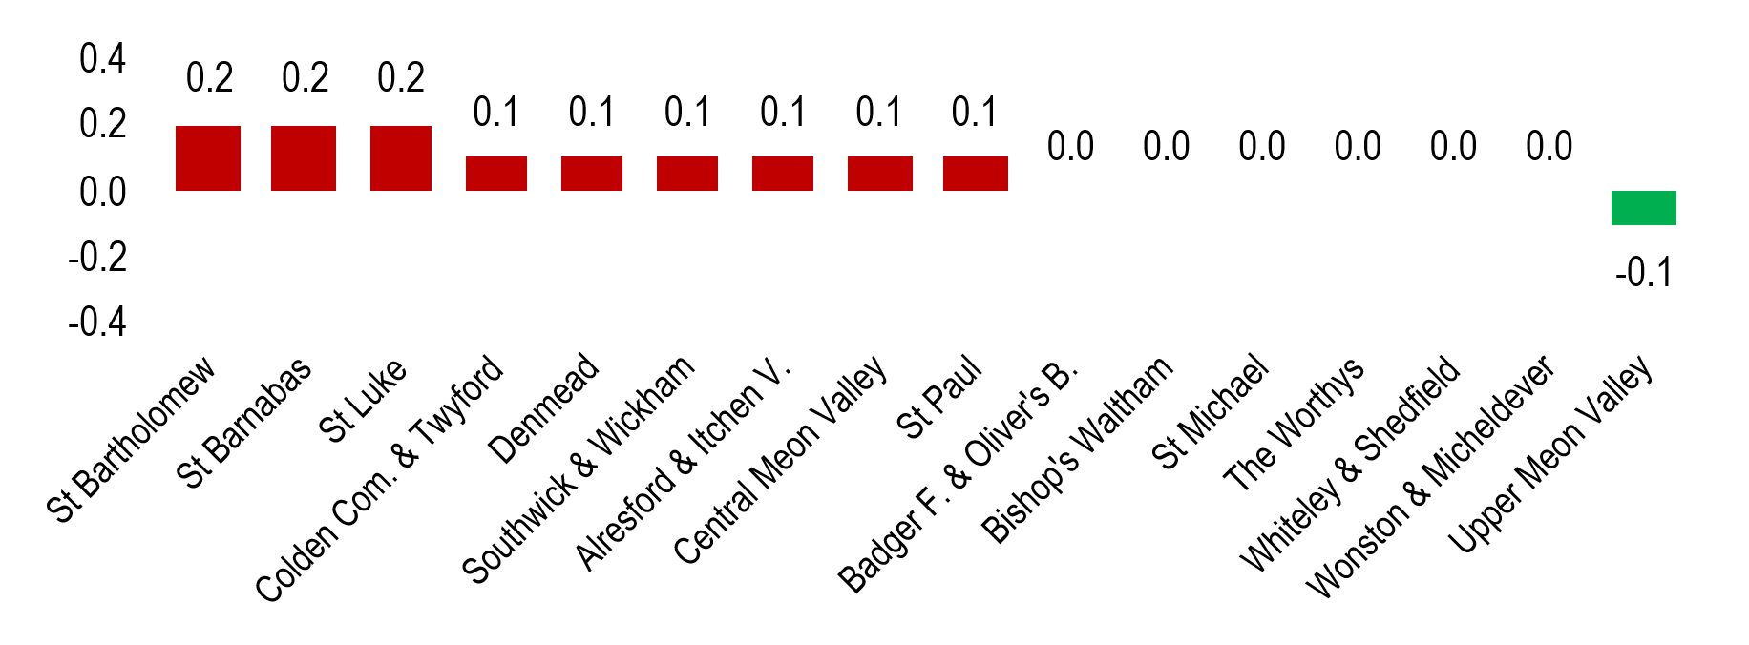
Portsmouth Ward Claimant Counts
68
Jobs and Unemployment: Local Unemployment Claimants at Ward Level
4
Based on the thresholds most wards saw no change in claimant counts on the previous month i.e., between -10 and 10.
Only St Barnabas Ward (+15) met the threshold for an increase of greater than 10 claimants.
Claimant count concentrations (over 150) are in the City of Winchester.
Small increases in claimant counts was enough for nine of the 16 Winchester district wards to also see small increases in their claimant rates in May, with St Batholomew, St Barnabas and St Luke wards seeing +0.2ppt (albeit from a small base). Five wards saw no change while Upper Meon Valley Ward saw a small decrease.
There are two wards with an unemployment rate above or equal to the South East average (3.2%). No Winchester district wards are above the UK average (4.1%) – but St Luke Ward with 3.8% is the closest.
Claimant Count:
May 2025
Claimant Count Rate (%):
May 2025
Monthly change in claimant counts
>10
-10 to 10
> -10
Monthly change in rates percentage points (ppts)

Slide 7
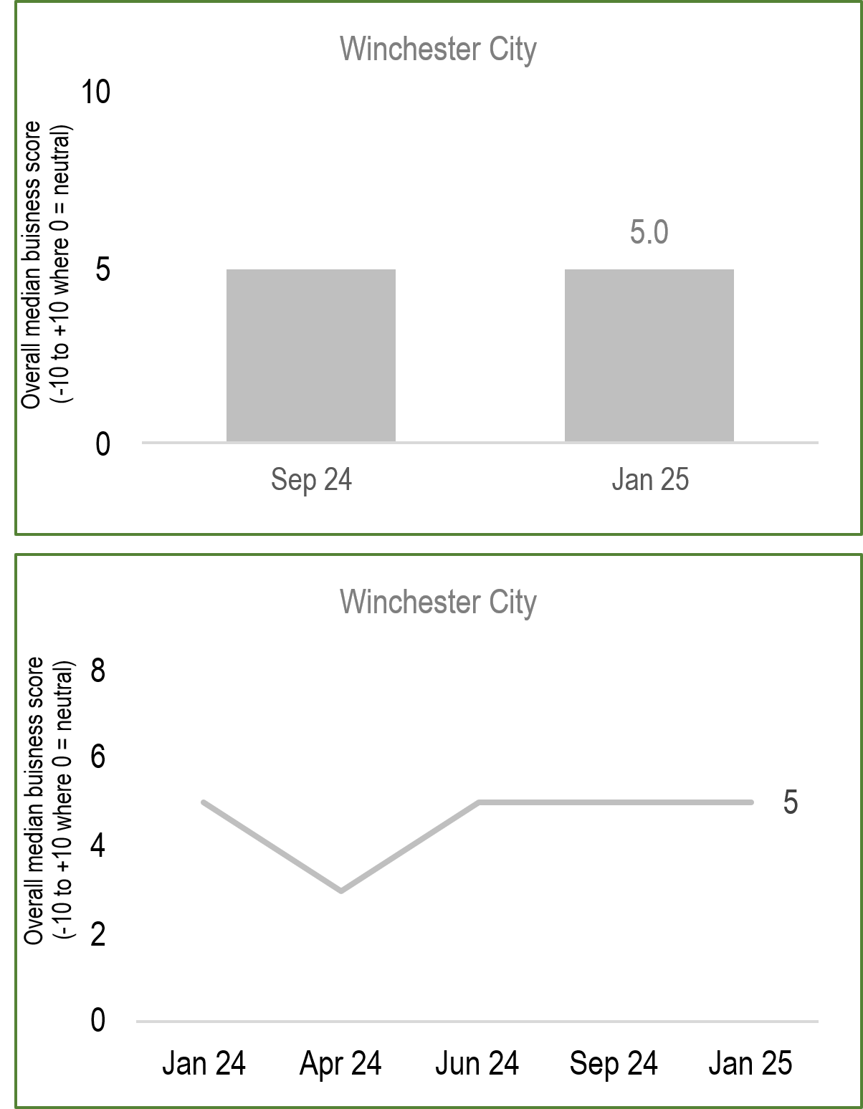
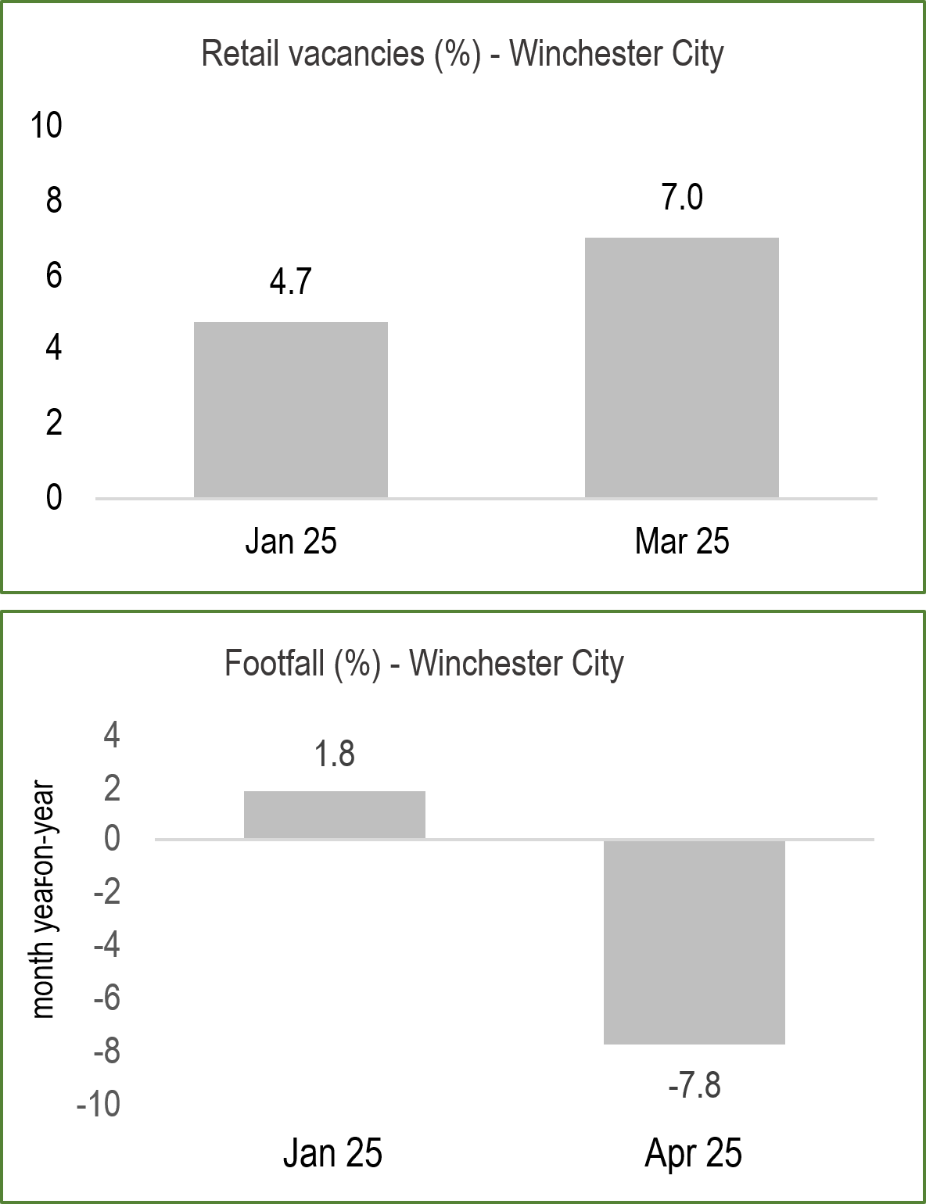
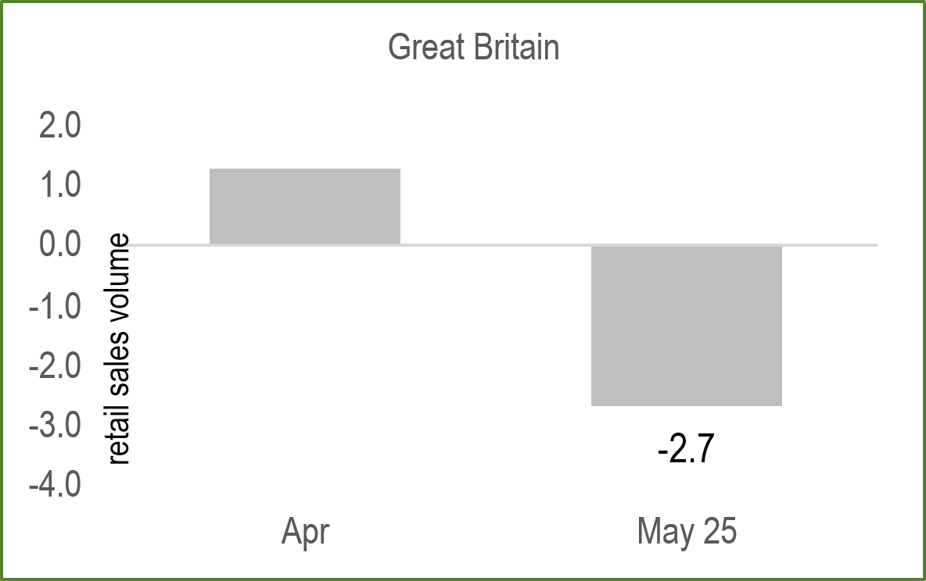
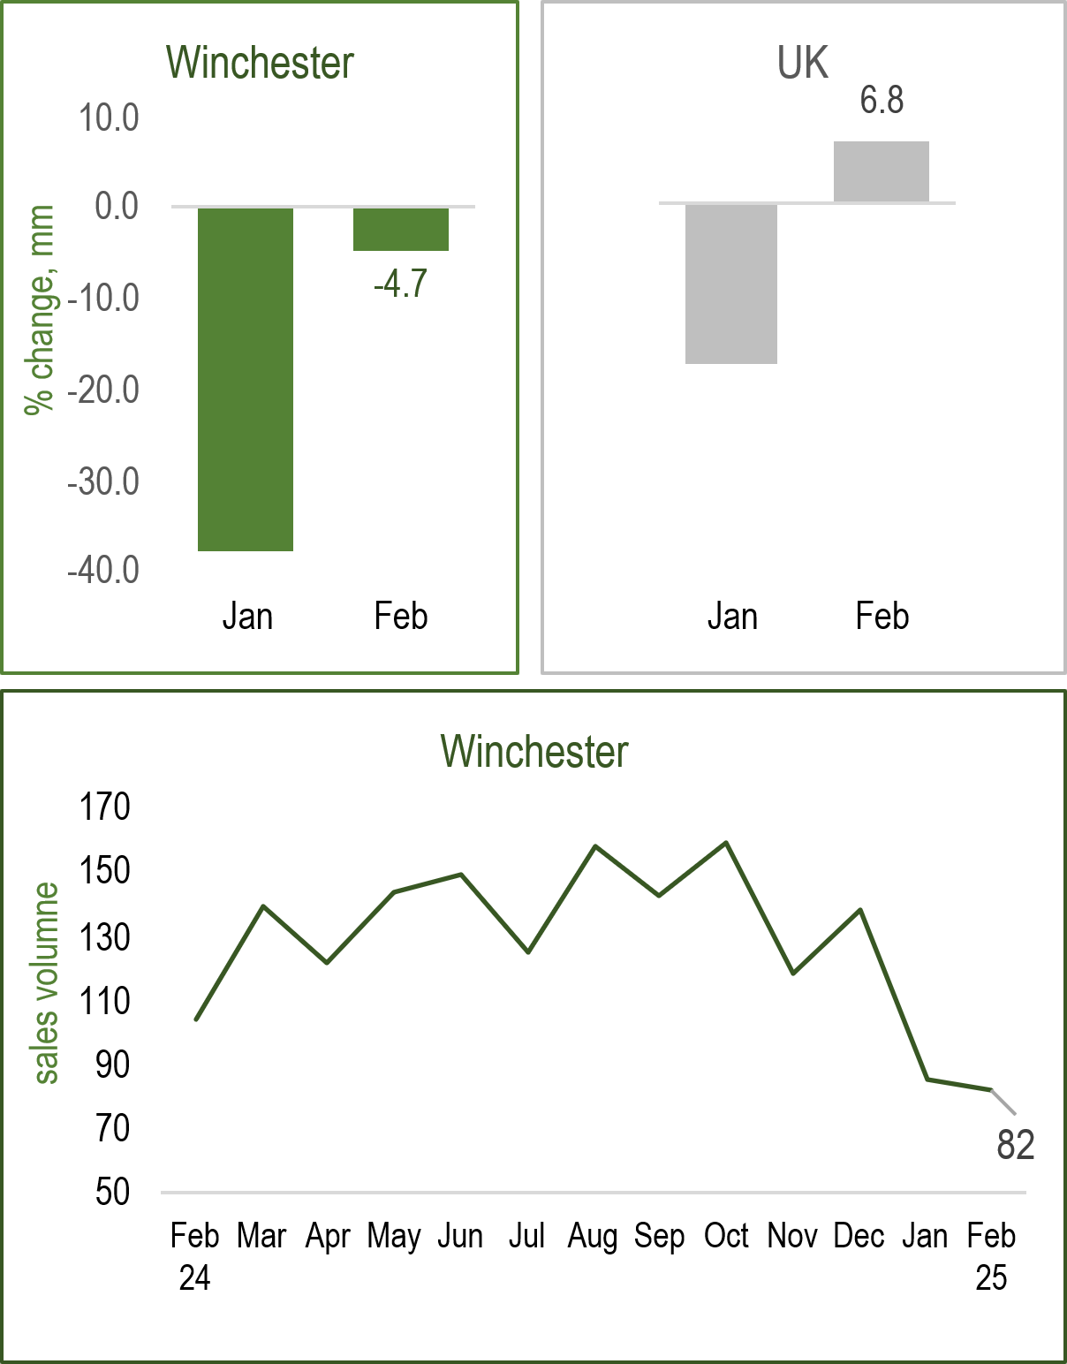
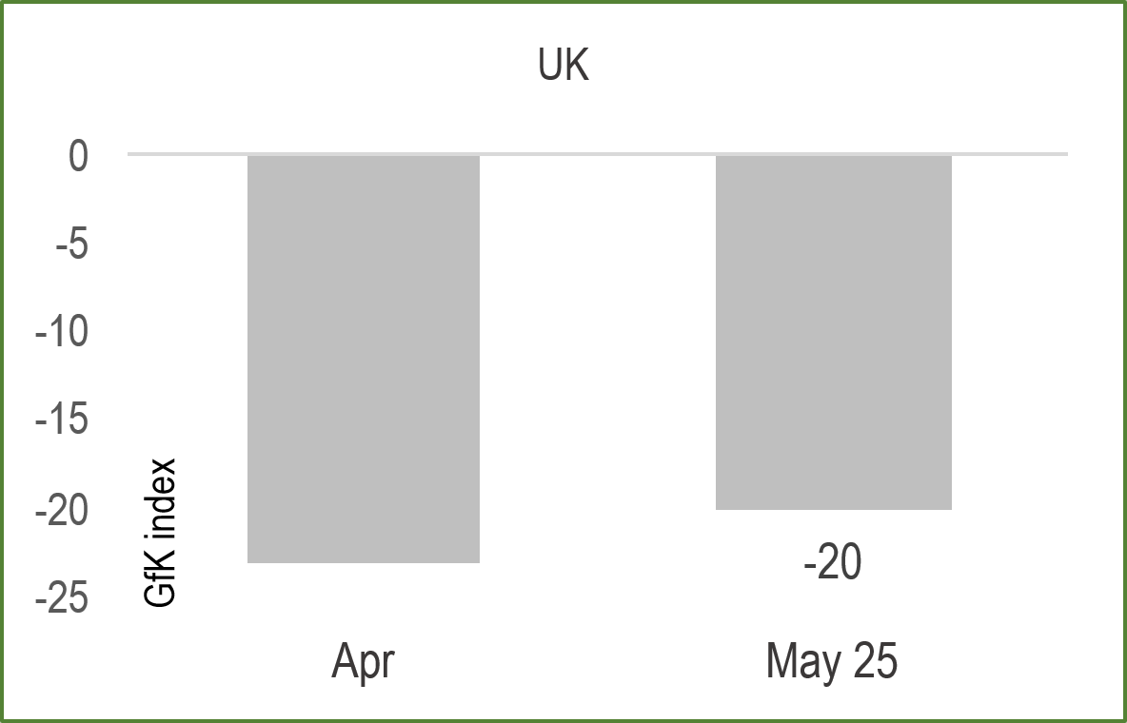
Spending and Sentiment
5
Business Confidence
Vacancies & Footfall
Spending & Sentiment
House Sales
Business sentiment score in Winchester city centre was 5 in Jan 2025, unchanged for the past quarter. Businesses broadly optimistic for 2025, despite headwinds.
Timelier survey data shows signs of recovery and optimism for growth over the next 12 months from new products.
The Winchester High Street vacancy rate ticked up to 7% in Mar 2025, lower than a year ago but well below the national vacancy rate (13.9%).
Winchester City businesses reported 7.8% decrease in footfall in April 2025, although 3% higher than April 2024. The High Street is the busiest destination for footfall.
Monthly retail sales volumes down 2.7% in May, driven fall food sales. Quarterly sales up +0.8% but sales over the year were down 1.3%.
Consumer confidence rebounded from April’s fall by increasing 3 points to -20 in May and surpassing market expectations of -22. Optimism on finances which is good for retailers
Winchester house sales eased in February but at a considerably slower pace than in January. However, average house prices up 3.7% in Winchester in Apr 2025 and up by 5.1% compared to a year ago.
The average price in Winchester stood at around £502K in Apr, with average detached houses worth around £800K.

Slide 8
Local Business Intelligence and Public Policy News
6
Business-specific Intelligence and News (BID)
Winchester City BID report (April 2025) showed stable performance at the end of the quarter compared to start of the previous quarter e.g. March compared to January. However, performance scores were down to ‘6’ and ‘8’ respectively for Retail/Hospitality (RH) and Professional services (PS)’.
Winchester’s city-centre RH outlets reported ‘no change’ in their total sales compared with Q1 2024.
Over one third 37% of RH businesses reported higher levels of net profitability during Q1, 2025. PS businesses achieved higher levels of net profitability at 45%, and slightly up on last year (43%).
Cash flows remain an issue for around one fifth (22%) of RH businesses and for around 1-in-7 (15%) of PS businesses and up from 9% in 2024.
Short term RH sentiment scores has risen from +5.5 last time to
+6.5. Cautious optimism from PS businesses for new work from existing and new clients.
Cost pressures of increasing due to Employers’ National Insurance Contributions increases to the National living and Minimum Wage. Tax increases beginning to filter through into the labour market with fewer vacancies and unemployment on the rise.
The Winchester High Street vacancy rate increased to 7% in January 2025 on the back of several closures but lower than a year ago (4.7%). This is half the national vacancy rate (13.9%).
Winchester City businesses reported 7.8% decrease in footfall in April 2025, some 3% higher than April 2024. The High Street is the busiest destination for footfall.
Public Policy News
In the Government Spending Review health and defence received by far the largest increases among government departments. More than half the increase in day-to-day spending went to health and social care, while defence will see spending rise to 2.6% of GDP by April 2027.
Local government core spending power (amount of available to spend on local services) will increase from £69.4 billion in 2025/26 to £79.3 billion by 2028/29, a 2.6% average annual growth rate in real terms.
However, the Institute for Government highlights actual spending power is 2.7% lower in real terms in 2028/29 than in 2010/11 – and 15.9% lower once population growth factored in. It is implied in the review that councils would be expected to raise council tax and the social care precept, alongside grant, to fund adult social care, and to increase precepts for police funding.
The review will commit to multi-year settlements and update the processes used to assess local authorities’ funding needs.
Growth Mission Fund announced to directly support local economic growth, investing £240 million of capital from 2026-27 to 2029-30 in projects enabling local job creation and economic regeneration of local communities.
Social housing will receive £39 billion in the Affordable Homes Program over the next 10 years (10-year social housing rent settlement from 2026 at Consumer Price Index + 1 per cent), taking the annual spend from £2.3 billion a year to £4 billion a year by 2030.
For more information see: https://www.local.gov.uk/parliament/briefings-and-responses/spending-review-2025-briefing-12-june-2025
Government publishes its 10-year Infrastructure Strategy and Industrial Strategy . The strategies are about long-term plans for economic, housing and social infrastructure to drive growth, and to increase business investment to grow the industries of the future.

Slide 9

How to read ‘traffic lights’:
Sources:
The primary data sources are the Office for National Statistics (ONS) and HMRC, while additional data comes from several commercial sources such as S&P Global, Lightcast, CBI, BCC, HM Land Registry, the Bank of England and Winchester BID.
Monthly/Quarterly data for Business Activity, Jobs & Earnings, Unemployment and Sentiment & Investment.
In the case of several monthly indicators, the South East is used as a proxy geography for Winchester and Hampshire.
Estimates of payrolled employees and their pay from HMRC Pay As You Earn (PAYE) Real Time Information are preliminary but seasonally adjusted. Employment figures differ from the ONS Labour Force Survey (LFS) data. Moreover, median pay figures differ from the ONS Average Weekly Earnings (AWE) and are based on gross earnings which do not cover other sources of income, such as self-employment.
For further information on Winchester’s labour market see
Quarterly Labour Market Updates and Monthly Ward Claimant Count Reports available at:
https://www.hants.gov.uk/business/ebis/reports
Refers to decline or growth relative to the previous period (GVA, PMI business activity and business prices indicators, job postings, business investment, retail and house sales).
In the case of inflation, PAYE employment & earnings and consumer sentiment, it refers to the direction of travel relative to the previous period.
For claimant count unemployment indicators the change refers to the rate not the level. For example, a decrease in youth unemployment would see a downward green arrow.
Little or no change on previous period.
† The local estimate is preliminary and it needs to be treated with a high degree of caution since it is based on the sectoral mix of the Portsmouth economy and the national sectoral impacts.
Produced by Winchester City Council in partnership with the Economic & Business Intelligence Team
The information and views set out in this note are those of the authors and do not necessarily reflect the opinion of Winchester City Council. The Council nor any person acting on their behalf may not be held responsible for the use of the information contained therein. © Economic & Business Intelligence Team, Hampshire County Council.

