Slide 1
OPEN FORUM
22 November 2021
Central Winchester Regeneration (CWR)

Slide 2

Agenda
Introduction
Recap
Business Case progress update
Work streams update
  Archaeology
  Kings Walk
  Friarsgate Medical Centre
Next Steps
Questions

Slide 3
Introduction

Slide 4
Recap

Slide 5
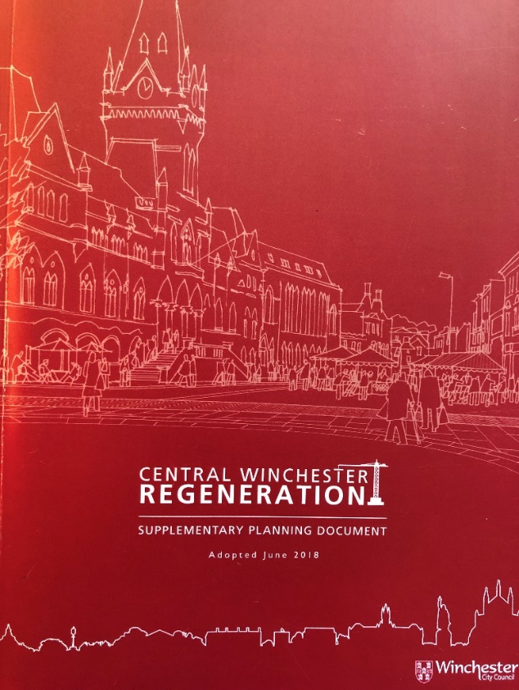

THE SPD AND THE Case for change
Retention of
the younger
generation
Student
experience
Employment and workplace creation
Night-time
economy
Affordable homes
and smaller units
Family life
Overnight
tourism

Slide 6
THE VISION

Slide 7
THE DEVELOPMENT PROPOSALS

Slide 8
INVESTMENT OBJECTIVES
Work | Provide creative, flexible workspaces to help grow start-up businesses and allow like-minded professionals to support each other by sharing skills, ideas and resources.
Live | Provide housing suitable for a range of people, including young people and families. A mix of private and affordable housing is needed with new homes for key workers and homes for rent.
Play | Create high quality exceptional public places where people want to spend time, to enjoy outside spaces, to experience new things, celebrate heritage and culture and get involved in something that interests them.
Student and young person experience | Create a mix of uses which is attractive to students and young people. Which encourages them to visit the centre of Winchester instead of going elsewhere and gives them reason to want to stay in the city beyond their time at university.
Overnight tourism | Create an attractive night-time offering to complement the existing city quarters and encourage residents and tourists to visit the area in the evening.
Sustainable development | Work towards the city carbon neutrality target through choice of building materials, measures to minimise energy use, re-use of buildings where appropriate and encouraging suitable modes of transport.

Slide 9
CRITICAL SUCCESS FACTORS
CSF 1
  Alignment to City Needs (Winchester City Council Plan 2020- 25)
CSF 2
  Alignment to the CWR Supplementary Planning Document
CSF 3
  Alignment to the Investment Objectives
CSF 4
  Achieving the benefits optimisation
CSF 5
  Affordability
CSF 6
  Obtaining planning permission
CSF 7
  Political Risk

Slide 10
Business Case Progress Update

Slide 11
The Outline business case
The Outline Business Case (OBC) expands on the work undertaken at the SOC stage and examines all 5 cases following the Green Book approach;
  Strategic
  Economic
  Commercial
  Financial
  Management
SOC approved at Cabinet in July

Slide 12
The Outline business case
The work undertaken:
  Analyses potential strategic and economic benefits from implementing the proposed development;
  Analyses financial modelling to determine affordability and viability;
  Further expands on the proposed commercial approach and management of the development going forward.

Slide 13
The Strategic Case identifies and confirms;
  The city need for homes for all
  The need to fill the current gap in affordable and flexible commercial space
  The need to attract and retain the young and creative talent in the city.
  It demonstrates that the CWR site will deliver the Council’s investment objectives whilst fulfilling the aspirations of the SPD.

Slide 14
The Economic case details;
  The significant economic benefits to the Winchester economy from the development of the CWR site
  Clear the CWR development will have a lasting positive impact on the city.
  Quantifiable benefits include additional employment opportunities, increased footfall and stimulation of the city’s night-time economy
  Qualitative benefits include improved health and wellbeing, increased land values, retention of younger people and sustainable transport

Slide 15
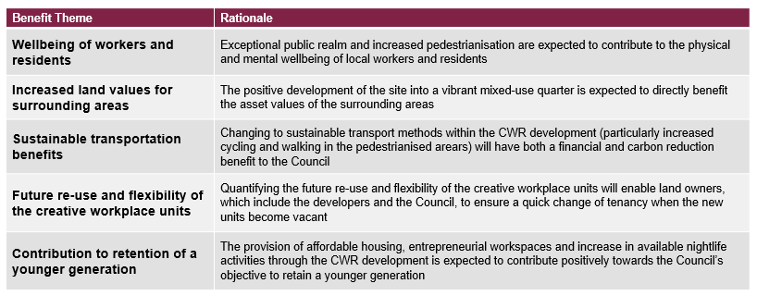
Economic Case
Qualitative benefits

Slide 16
Economic Case
Quantitative Benefits
(estimated over 15 year period)

Slide 17
Economic Case
Benefits Cost Ratio summary Benefits Cost Ratio results
(Per £1 spent developer costs)
Public Purse Benefits £0.29
All Economy Benefits £2.68
Summary | £’m
Total value of All Economy Benefits | £296
Present value of All Economy Benefits | £216
Present Value of Local Economy Benefits | £181
Present Value of Public Purse Benefits | £35
Present Value of Developer Costs | £80

Slide 18
The Commercial case outlines;
  How bidder responses will be assessed against criteria in order to select a likeminded development partner to work with, not a designed scheme.
  The commercial arrangements that will be the basis of the development agreement
  The procurement approach that will be undertaken

Slide 19
    The Financial case demonstrates;
      that the proposed development is viable on a capital receipt basis and is likely to attract development partners.
      Further work is recommended to address the affordability through the dialogue process with potential development partners to be balanced against the wider economic benefits set out in the economic case.

Slide 20
The Management case concludes;
  That the redevelopment of Central Winchester is a considered, deliverable and realistic objective.
  The responsibility for delivery of the CWR scheme will be with the Development Partner, and activities will be at the Development Partner’s cost and risk.
  A risk register is in place and developed to monitor business risks, service risks and external risks

Slide 21
The conclusions reached within each of the 5 elements will be discussed at Cabinet with the recommendation to proceed with the preferred delivery route
The next steps include undertaking a procurement exercise, the preparation of the Full Business Case and to secure a development partner

Slide 22
PROCUREMENT PROCESS
Published Contract Notice
  Announcing the opportunity to the market, together with the procurement documents
Selection Stage
  Based on previous experience of potential partners to arrive at short list
Tender Stage
  Dialogue with short listed bidders to enable understanding and discuss proposals concluding in final bids from short listed bidders
Tender Evaluation
  Evaluation of final bids
Preferred Bidder

Slide 23
Procurement Process: Development Brief
Introduction
The Scheme
  The Vision
  Site and Situation
  Vacant Possession
Development Proposals
  Land Uses
  Development Framework Mix of Uses
Key Objectives
  The SPD
  Investment Objectives
  Sustainability Objectives
  Bus Solution and Movement Strategy
  Winchester Public Realm Strategy
  Design and Placemaking
  Archaeology
The Opportunity
  The Partnership Approach
  Role of the Development Partner
  Social Value and Engagement with Stakeholders
Planning Context
Adjacent Land Ownerships
Reference Documents
Appendices

Slide 24
Stage 2 – Evaluation Criteria:
Quality
Approach
- long term place making, sustainability, meanwhile uses
Planning
- planning strategy
Team
- core team proposed
Commercial
Market understanding
Legal terms
Finance approach
Procurement Process: Selection and Evaluation Criteria
Stage 1 - Selection Criteria:
Technical and Professional Ability
Collaborative Working
Development Experience
Long term placemaking
Design, Planning Approach and Implementation
Sustainability
Capital and Financing
Management of Construction Delivery

Slide 25
Archaeology

Slide 26
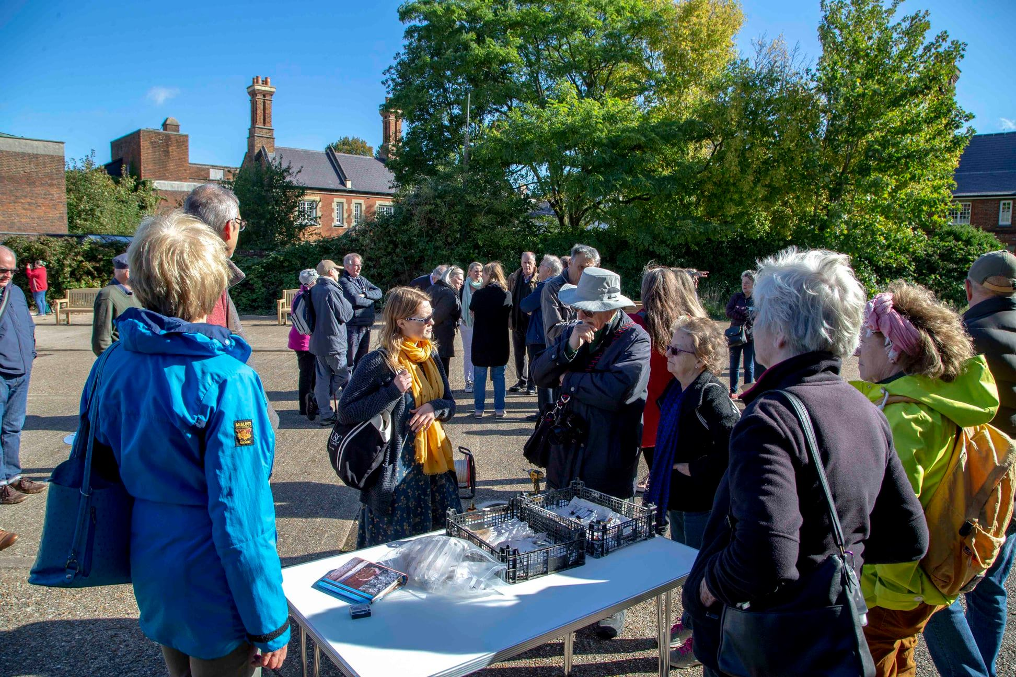
Update on Archaeology
We hosted an Archaeology day on 6 October, offering local residents the chance to see some of the tools used in the investigations that have been undertaken far.
Keith Wilkinson from ARCA, University of Winchester spoke to over 50 interested local residents on site during an informal drop-in session in the morning.
This was followed by a presentation hosted online highlighting some of the findings so far, and a Q&A session with the Central Winchester Regeneration Archaeology Advisory Panel.

Slide 27
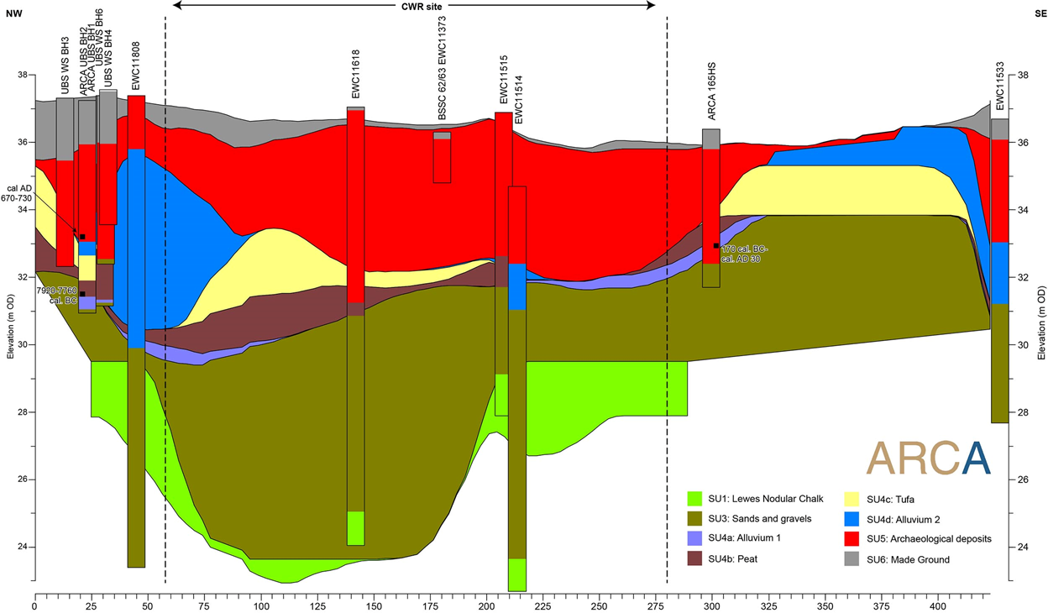
Update on Archaeology
  Geoarchaeological study undertaken to look at:
    The stratigraphic sequence underlying the site
    Determine the hydrological context
    Assess biological preservation in the deposits that the redevelopment of Central Winchester is a considered, deliverable and realistic objective.
  Part of the site contained the Itchen channel
  Archaeological deposits formed from the Roman period onwards. They are thickest on the east of the site
  Biological preservation is good throughout the archaeological deposits

Slide 28
Update on Archaeology
  Full details on the website – www.winchester.gov.uk/cwr - including full reports, presentations and a video diary
  Final Stage 1 geoarchaeology report due later this year (integrating hydrology, stratigraphy, biology and archaeology as evidenced in the boreholes)
  As a result of discussions from the Archaeology day we are drafting a statement outlining our approach to archaeology will form part of the next stage of the process to identify a suitable development partner

Slide 29
Kings Walk

Slide 30
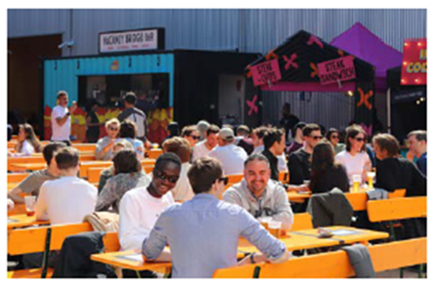
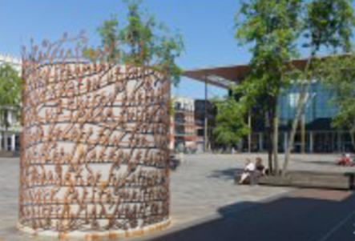
Kings Walk
  Plans are underway to increase activity and footfall
  We will be transforming the area around Kings Walk with:
    New seating
    Better lighting
    Improved spaces on the ground floor
    Planting and public realm improvements

Slide 31
Friarsgate Medical Centre

Slide 32
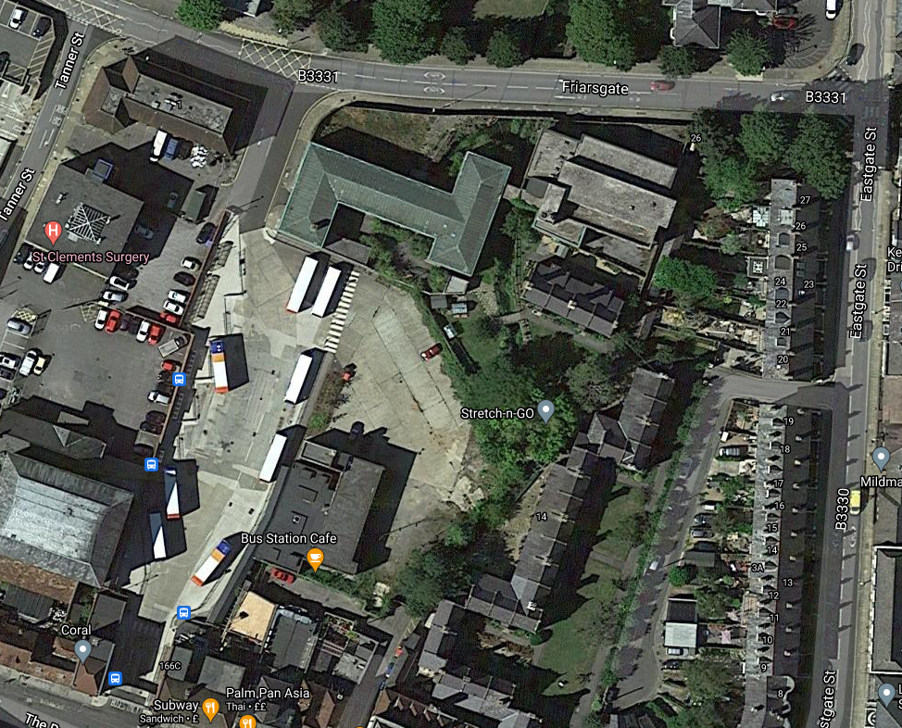
Friarsgate Medical Centre
  We are working on plans to transform this site whilst plans for the longer term regeneration of the site are progressed
  The building has been vacant for over six years we would like to demolish it in order to address the issues of trespass and vandalism

Slide 33
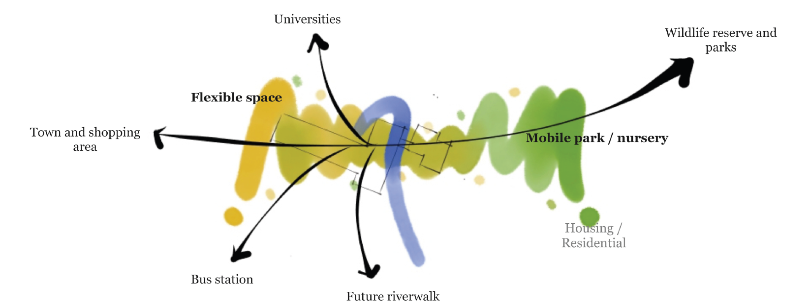
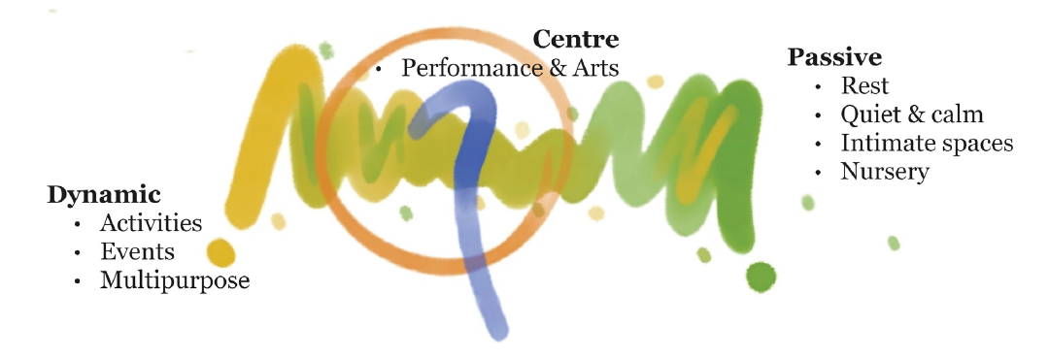
Friarsgate Medical Centre

Slide 34
Friarsgate Medical Centre
    In its place we would like to create:
    A fantastic new public space for people to enjoy
    A vibrant and attractive place designed to encourage access to nature
    An area fully accessible for all ages
    A route between Friarsgate, the bus station and the town centre
    Open areas for small events to be held, in collaboration with local organisations, with seating and lighting
    Green space to enhance biodiversity, create a new habitat for pollinators that will be carefully managed and maintained

Slide 35
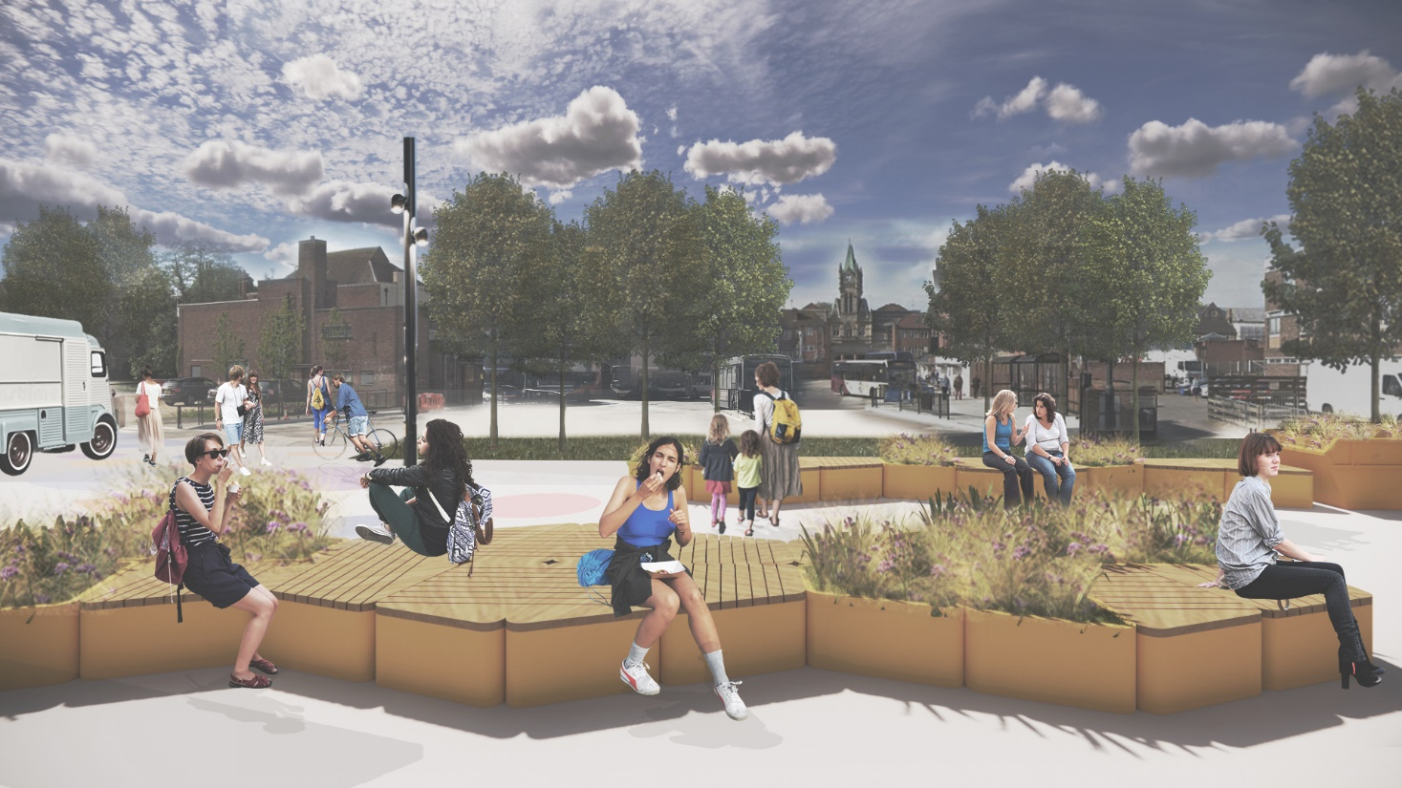
Friarsgate Medical Centre
Let us know what you think!
View the full plans and download a feedback form from our website from 23 November
www.winchester.gov.uk/cwr
Hard copies can be requested by calling Customer Services on 01962 840 222.

Slide 36
Next Steps

Slide 37
KEY MEETINGS / DATES
Scrutiny Committee – 6 December 2021
Cabinet – 15 December 2021
Council – 12 January 2022

Slide 38
Questions

Slide 39
Close

