Slide 1
Winchester District carbon footprint reports A part of the WeCAN project

Slide 2
WeCAN
A project to engage and inspire parish-level climate action
Key project stages
Survey – parish councils & community organisations
Carbon footprint reports for civil parishes and urban wards
Webinars
Action days
Engagement & communications – resources & workshops
Identify clusters across Winchester suitable for targeted intervention

Slide 3
Survey results
Parish council
25% have working group; 35% have lead person
Highest priorities: biodiversity & loss of green space; traffic & air quality
Already doing: energy efficiency of homes; renewable energy; sustainable food; influencing local and national government
Want to do: sustainable waste; promoting green travel; increasing tree cover
Barriers: pandemic; lack of agency; need ideas and guidance; need to engage more residents; time constraints
Notes:
To date nearly 60% of parish councils have responded to the surveys to give a baseline of where there is already climate emergency-related activity (and where there isn’t), and the support that communities need to make changes and respond to the climate emergency.
2 have declared a climate emergency. 7 have a neighbourhood plan. 6 of those who responded don’t have climate change leadership structures. 2 of the parishes who responded said they are not active on climate change / and or did not wish to be active in the future. BUT overall there is an appetite for acting on climate change.
Other priorities: food and agriculture; climate change and carbon emissions
Other barriers: “Financial council initiatives to support people making climate influenced decisions. Joined up coherent bus service to encourage less car use. Finding cycle routes”
What can parish councils do? “There is plenty of advice on action that individuals can take, but the PC needs some kind of template to follow.”
A definite plea for support, guidance and leadership.

Slide 4
Survey results
Parish council
25% have working group; 35% have lead person
Highest priorities: biodiversity & loss of green space, traffic & air quality
Already doing: energy efficiency of homes; renewable energy; sustainable food; influencing local and national government
Want to do: sustainable waste; promoting green travel; increasing tree cover
Barriers: pandemic; lack of agency; want ideas and guidance; need to engage more residents; time constraints
Community organisations
Priority issues: waste management; plastic waste; carbon and climate change
Action: promoting sustainable waste behaviours; influencing government
Barriers: national and local government policies; time constraints.
Conclusions
Notes:
16 organisations, acting on a broad range of environmental and social issues. With 14 of the 16 taking action to address climate change.
Priority issues across the groups were: waste management; plastic waste; carbon emissions and climate change
Key areas of action: promoting sustainable waste behaviours; influencing local and national government to act on climate change.
Mixed responses in terms of what groups think about action from Winchester district council, Hampshire county council, local businesses; slightly higher levels of dissatisfaction as compared with satisfaction with local businesses.
General ask for more leadership and bolder leadership and acting with greater sense of urgency; leading by example. Also specific asks re. recycling facilities, better public transport and promoting walking and cycling. Also advice, information, support.

Slide 5
Carbon footprint reports
An overview of carbon emissions from each civil parish and urban ward
Impact – online carbon footprinting tool
Guide climate action
Shown on territorial & consumption basis
Notes:
Part funded by CSE, BEIS & UK Research Councils.
Project idea developed by CSE, in response to requests from parish councils. Consumption-based footprinting approach.
University of Exeter working on a similar idea. Territorial-based footprinting approach.
Projects combined summer 2020 – launched February 2021.
Model – guide not gospel

Slide 6
Footprints…
Territorial
Considers emissions arising within a given area. Industry, roads, agriculture
Based on activities occurring there, even if local people don’t ‘demand’ these
Comparable to regional and national approaches
Cuts national/regional datasets down
Consumption
Things people ‘choose’ to consume
Transport – miles driven/flown, not presence of a road
Largely based on household/address level data, aggregated up
Housing energy = same as territorial

Slide 7
Carbon footprint reports
Anything surprising?
Anything confusing?

Slide 8
Notes:
Discussed the sections of this report.

Slide 9
Maps of domestic electricity, gas and other heating fuel emissions in Winchester district by parish (based on the CSE Impact tool)
Bob Whitmarsh
Winchester Action on Climate Change (WinACC)

Slide 10
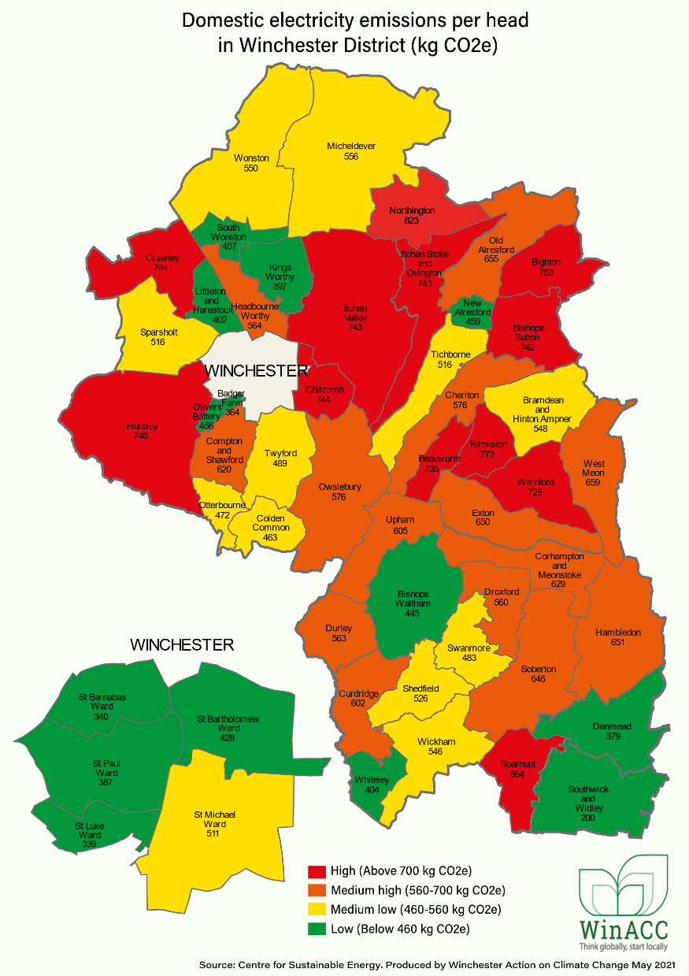

Slide 11
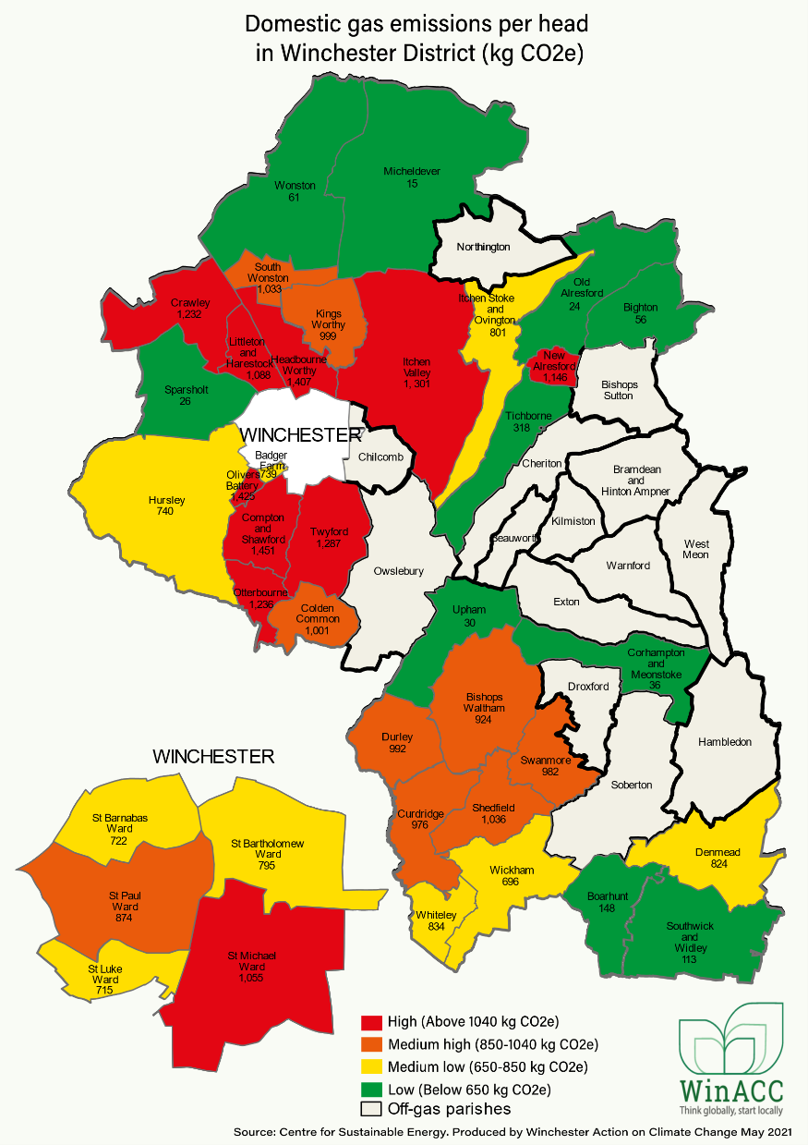
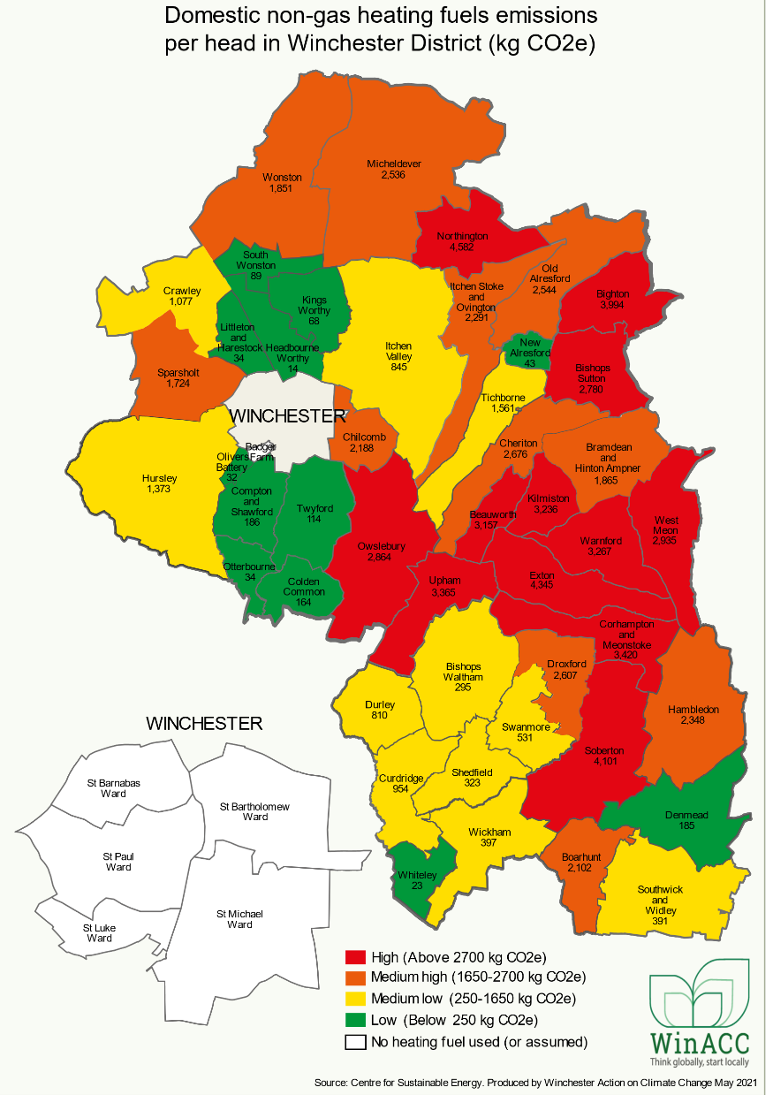

Slide 12
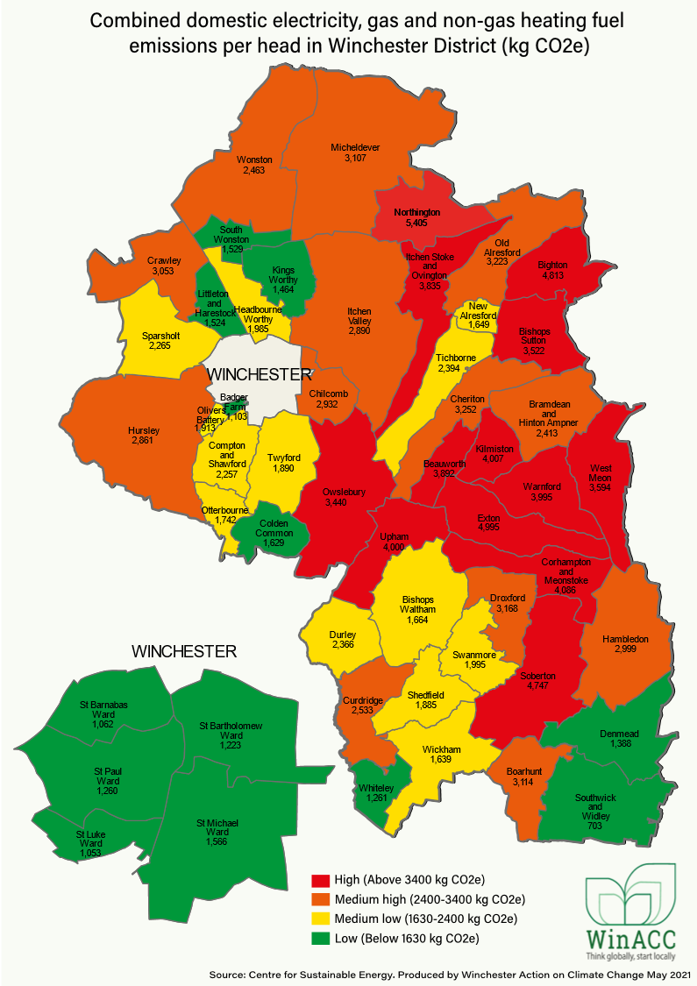

Slide 13
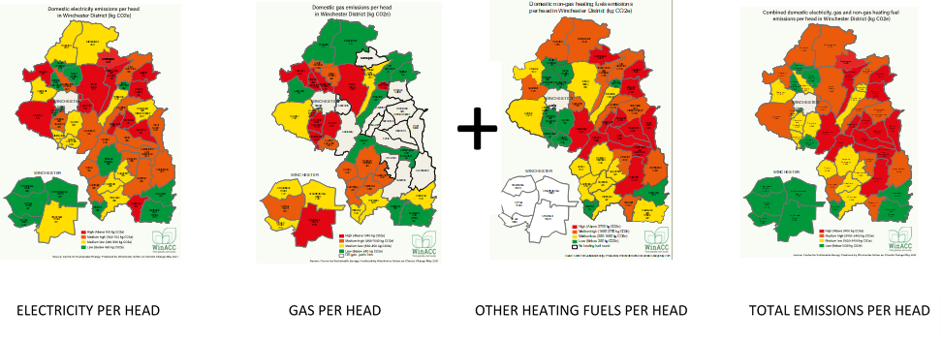
Electricity, gas and other heating fuels make up only 22% of the district’s emissions
78% is down to consumption (34%), travel (23%), food (21%) and waste (0.3%)
+
=
For more information go to:
www.winacc.org.uk/new-interactive-greenhouse-gas-maps

Slide 15
Carbon footprint reports
Anything surprising?
Anything confusing?
Priorities
Next stages of project: report to all attendees, action planning (autumn), communications materials, CSE tools to indicate carbon savings of actions
What would you like to see happen next?

Slide 16
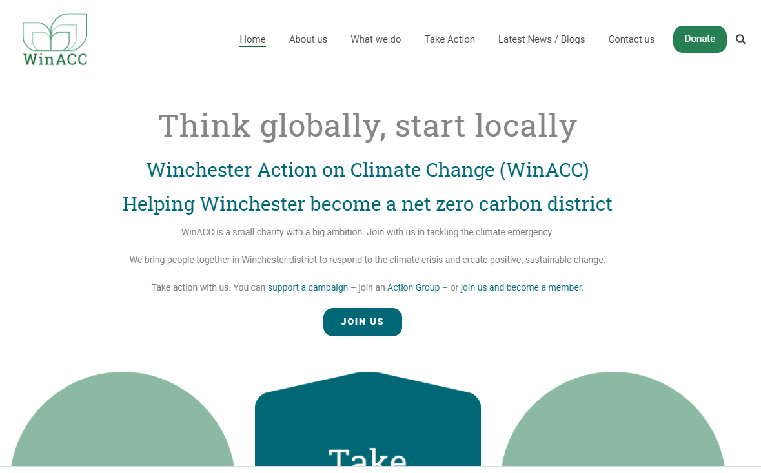

Slide 17
We help people change the way they think and act on energy.
cse.org.uk

