Slide 1
Proposed Reforms to the Planning System Briefing September 2020

Slide 2
The government has published two important consultation documents proposing fundamental change to the planning system
the White Paper ‘Planning for the Future’
a technical document on ‘Changes to the Current Planning System’

Slide 3
Why is the government proposing changes?
it believes the country needs to boost growth and development especially housing delivery
the current system needs fundamental reform to enable appropriate development
plan making is too slow and too complex
there is too much opportunity for challenge and delay
current requirements for obtaining planning consent are too onerous and allow for too many interventions
change is needed to ensure higher quality development – more ‘beautiful’ buildings which people will be happy to live alongside

Slide 4
Planning for the Future

Slide 5
The White Paper proposes major changes to the way in which Local Plans are made and what they contain
there will still be a ‘plan led’ system in which the local planning authority will make a long term set of judgements which must be followed …
….but the way in which the plan is made, and the way in which land is allocated for development will change radically…
….and once a plan is in force, there will be very different rules and regulations before development can take place

Slide 6
Plan making
Local plans won’t need to be “sound” or “deliverable” any more but will need to pass a new statutory test - that they allow for “sustainable development.” This replaces all the other current tests.
10 year time horizon
start to finish in 30 months - ‘digital first’ approach
housing target set by Whitehall
development management policies largely a generic set of national requirements with very few set locally
emphasis on master planning and design codes being drawn up simultaneously with site allocations to save time and resources
no ‘duty to cooperate’ with other councils

Slide 7
Plan format
introduce a ‘categorisation’ type approach as used in many other countries
growth areas – substantial development such as a new town, MDA or large brownfield site
renewal areas – existing built up areas where smaller development is allowed.
protected areas – more stringent controls.
extensive use of design codes and briefs to shape the detail
vague on the role of formal neighbourhood plans but village design statements and similar could become more important

Slide 8
Growth Areas
sites within growth areas in a local plan would ‘automatically’ have outline planning permission for the prescribed uses within set parameters of height, density set out in a design codes and brief
to obtain full permission a reserved matters application in compliance with design code, a Local Development Order (linked to a masterplan and design codes) or potentially a development consent order (NSIP)
not vastly different to current approach except that design code/master planning simultaneous with allocation

Slide 9
Renewal Areas and Protected Areas
Renewal areas
consent can be granted through permission in principle, a full planning application, or a Local / Neighbourhood Development Order
Permitted development rights for development which meet local design code/schemes and other prior approval requirements.
Protected areas
a full planning application required. Doesn’t mean no development is permitted

Slide 10
Infrastructure
current system of s106s and CIL replaced by a new nationally set infrastructure levy
based on development value
thresholds/local variation to ensure developments of marginal viability are not ruled out
designed to be transparent and more market responsive
payment at point of occupation not commencement. Local authorities permitted to borrow against future receipts to forward fund infrastructure
more flexibility on spend including affordable housing
parish share will remain

Slide 11
Development management
proposals clearly designed to reduce number and type of decisions taken locally
national development management policies to save time and duplication
government wants more flexibility and re-purposing without bureaucratic intervention
conformity with design code or development management policies could allow decision making by AI
focus on design and quality rather than compliance with myriad of rules and technicalities
unclear what enforcement and compliance would look like in new regime

Slide 12
Changes to the Current Planning System

Slide 13
Changing the current system
to boost the supply of new homes the government proposes changes to the standard methodology including greater emphasis on affordability.
a significantly higher housing requirement for Winchester and many others local authorities
priority in affordable housing for discounted market sales called First Homes.
increase threshold for affordable housing from 10 units to 40 or 50 to supports small builders and as a response to Covid impacts.
extend ‘permissions in principle’ to include major development with a broader mix/quantum of non-residential uses – despite little interest from developers

Slide 14
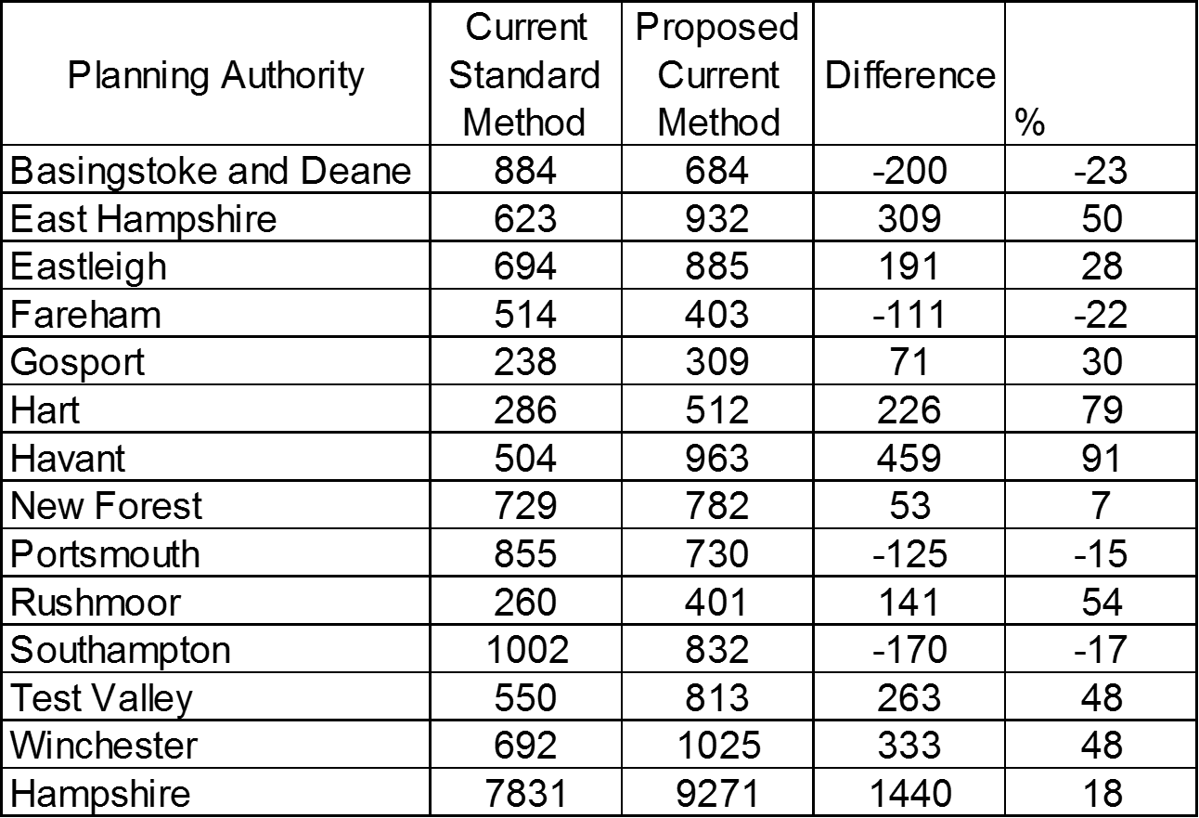

Slide 15
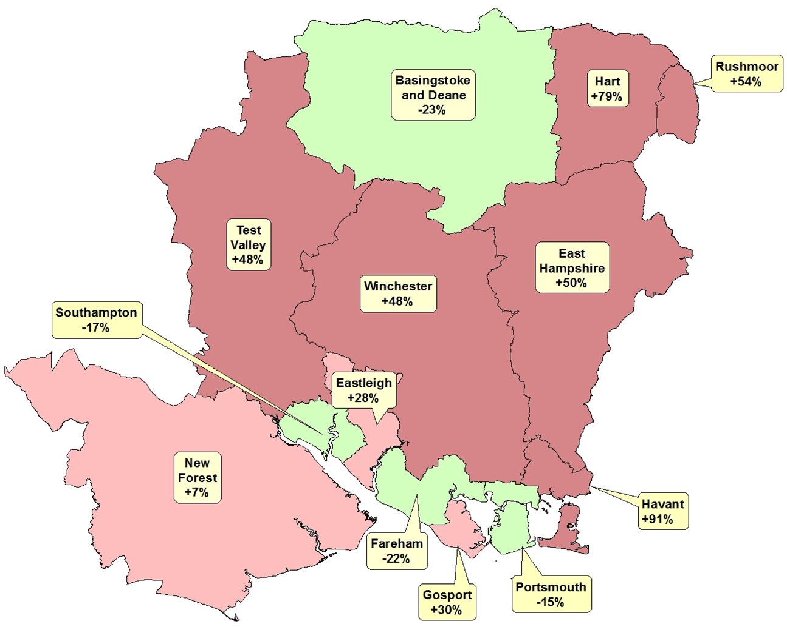

Slide 16
Impact on Winchester
all local planning authorities now faced with difficult choices over timetable for plan making
an annual housing requirement in excess of 1000 homes instead of less than 700.
if the requirement is fixed, the development strategy for the new local plan will have to be fundamentally different – significantly more development land needed
changes can be brought in by government immediately
affordable housing delivery will reduce if threshold is increased from 10 units to 40 or 50 temporarily.
focus on First Homes will impact on affordable housing mix.
wider use of PIPs could have an impact on DM (very short determination period of 5 weeks) and may cause policy issues if mix/quantum of non-residential uses within schemes is allowed to expand

Slide 17
Timetables and current uncertainties
what decision making and legislative path way will the government follow?
will it stick with the proposals if there is widespread criticism?
will the increased housing requirement be implemented and if so when?
when will we have enough certainty to produce meaningful and purposeful options and to start on a new plan?
how do we engage with communities about such radical changes to process and outcome?
what is the relevance of PfSH type arrangements under the new system?

Slide 18
Questions

