Slide 1
Working with the voluntary sector to deliver better health outcomes
Tim Houghton
8th December 2015

Slide 2
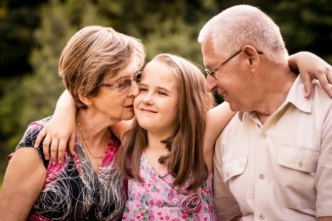
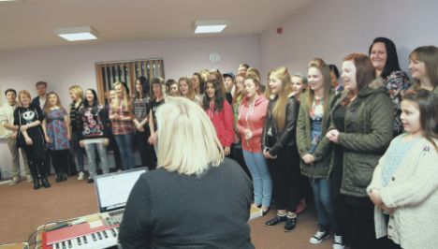
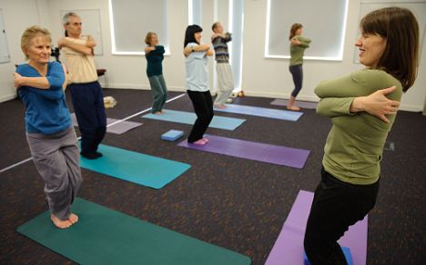
Delivering better health outcomes
Early intervention and prevention promoting healthy lifestyles and reducing higher risk behaviour
Providing services; health and social care, information, advocacy and advice
Tackling isolation and social determinants on health
Service provider of choice for many
Campaigning, research and commissioning advice

Slide 3
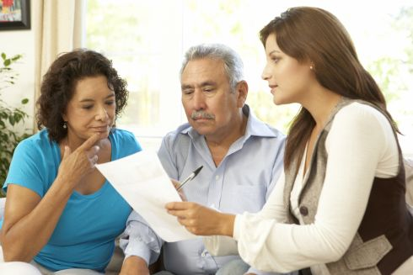
Going forward
Care Navigators and Surgery Sign Posters
Activity Co-ordinators
Social Prescribing and Advice on Prescription
BILL (Being Independent in Later Life)
Befriending and Advocacy
Transport
Interactive Directory; communication and awareness of organisations is key

Slide 4
Winchester Live at Home Scheme
A local charity for older people
Alan Darlington

Slide 5
Winchester Live at Home Scheme A local charity for older people
Providing Friendship & Support
Group Activities
Scheme Outings
New Projects
320 members; 120 volunteers
Notes:
Providing Friendship & Support
Befriending
Telephone Link
Shopping
Transport
Group Activities
Walking Group
Singing for wellbeing
Exercise Plus
Seated Exercise
Mens Pub Lunch
Lunch Club
Activity Day
Film Club
Scheme Outings
Outings
Holidays
New Projects
Bad Weather Scheme
Healthy Dancing

Slide 6
Winchester Live at Home Scheme A local charity for older people
Welcome Home Project

Slide 7
Winchester Live at Home Scheme A local charity for older people
Welcome Home Pilot Project
October 2015 – March 2016
Gather data
Vulnerable, isolated, elderly patients
Notes:
What is the need?
Data Gathering
Vulnerable, isolated, elderly patients
Without the network of friends and relatives nearby

Slide 8
Winchester Live at Home Scheme A local charity for older people
Day of Discharge
Basic shopping
Heating at home
Signposting of local services
Before discharge
Befriending
After discharge
Shopping
Telephone link
Transition to the general L@H Scheme
Notes:
What is the need?
Data Gathering

Slide 9
Winchester Live at Home Scheme A local charity for older people
Royal Hampshire County Hospital
Winchester City
Winchester Rural East
Referrals through Adult Services
Notes:
Clifton Ward

Slide 10
Winchester Live at Home Scheme A local charity for older people
01962 890995
office@wlahs.org
www.wlahs.org
@winliveathome

