Slide 1
SOLD OUT…The art of successful off line event promotion Chris Powell The Event Expert

Slide 2
Some event promotion truisms
It’s noisy out there!
Keeping up…is a full time job
Difficult to know who and what to pay attention too
Cutting through the noise is really tough
Getting people to actually turn up to an event…is
….REALLY TOUGH!
….events do not sell themselves or not ours!

Slide 3
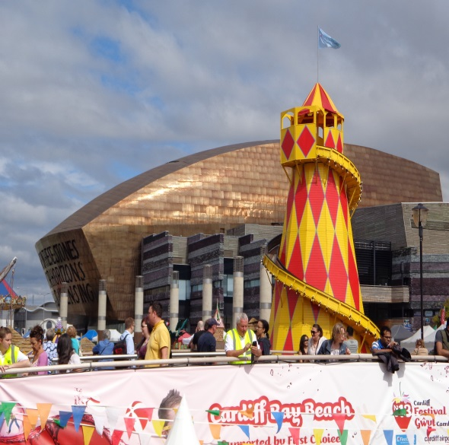
The solution !
Pre-event market research…providing events audiences actually want
Allocated blocks of time and cash
Precise target market…I’m ONLY talking to you
Tenacity, creativity and persistence
Great copy: inspiring, contain great visuals, compelling: promises a transformational experience
Seek collaborations and joint ventures…share lists and
burden
Create a full event promotional plan: simple to multiple
activities for new public event

Slide 4
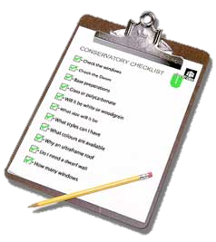
9 stage event promotional plan
Set some objectives: targets
Conduct an audit: existing promotional media, any gaps?
Audience: decide who they are, create avatar
Content: words, visuals, videos, key transformational messages, calls to action, scarcity, benefits, incentives, Stick campaign
Media: best ‘audience’ fit, on / off line media, email, cost
Event promotional budget: design time, print cost, media hire, media updates
Test it: edit x3 / review key content + visual / proof read
Timeline: create plan of activities with critical dates
Implement and monitor: which campaign delivers sign-ups

Slide 5
Example AIDA event promotional plan…
Awareness / attracting attention: Targeted adverts (on/off line): personalised message, phone call, coming soon, save the date, Press release, teaser information, tweet, post...
moving them from: I don’t know about this event to wanting to know more
Interest + Desire: Explain attendance benefits: the value, the experience, your track record: video / interview, inspiring picture – phone call, email, post, article, share important sign up…. moving them from I like the sound of this event and want to attend.
Action: create urgency by calls to action: entry deadlines: early bird offer: how to book…
…moving them to I’m going!
Stick campaign: keep in touch with those registered to maintain their interest / enthusiasm

Slide 6
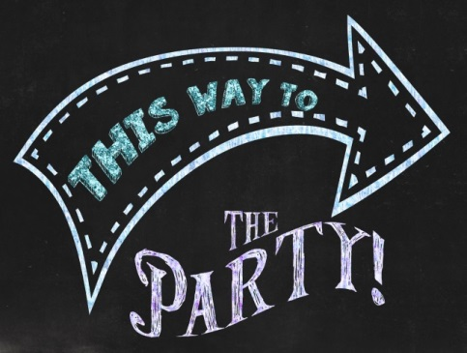
Off line event promotional media options
Advertising: ineffective
Interviews
Direct mail – letter
Save the date
Money off / incentives
Exhibitions
Events guides and listings
Press releases, editorials, advertorials
Open days
Event brochure
Public relations, stunts
Email marketing
Phone
newsletters
Email signature text, live link
Banners, pop-ups, drops
Leaflets and stickers
Post card marketing
Speak at events
Partnerships: a joint venture with non-competing partners
Personal message from key figure

Slide 7
Designing an event poster or e-flyer invitation
General requirements:
Event posters need to catch the eye
Less is more e.g. more white space
Headline statements in big bold fonts. The message: clear, concise, informative and sincere
Tell the audience why should they attend, and then where and when
Outline booking incentives and procedure, what next?
Stick only to the key highlights
Sign post users to further information links / details
Posters must carry the logos of organiser and sponsors

Slide 8
Off line event promotional summary
Have a multi activity on and off line event promotional plan
Seamless registration process
Lightning speed customer query response
Monitor: know which campaign delivers people: review and change plans
Event promotional plans need time + money. All Deadlines met.
One voice - everybody is on message, coordinated
Needs a web site and if appropriate a social media campaign too
Inspiring, targeted event name
The aim of all your promotional activities must be to draw people to your event: to excite them to buy, enquire, email, talk to you or register interest.

Slide 9
How can I help you plan your next event?
What is the No 1 problem I can solve for you?
I give event planners a structured: concept to completion process that helps them design, plan and deliver successful and rewarding events.
How do I do this?
By providing in-house and on-line event management training courses, after course support and consultancy services to individuals and teams tasked with planning events.
What results can you expect?
I turn accidental, occasional and new event planners into confident and skilled event professionals: able to deliver successful and rewarding events

Slide 10
Thank you for your time and attention
Good luck with your events
Chris Powell
The Event Expert
www.theeventexpert.co.uk
Helping turn accidental, occasional and new event planners into confident and skilled event professionals: able to deliver successful and rewarding events

