Slide 1
An Overview of Community First Development Services
Tim Houghton
(Chief Executive)
www.cfirst.org.uk
0300 500 8085

Slide 2
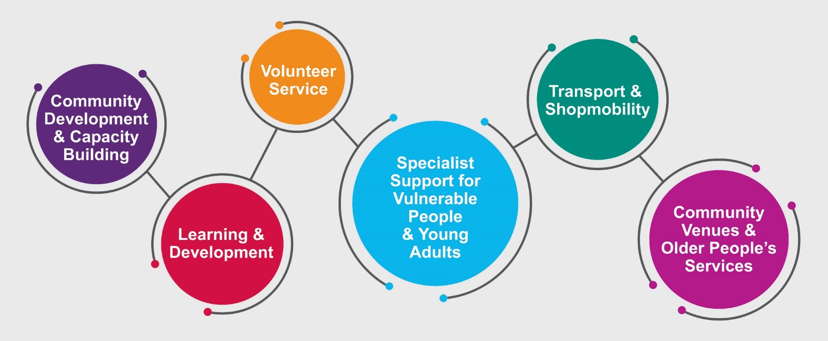
Who we are and what we do
We support a thriving & successful charity sector and provide critical community services.
www.cfirst.org.uk

Slide 3
Community Development
Promoting a Strong, Influential and Thriving Voluntary and Community Sector
Developing partnerships & networks
Information on governance, HR, charity law and much more
Practical help and support to become funding and tender ready, finding suitable funding streams and providing bid writing support
Access to toolkits & training designed for not-for-profit organisations
DBS checking service
Payroll, Book keeping service
Sustainability
Governance
Fundraising

Slide 4
Volunteering Services
Matching Volunteers with Opportunities & Employee Volunteering
Our Volunteering Service matches volunteers with opportunities
Our online “Volunteer Wessex” service enables groups to promote volunteer opportunities quickly and easily
We also offer an Employee Volunteering Service to enable businesses to easily access team challenges and individual skill sharing activities.
www.volunteerwessex.org

Slide 5
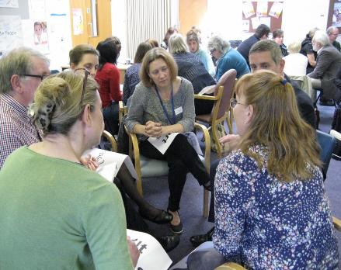
Training
Quality, Affordable Training
We provide high value, low cost training and development activities to charities, voluntary organisations, social enterprises, statutory bodies and businesses.
The courses are facilitated by professional trainers who have a wide range of experience in both the voluntary and business sectors.
All trainers have the relevant teaching qualifications in their specialised subjects.

Slide 6
Contact us
To speak to a member of the Winchester Community Development team please contact:
Bruce White bruce.white@cfirst.org.uk (Community Development Worker) or
Anstey Brierley anstey.brierley@cfirst.org.uk (Community Development Manager)
For enquiries on all our services contact a member of our team whenever it suits you via our 24 hour online help desk service. Visit www.cfirst.org.uk and click on the “Got a question?” button to submit your enquiry.
www.facebook.com/cfirstposts
@cfirsttweets
www.cfirst.org.uk

