Slide 1
Grants for the arts funding seminar
7 February 2018
Simon Jutton
Senior Relationship Manager
#culturematters
Notes:
Note to presenters: This presentation is designed to take about an hour. If you are unable to answer a question, refer the potential applicant to the Enquiries team on 0845 300 6200
This presentation is about Arts Council England’s open access funding scheme, Grants for the arts (GFTA) – what it funds, how it works, how you apply and what they do with your application.
Arts Council England is the country’s Arts Development Agency. It has Head Offices in London and in Manchester (where the Grant Management team is situated) and five area offices which employ Relationship Managers with specialist knowledge of artform or policy areas (for example Visual Arts or Children & Young People).
These five areas reflect the government’s administrative for Arts Council England ’s decision-making purposes, they are grouped together as
North (Yorkshire, North East and West),
Midlands (which include both East and West Midlands),
East and South East,
London
South West
The nature of what you are applying for determines where a decision on your application will be made, and more of that later.
There are complementary Arts Councils in Scotland, Wales and Northern Ireland. Arts Council England is a Non-Departmental Public Body (or Quango) funded at ‘arms-length’ by the government and as well as being the strategic body shaping the future of the arts in England, also directly funds a roster of ‘Regularly Funded Organisations’ ranging from large building based companies such as London’s Royal Opera House to small organisations like the touring carnival company Barracudas, based in Barrow-in-Furness in Cumbria. Whilst these organisations operate on a three year revenue agreement, Arts Council England also wants to fund one-off, good ideas and this is where GFTA project funding comes in.
Arts Council England is funded through Grant-in-Aid, which comes from tax revenues and is also one of the National Lottery ‘good causes’ – Grants for the arts is Lottery money, which places a number of conditions on the way it can be used and we’ll cover these throughout the presentation.

Slide 2
Arts Council England
Arts Council England champions, develops and invests in artistic and cultural experiences that enrich people's lives. We support a range of activities across the arts, museums and libraries - from theatre to digital art, reading to dance, music to literature, and crafts to collections.
Between 2015 and 2018, we will invest £1.1 billion of public money from government and an estimated £700 million from the National Lottery to help create these experiences for as many people as possible across the country.
#culturematters
Artswork: Strong Voices, Guildhall 2015
Photo © Murray Freestone

Slide 3
Our funding portfolio
We offer a range of different funding programmes including:
National Portfolio funding
Major Partner Museum funding
Grants for the arts
We also offer a range of strategic funding programmes which are specifically aligned to certain priorities or sectors.
You can find out more about these on the funding pages of our website.
#culturematters
Nuffield Youth Theatre – Southamapton ‘Girls Like That’
Photo © Richard Budd
Notes:
Grants for the arts is just one of the Arts Council’s funding programmes.
We provide regular funding for organisations through the National Portfolio and Major Partner Museums programmes, and a range of strategic programmes that are geared towards addressing certain priorities against our goals.

Slide 4
What is Grants for the arts?
A key feature of how Arts Council England delivers our mission, ‘Achieving Great Art For Everyone’
Grants for the arts distributes awards of between £1000 and usually £100,000 from the National Lottery to:
individuals
arts organisations
people who use the arts in their work
For time limited arts-related activities that:
benefit people in England
help artists and arts organisations in England carry out their work
#culturematters
Notes:
Gfta is our open access fund that exists to be reactive to new ideas, new talent and new approaches in the arts.
It is open both to individuals and organisations – as long as the activity being proposed is arts-focused, many different types of organisations can apply: arts organisations, libraries, museums, archives services, non-arts organisations such as health trusts, housing associations etc using the arts in their work, and so on.
The full eligibility criteria are in our How To Apply guidance, available on our website. Read through this guidance carefully before making an application to us – it goes through the whole application process in detail, and explains what kind of information we need to see in applications.

Slide 5
Background
first launched in April 2003
budget £210 million for 2015–2018; that’s £70 million of lottery funding each year
is light touch
Quick decisions:
6 weeks for applications for £15k and under
12 weeks for applications for over £15k
decisions are made on an area basis
– based on the postcode location of lead applicant
Farnham Maltings: Youth Theatre rehearsals
Photo © Lulu Lockett
#culturematters
Notes:
Before we talk about what we fund it’s useful to have a quick overview of the programme
Ongoing programme - 12 years of operating, with occasional improvements, but is time proven and evidently works.
Budget – £210 million for 2015 - 2018
Customer focussed / Equality - Gfta is designed to be open and consistent. It is easy to understand, there are no hidden agendas and it doesn’t require prior knowledge of Arts Council England. Both an Excellence and an Access fund, Applicants are appraised on what’s written in their application, rather than any prior relationship with Arts Council England
Flexibility - Gfta designed to fund any and all types of arts activity, and flexibility to respond to the needs of applicants.
Grants to individuals - Many other funding schemes won’t fund individuals, but many artists practice alone, so the scheme was designed to respond to that
Light touch - Arts Council England recognises that there are some risks in being accountable for the public money it receives. The scheme is designed for a balance of risk vs. reducing bureaucracy for applicants – this is why we our appraisal of smaller (<£15k bids) is less forensic
Quick decisions. Six weeks for applications £15,000 and under; 12 weeks for applications £15,001 and over.

Slide 6
The competition
Last year we received more than 10,000 applications.
We must fund just over 4,000 awards – 40%
We will always receive more good applications than we can fund so advise you to consider other sources of funding whilst applying to us.
#culturematters
Imbalance by Joli Vyann
Photo © Moving Productions Photography
Notes:
Grants for the arts is a competitive programme, and we will always receive more applications than we can fund (success rate for 13/14 was 50% - that’s for eligible applications)
In today’s climate, it is important that an application stands up against competition. Gfta is a logical, evidence-based process in which applications must meet our published criteria. Providing the relevant information we need – following our prompts and including specific and concrete detail throughout – is the best way of meeting our criteria.

Slide 7
Who can apply?
arts organisations / artists / researchers / local authorities / commissioners / festival writers / musicians / museums / libraries / performers / directors/ promoters presenters / curators / designer makers / producers / universities / voluntary groups consortiums of schools / choreographers / community groups / composers / experimental artists
#culturematters
Farnham Maltings: Antarctica by Little Bulb Theatre, produced by Farnham Maltings'
Photo © Paul Blackmore
Notes:
We accept applications from both individuals and organisations.
We have funded activity from an incredibly wide variety of types of applicant: as well as the more usual suspects on this slide, we have also received applications from Silverstone Circuits for an activity taking place during the Grand Prix; from boxing clubs wanting to employ a writer in residence; from large shopping centres who want to commission a street arts company to create a performance for their shoppers to engage in, for example.

Slide 8
What kind of activity do we fund?
productions / exhibitions / participatory projects / events / festivals / carnivals / workshops / digital projects / artistic research and development / commissions / participation / asset purchase / building renovation / making work / touring / residencies / professional development / international partnerships / organisation and business development / audience development / consortium building
Napoleon Maddox performing at Turner Sims Southampton
Photo © Gerry Walden for Turner Sims Southampton
#culturematters
Theatre Alibi - Mucky Pup
Photo © Steve Tanner
Notes:
This is just a snapshot of the kind of activities we can fund, and we’re continually surprised by the variety of projects that come in to Gfta.
Although they’re very different activities, all these types of projects share key attributes – they are time limited projects based in the arts that will engage people in England. They share our passion for getting great art to everyone, whether that is through a project to create a great piece of art, developing the arts organisations who deliver high quality work, or forging new ways for different sectors to work together using the arts.

Slide 9
What kind of activity do we not fund?
  Activities that are not arts-related
  Activities that provide no potential benefit to the public, either in the short or long term
  Students towards their course of study
  Educational establishments towards curriculum activity
  Retrospective activities, including buying goods or services, which take place or start before we would be able to decide on the application
  General running costs and overheads that are paid for by other income, including applicants own funds
  Secondhand equipment (apart from certain musical instruments and specialist equipment)
  Activities or events mainly taking place outside England (some exceptions)
  Film or video production, training or assets unless it is in support of artists’ work in the moving image
#culturematters
Notes:
Our funding remit is very broad, as you’ve seen from the previous slides. There are some types of activity that we can’t fund – they’re listed fully in the How to apply guidance, but it is worth taking note of some key examples here.
The examples on this slide are to do with the basic aims of and restrictions on the Grants for the arts programme. The fundamental aims of the programme are around supporting arts activity and engaging people, so we are not able to support activities that are not arts related or those that don’t give people an opportunity to engage.
The bottom example on this slide is about retrospective activity (activity that’s started or taken place before we reach a decision on your application). This is to do with what we’re able to use Lottery funds to support – it is earmarked for activity that ‘would not otherwise happen’ (ie it is for additional activity), and if something has already started or taken place, it doesn’t adhere to this rule.
We have a series of detailed guidance sheets available on our website that go into more detail about some of the more grey areas around what we can and cannot fund, for example:
the crossover between film and artists’ work in the moving image
work happening outside England
running costs and costs such as salaries
buying assets such as equipment
Again, if you’re ever unsure whether your activity is suitable for Gfta support you can contact our Enquiries team who can help.

Slide 10
Read the guidance
Read our How to apply guidance
Use the information sheets on our website
Contact us to discuss eligibility – 0845 300 6200
Online application form available through Arts Council England website – www.artscouncil.org.uk
The website includes links to all relevant guidance and will check applications before they are submitted – for instance, it will check if the budget is balanced.
#culturematters
Notes:
Getting the right advice is key to making a good application, and there are many ways to access this – the How to apply guidance, information sheets, our Customer Services team, and speaking to other ACE staff where appropriate

Slide 11
The application form
  Focused, directive questions relating to our four criteria
  Quality
  Public engagement
  Management
  Finance
  To ensure applicants give us exactly the information we need to know
  How to apply guidance online provides step by step advice
#culturematters
Proteus Theatre, Mexican Day of the Dead half term parade
Photo © D & M Photography
Notes:
The criteria are not changing, because the purpose/aims of Gfta remains the same.
The appraisal process looks at how closely the activity meets our four criteria.

Slide 12
Artistic Quality
The quality of the activity and its ongoing effect on artistic practice
In this section of the application form we want applicants to tell us about
their artistic work, some more detail about the activity
they would like to do, and
how this activity will help them or their organisation develop.
We also ask about any other artists they may be working with, what their role is, and why they have chosen to work with them.
#culturematters
New Carnival Company - Mardi Gras
Photo © Julian Winslow
Notes:
It’s the ‘Great art’ in the mission statement

Slide 13
Public engagement
How the activity increases opportunities for the public to engage in arts activities
In this section of the application form we want applicants to tell us about who will engage with their activity.
We ask them to estimate the numbers engaging with the activity based on what they think they will achieve. They have a chance to tell us more about the audiences and/or participants, who they are and how they will reach them.
#culturematters
Proteus Theatre, Mexican Day of the Dead half term parade
Photo © D & M Photography

Slide 14
What is public engagement?
Any of, or all of the following
  attending an arts event
  taking part in an arts activity
  volunteering to work at or with an arts organisation
  working with an artist or group of artists to design or create an artwork
  helping to make decisions about arts activity in a local community or helping an arts organisation to make decisions about its work
#culturematters
The New Carnival Company, Newchurch Lantern Trail
Photo © Graham Reading
Notes:
Applicants applying for more than £15,000, can choose to upload an audience development and marketing plan if it is appropriate to do so
Uploading an audience development and marketing plan is mandatory for applicants applying for more than £100,000

Slide 15
Finance
How realistic the activity is financially –
Does the budget balance?
The budget should cover the whole activity
Should have at least 10% match funding from other sources
Can include support in kind as match funding
Is there enough money to do the project?
Is the income and expenditure appropriate?
Have the risks been accounted for?
Does it leverage other funds?
Can the applicant manage it?
#culturematters
Notes:
Applicants will need to complete a budget for their activity, and answer some questions about how they will manage their budget.
10% - IN REALITY THIS IS LOW. THE HIGHER THE MATCH FUNDING THE MORE A COMMITED & STRONGER CASE IS DEOMSTRATED. EVEN BETTER IF THE MATCH FUNDING IS ALREADY IN PLACE.
For all applications of over £15,000 we also ask applicants to upload a detailed budget breakdown to support the budget table in the application form and provide more information about their budget. This is particularly important if their activity is complex and/or high value (for example, if it has a number of different strands or is happening over a number of years) as it will allow us to get a fuller picture of their budget.

Slide 16
Management
How the activity will be managed
Is it doable and can you do it?
Remember Gfta funds projects (e.g. one-off activity which achieves clearly stated objectives within a time limit)
Consider the principles of good project management:
Capability - do you have the skills and experience or do your partners
Capacity
Resources - Time, Money, People, Equipment
Project management Triangle - time/resources/quality
#culturematters

Slide 17
Evaluation – why is it needed?
All GFTA applicants have to complete and submit a Final activity report form for their activity in order to receive the final 10% of the grant
Wider rationale
Evaluation helps with planning, as it makes you think about what you’re aiming to do, how you will do it and how you will know if you’ve succeeded
Ongoing feedback keeps you on track
Evaluation helps prove the value of what you are doing
Evaluation costs money - has it been accounted for in the budget?
Learn from what didn’t go well
#culturematters
Notes:
Evaluation is needed both for ACE reviewing procedures but also to ensure there are learning outcomes.

Slide 18
What informs our decision meeting?
Information in the application form
The context
Our professional judgement
Benchmark against other applications
'The Church of Vétheuil by Claude Monet
Photo © Southampton City Art Gallery
#culturematters
Notes:
Application form: Applicants are told in guidance that it’s the content of the form we appraise. Gfta is an evidence-based process, first and foremost.
Context: consider the relevance/quality of the work against the context, using your sector knowledge.
Professional judgement: Use your judgement, but always in the context of the evidence provided in the form. You can comment on how convincing the artistic idea as presented is, or how strong the track record presented is, for example, using your professional knowledge. Remember that Gfta is a project-based funding programme, and judgements should be based on the project being proposed.
Benchmarking: Discuss work – benchmark your thoughts and standards against others, hear about their experience – this has been a key strength of the Gfta team, and can continue to work well in Area teams (and across Areas)

Slide 19
If you are unsuccessful
Most decision meetings are competitive
If we are not able to fund your activity this time, we will highlight the main reason(s) the application was unsuccessful
The information in the decision letter is the full level of feedback that we can provide
We recommend that unsuccessful applicants revisit the ‘How to apply’ guidance as well as any appropriate information sheets, particularly the ‘understanding the appraisal process’ guidance
You can apply again at any time, but any new application for the same activity must address the reasons that the original application was not successful
#culturematters

Slide 20
If you are successful
Offer packs must be signed and returned to us within one month
We will normally pay the money in stages
    90/10 for under £15k or 50/40/10 for over £15k
Conditions monitored by Grant Management Assistants, tasking out to RMs where needed
Applicants cannot reapply if there are outstanding documents required in their last project.
Applicants must acknowledge our funding and the National Lottery, including using our funding mark appropriately
Applicants must evaluate their work and fill in an activity report form
#culturematters

Slide 21
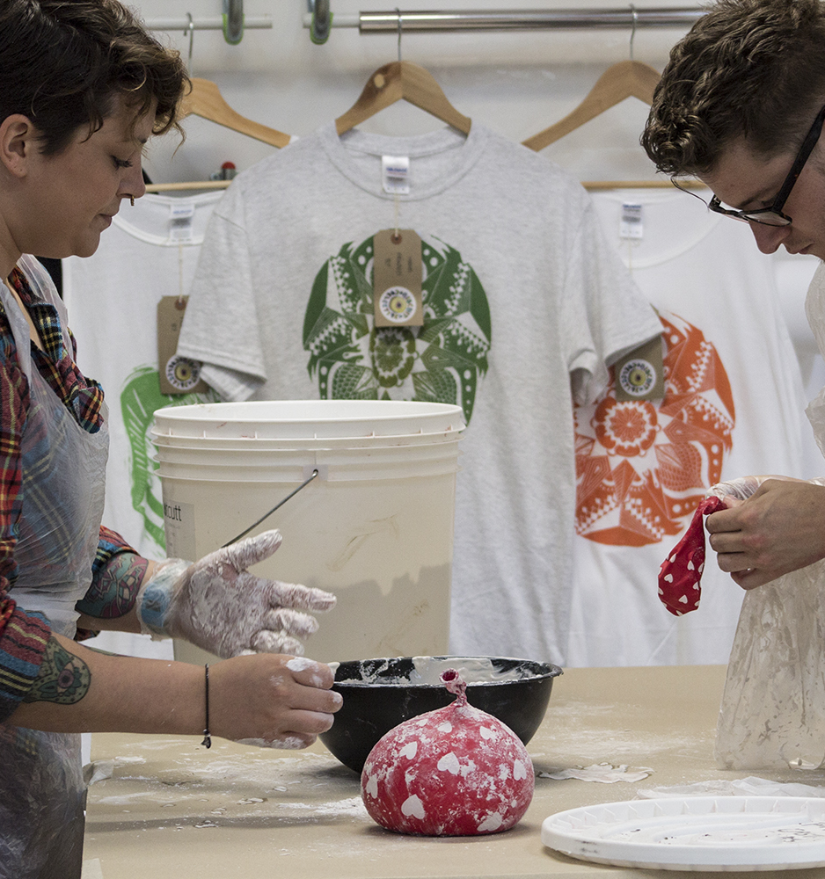
Arts Council National Lottery Project Grants
12 March 2018
Detailed guidance 12 February 2018
SOS Studios – Resident Illustrators Biscuit Collective demonstrate balloon moulding in their studio, A Space Arts © Harry Usborne 2017

Slide 22
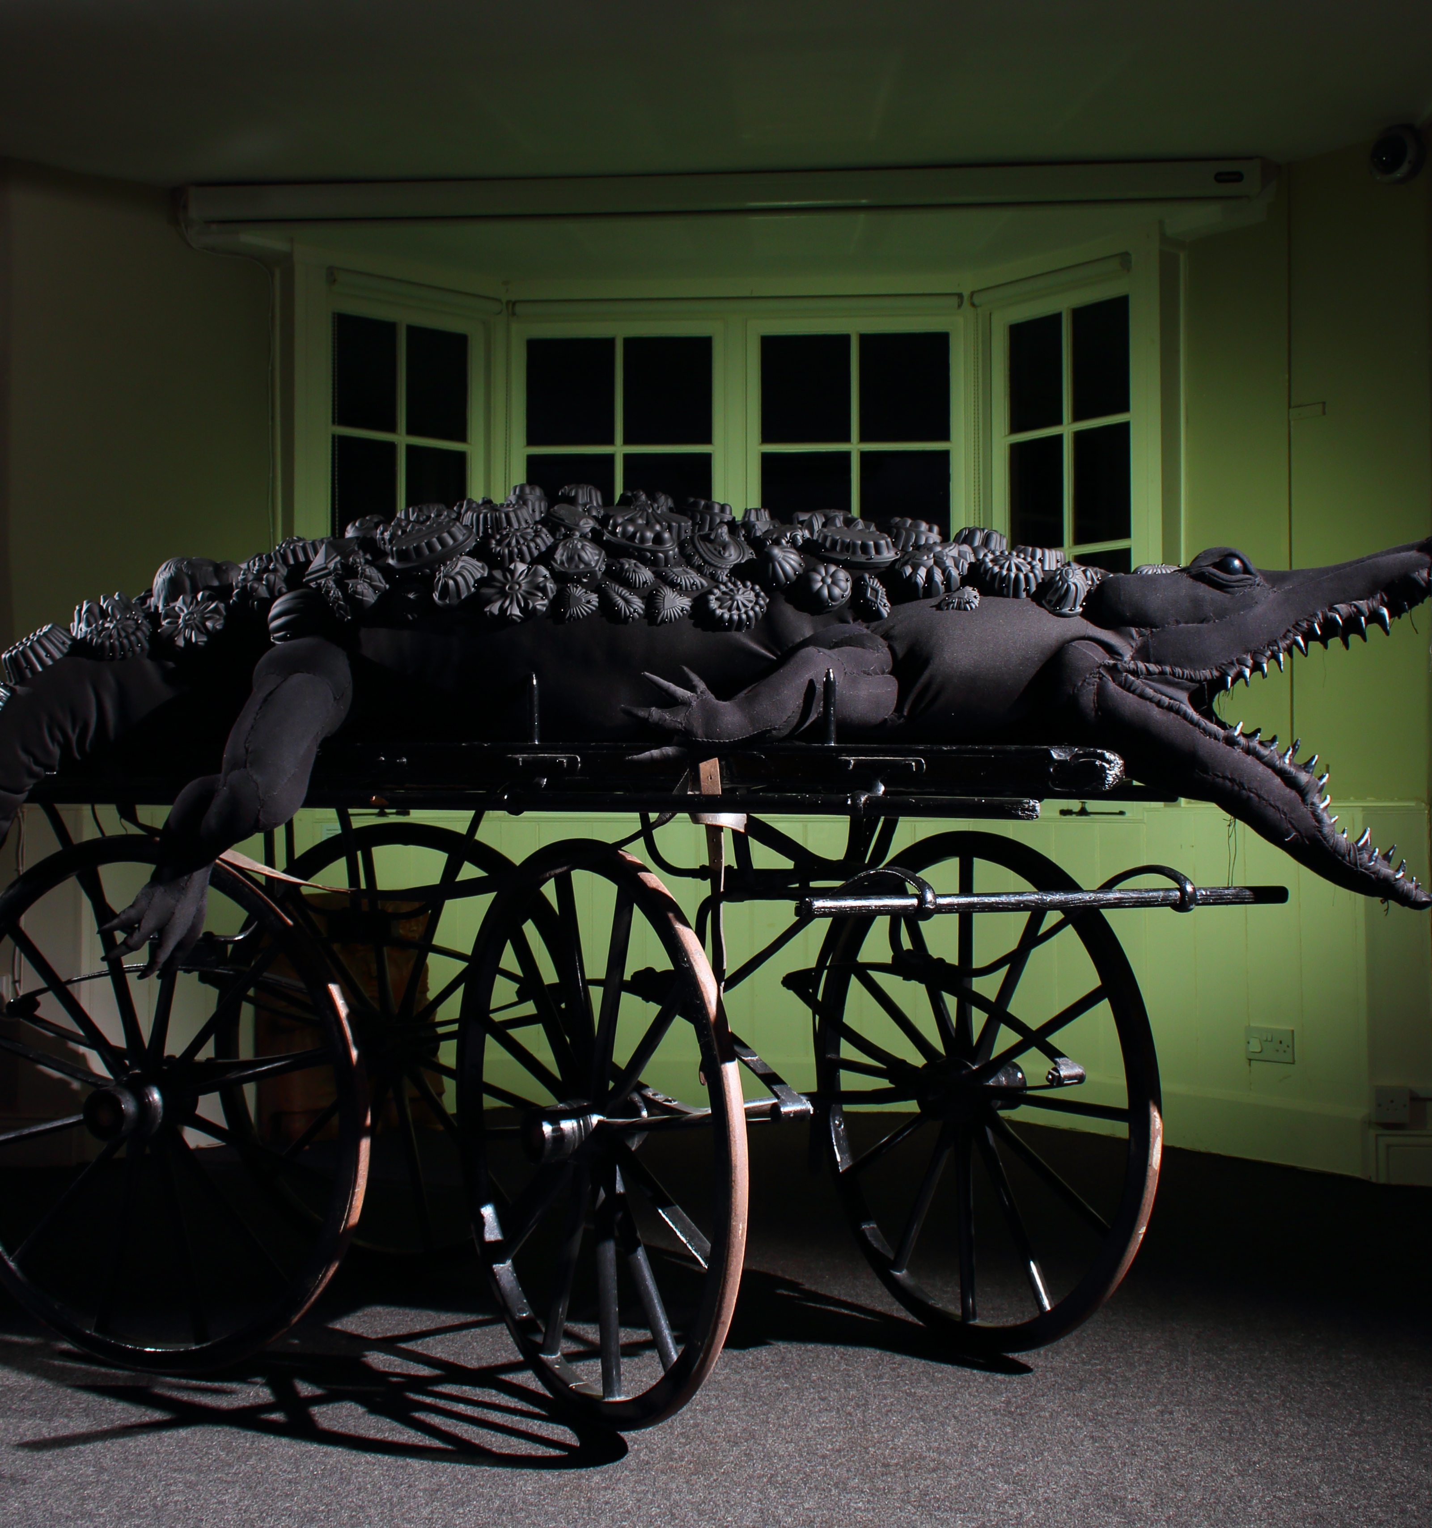
Changes
Museums & Libraries
Creative & digital media
Nationally significant
projects
MUSE: makers in museums a SW Heritage Trust project with contemporary makers © Dorcas Casey

Slide 23
Development Funds
Diversity, resilience, business innovation and leadership
Creative People & Places
Capital
Developing Your Creative Practice
Gulbenkian's bOing! Festival, 2016, feat. ZoieLogic Dance Theatre's RIDE © ZoieLogic Dance Theatre.

