Slide 1


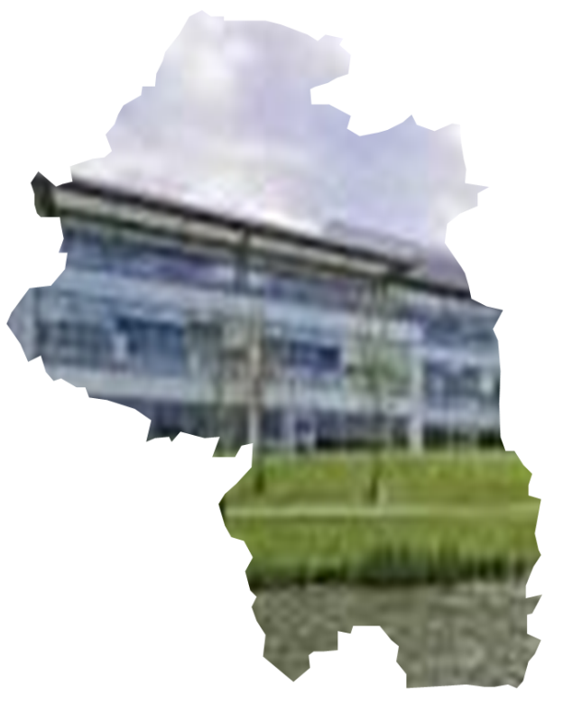


Winchester Sub-Area Economic Profile – July 2017
Winchester Town
Market Towns & Rural
South Winchester

Slide 2
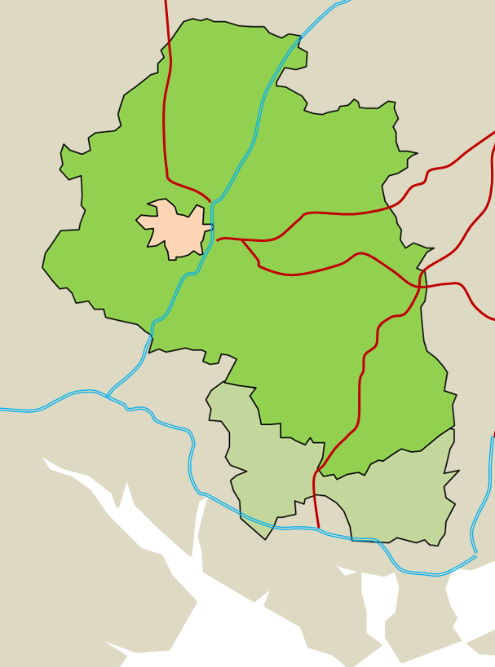


Winchester Sub-Areas
i
M3
The Winchester Town Sub-area covers most of the city of Winchester and is built from four middle super output areas (MSOA – 005 to 008). To avoid including large swathes of rural Winchester there are two MSOA that include Oliver’s Battery/Badger Farm, Littleton and Harestock that are counted as Market Towns and Rural. These are mostly residential areas so have less impact on the employment and business analysis. The sub-area includes the city centre which is dominated by public sector and retails employment and businesses, as well as four industrial/business parks (Bar End, St Martins, Winnall and Wykeham). The sub-area has good access to the M3, A34 and A31 as well as direct rails links to Southampton and London.
The Market Towns & Rural Sub-area is the largest in terms of area and is made up of eight MSOA (001-004 & 009-012) covering rural Winchester and a number of market towns. It also includes the western edge of the South Downs National Park. There are a number of smaller industry/business parks in Bishop’s Waltham, Kings Worthy and New Alresford (New Farm & New Dean).
The Winchester South Sub-area consists of two MSOA (013 & 014) that borders the M27 corridor. The sub-area falls mostly within the Solent LEP. The sub-area has two market towns (Denmead and Wickham), the former home to a small business park. To the west and adjacent to Lock’s Heath is the large Solent Business Park, Whiteley Village shopping centre and south of the M27, the Segensworth North business park. These three closely connected sites form the main employment centres in the sub-area.
Legend
Winchester Town
Sub-area
A34
Kings
Worthy
A31
Market Towns & Rural
Sub-area
New Alresford
A32
Winchester
South Winchester
Sub-area
A272
Twyford
A272
Winchester towns
M3
Eastleigh
Bishop’s
Waltham
Winchester industrial/
business parks
M27
A32
Neighbouring
towns/cities
Southampton
Hedge
End
A3(M)
Wickham
Denmead
Waterlooville
Airport
Lock’s
Heath
Major port
Fareham
M27
Portsmouth

Slide 3
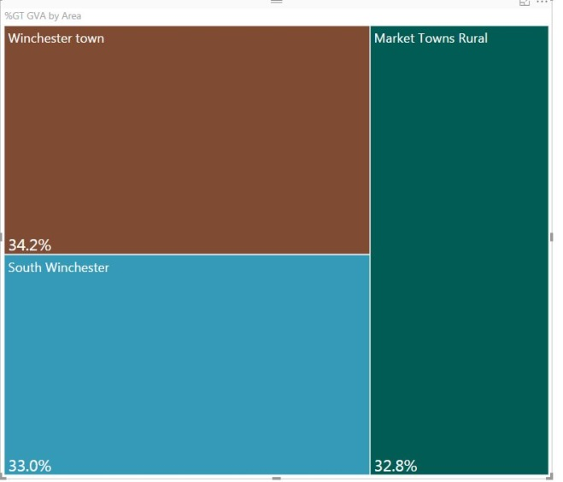
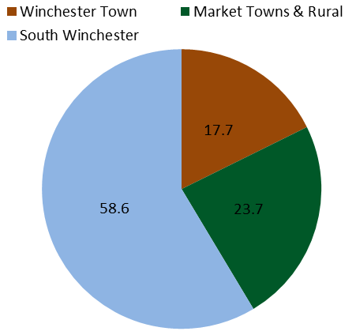
Executive Summary
ii
Successful and prosperous economy. By any measure of economic performance Winchester is a successful and prosperous place. This is primarily due to its people, business and place/location. A large part of local growth is due to the fact that Winchester is part of a dynamic national economy (local economies share the same monetary and fiscal policy and are part of the same regulatory environment). Sector shape is one of the most important factors that helps to explain disparities in economic performance at local or sub-area level.
Fastest growing economy in Hampshire with highest levels of economic prosperity. With £4.8 billion in total output (Gross Value Added, GVA) in 2015 Winchester was the second largest economy in the Hampshire County Council Area. Nominal economic growth in the area averaged 4.6% p.a. since 2010, much faster than the Hampshire or the UK average. Winchester is by far the most prosperous local economy in Hampshire. In terms of GVA per head of population Winchester is almost 50% more prosperous than the Hampshire average and almost a quarter more prosperous than the next most prosperous district in Hampshire.
Sub-area economies are of similar size but there are disparities in GVA growth. The three sub-area economies in Winchester are of similar size. Winchester Town accounts for about £1.65 billion in total GVA or about 34% of the total economic output (GVA) in Winchester district. South Winchester and Market Towns and Rural account for about a third (£1.59 billion respectively). South Winchester was the main contributor to economic growth in Winchester district since 2010. This sub-area accounted for approximately 58% of the overall growth in GVA between 2010 and 2015 compared to less than a quarter in Market Towns and Rural and less than a fifth in Winchester Town.
Economic growth driven by a handful of sectors. Economic growth in Winchester was driven by a handful of sectors. The broad distribution sector accounted for over a fifth of the overall growth in GVA in Winchester District since 2010. Business services and information & communication (ICT) are much smaller but significant sectors in the local economy. They accounted for about a fifth of the overall growth in the economy respectively. Several smaller sectors such as agriculture performed well over the period. Finance & insurance was another strong performer. Faster growth in the economy was held back by the broad public sector that accounts for almost a fifth of total output (GVA) in Winchester and sluggish performance of several smaller sectors.
Disparities in economic performance at sub-area level are driven by sector shape. South Winchester performed strongly thanks to the strength of its key private services – the broad distribution (retail) and business services sectors that account for about one quarter and a fifth of the economy respectively. Finance & insurance is another major contributor to the local economy. High value added ICT was the main contributor to growth in Market Towns & Rural. GVA growth in Winchester Town was held back by its large public sector and real estate activities but business services and ICT performed strongly.
similar
GVA share by sub-area (2015)*
Contribution to Winchester GVA growth
(2010-2015)*
*Sub-area estimates are proxy estimates that need to be treated with a degree of caution

Slide 4
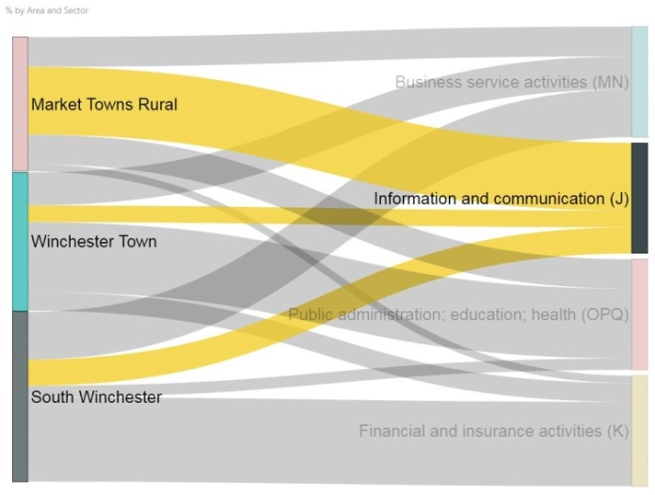
Executive Summary
iii
Large and growing working age population. About one in twelve of Hampshire residents reside in Winchester district. More than a half of Winchester residents reside in Market Towns & Rural with almost 30% in Winchester Town and about 17% in South Winchester. Working age population in the area is smaller than the national average but larger than the Hampshire average.
Strong growth in working age population projected over the medium-term. The most recent population projections point to relatively strong growth in working age population in Winchester district over the medium-term. Working age population in Winchester Town is projected to remain broadly stable between 2017 and 2023 but strong growth is projected in South Winchester. Market Towns & Rural are projected to see strong growth in both elderly and working age population.
A healthy labour market, with high employment and low economic exclusion. There is a large resident workforce of 57,500 in Winchester District (approximately 9% of the Hampshire County Council total). The employment rate (76.5%) is above the national average (73.9%) with the highest rate found in Winchester Town at 80.9%. Economic exclusion is also lower than the national average with relatively low levels of economic inactivity and unemployment. Economic inactivity rates are above the national average but that is mostly attributable to student population.
Successful economy exerts a strong pull factor on neighbouring labour markets. Unlike Hampshire as a whole which sees greater commuter out-flows, Winchester experiences significant net in-flow of workers; notably from Solent to the Winchester Town and South Winchester sub-areas. The more rural Market Town & Rural sub-area, with its large resident population is a net exporter of labour (mostly to Winchester Town, but also to adjacent authorities).
Large business base. The Winchester economy had approximately 8,200 businesses in 2016. The largest concentration of businesses is found in the Market Town & Rural sub-area with about 4,000 businesses or 48.8% of all business in Winchester. The rest of businesses are split between Winchester Town with 2,255 or 27.5% and South Winchester with 1,940 or 23.7% of all businesses in the area.
Strong business growth. The total number of businesses in Winchester increased by about 1,185 businesses since 2010. Business growth averaged 2.6% p.a. since 2010, comparable to the national average and faster than in Hampshire. Business growth in the area was driven by South Winchester with the share of Winchester Town comparable to its share in the overall business stock. Business growth in South Winchester was 4.2% p.a., followed by Winchester Town (2.8%) and Market Town & Rural (1.8%). Market Towns & Rural and South Winchester added about 425 and 415 additional businesses with Winchester Town accounting for about 345 additional businesses.
Information & Communication GVA (£656m)
in Winchester by sub-area, 2015
*Sub-area estimates are proxy estimates that need to be treated with a degree of caution
Sub-area Business Share & Business Growth 2016

Slide 5
Executive Summary
iii
Relatively high concentration of high value added businesses. One of the main factors behind the relative success of the economy is found in a high concentration of several highly productive services. Business services (mostly professional, scientific and technical activities) are over-represented in the area relative to the national average. Business concentration in this sector in Winchester is about 1.2 times the national average (20% above the national average). The concentrations in Winchester Town and Market Towns & Rural is about 1.3 times the national average. The relative concentration in South Winchester is similar to the national average but these businesses tend to be larger and more productive than the average business. ICT is another sector that is over-represented in Winchester Town and Market Towns & Rural Areas (1.3 times the national average). South Winchester has the strongest mix of private services in the area, its public sector is tiny and the sub-area has a relatively strong concentration of smaller niche sectors such as aerospace & defence (2.7 times as concentrated in the area as across the UK).
Business growth was strong in several key sectors. The professional, scientific & technical sub-sector saw strong growth in the number of businesses across Winchester. Market Towns & Rural had 175 additional businesses in this sector in 2016 compared to 2010. Winchester Town and South Winchester had 155 and 90 additional businesses respectively. Business growth was strongest in South Winchester (6.8% p.a.) followed by Winchester Town (5.7% p.a.). South Winchester and Winchester Town saw strong growth in the number of ICT firms (5.2% and 4.2% p.a. respectively). Retail and finance & insurance performed strongly in South Winchester but retail saw little growth in Market Towns & Rural and no growth in Winchester Town. Rural areas saw strong growth in business services (alongside the professional sub-sector, business growth in business administration was 4.6% p.a.), health and property. Tourism in Winchester Town and South Winchester saw growth in business stock of about 4.3% and 4.6% p.a. but Market Town & Rural saw no growth in new business.
Majority work in private sector, with significant concentration in South Winchester. Of the 81,000 workplace based employees in Winchester, the private sector accounts for 57,000 (70%) although this varies greatly by sub-area. South Winchester is very much geared to private sector employment (90%, 22,000+) reflecting the absence of any significant public sector employers and the presence of the Solent Business Park, Segensworth North and Whiteley Shopping village.
Large public sector employment, but heavily concentrated in Winchester Town. While a large public sector presence in a city is commonplace, about half of all employees in the Winchester Town sub-area work in the public sector (15,500 or 63% of all public sector employees in Winchester) compared to just 10% in South Winchester. This makes Winchester Town more vulnerable to certain economic shocks. Public sector employment (mostly public admin and social work) in the sub-area contracted by 1,000 since 2010.
Major Business Sectors with Strong Growth
Selected sectors | Number of businesses | % growth p.a. 2010-2016
Professional, scientific & technical | 1,695 | 4.9%
Retail | 940 | 2.5%
Business administration | 705 | 6.1%
ICT | 608 | 3.1%
Health | 385 | 3.1%
Public/Private Sector Employment

Slide 6
Executive Summary
iv
Employment growth driven by South Winchester’s private services. The largest sectors in terms of employment are the distribution, transport, accommodation & food sector, followed by business services and financial & insurance. This is facilitated in the south by sectors facilitated by prime employment sites in the Solent Business Park. The main growth sector in numbers is the distribution sector, however this varies across the sub-areas with accommodation the largest driver in Market Towns & Rural, accommodation/food and beverages in Winchester Town and retail in South Winchester (Whiteley Village Shopping Centre development). Other services also saw strong growth in the Market Towns & Rural and in Winchester Town. In relative terms ICT, other services, finance and insurance, construction, and real estate were the fastest growing sectors.
High value added sectors made significant contribution to employment growth. As with the broad sectors there are sub-area variations in high value added employment growth by sector. Winchester Town has a smaller high value added sector share than comparison areas and down to the higher number of public sector employment, although these sectors are still major employers. The financial & professional (business) services is an important employer in South Winchester with one in seven workers (3,500) employed in this sector compared to one in ten for Winchester as a whole (8,000). This sector expanded by about 2.7% on average p.a. across Winchester. The ICT sector is disproportionately represented in the market Town & Rural sub-area. Employment in this sector expanded by almost 6% p.a. across Winchester. Tourism is a strategic sector to the economy and this is another growth sector. Total employment in this sector increased by about 7% p.a. since 2010.
Relatively strong growth in output (GVA) is projected over the medium-term but risks to growth are on the downside. The economy of Winchester district is projected to expand by about 4.3% on average per annum by 2023 but there is a downside risk to growth. This risk to economic growth is primarily found in rising inflation and sluggish growth in earnings and their impact on disposable incomes, consumption and growth. The economy remains exposed to external shock while another source of uncertainty is related to Brexit. It will take some time for the impact of Brexit on trade and investment to become clearer.
Several sectors are more exposed to consumer lead-slowdown but Winchester has a concentration of resilient sectors. Retail and accommodation & food are more exposed to a consumer lead slowdown than other sectors of the economy. Large currency depreciation through its impact on relative prices has made Winchester more attractive to both foreign and domestic visitors which might boost accommodation & food and offset the negative impact of lower consumer spending elsewhere in the economy. In terms of GVA growth the real estate sector underperformed since 2010 and a slowdown in house price growth will most likely curb activity in this sector and construction. Further restructuring in public administration will most probably constrain growth in Winchester and Winchester Town in particular.
Sub-area Employee Share & Employee Growth
Major Employment Sectors with Strong Growth
Selected sector | Number of employees | % growth p.a. on 2010
Tourism | 7,000 | 7%
Retail/wholesale | 13,000 | 5.4%
ICT | 6,000 | 5.9%
Education | 7,000 | 3.1%
Financial & prof. | 8,000 | 2.7%

Slide 7
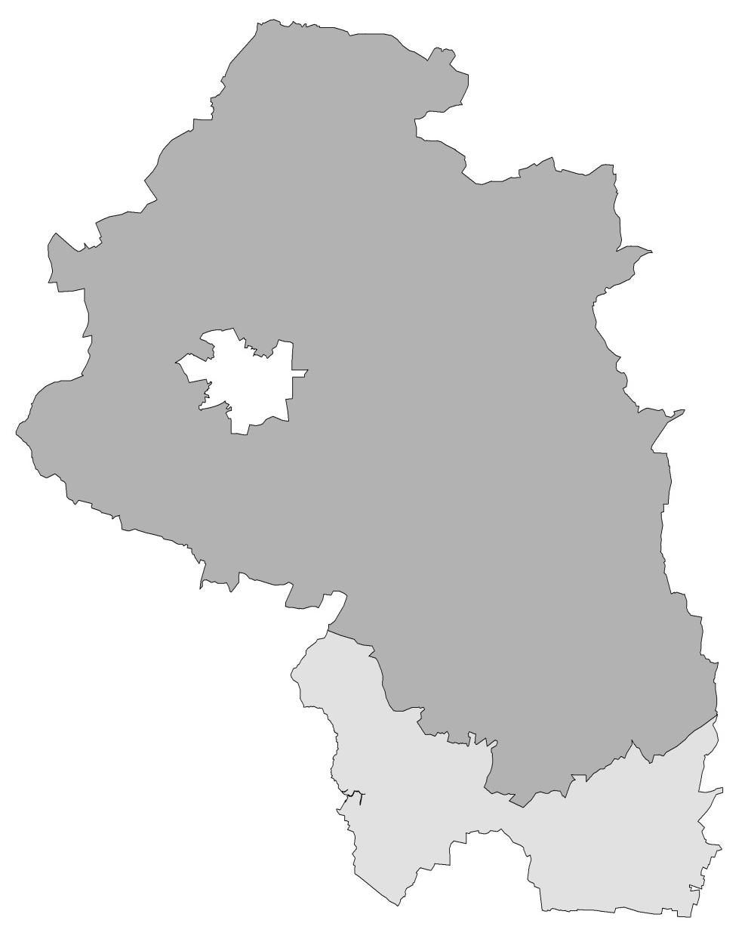
Winchester Sub-Area Sector Concentrations
v
Employee/GVA Concentrations
Business Concentrations
10 Broad Sectors
10 Broad Sectors
Public Admin, education & health
Public Admin, education & health
Distribution, transport, accommodation & food
Distribution, transport, accommodation & food
Insert Map
Business services
Business services
Information & communications
Information & communications
Winchester Town
Construction
(education)
Construction
Financial & insurance
Financial & insurance
Other services
Other services
Real estate
Market Towns & Rural
Real estate
Agriculture, forestry & fishing
Agriculture, forestry & fishing
Production (mostly manufacturing)
Production (mostly manufacturing)
High Value Added LEP Sectors
(education)
High Value Added LEP Sectors
Financial & Business (EM3)
Financial & Business (EM3)
ICT & Digital Media (EM3)
ICT & Digital Media (EM3)
Logistics (EM3 & Solent)
Logistics (EM3 & Solent)
Aerospace & Defence (EM3)
(retail)
Aerospace & Defence (EM3)
Engineering & marine (EM3 & Solent)
South Winchester
Engineering & marine (EM3 & Solent)
Tourism & Visitor economy (Solent)
Tourism & Visitor economy (Solent)
Source: ONS
Sector employee/GVA and business concentrations are relative to the national (GB/UK) average, where local concentration is at least 20% above the national average. Some sector concentrations are based on smaller employee/businesses than others.

Slide 8
Executive Summary – dominant sectors and drivers of growth
vi
Output (GVA) Based* | Strongest sectors | Main growth sectors | Main declining sectors
Winchester District | Distribution, transport, accommodation & food; Public administration, education & health; Business services; Real estate | Finance & insurance; Information & communication (ICT); Business services; Distribution, transport, accommodation & food; Agriculture* | Public administration; Real estate; Other services
Winchester Town | Public admin, health & education; Distribution, transport, accommodation & food; Real estate activities; Business services. | ICT; Business services; Construction | Real estate; public administration; finance; other services
Market Towns & Rural | ICT; Distribution, transport, accommodation & food; Public administration, education & health; Real estate; Business services; | Real estate activities; ICT; Business services; Agriculture* | Finance & insurance; other services; production; construction
South Winchester | Distribution, transport, accommodation & food; Business services; Finance & insurance; Manufacturing; ICT | ICT; Real estate; Finance & insurance; Distribution & retail; Construction; Business services | None at broad sector level. Slowest growth in the broad public sector
Disparities in economic performance at sub-national and local levels are primarily due to two factors: sector shape and sub-national/local competitiveness.
The economy of Winchester is characterised by a handful of relatively large sectors but the distribution of output (GVA) by sector differs by sub-area.
In terms of total output (GVA) the broad public administration is the dominant sector in Winchester Town but information & communication (ICT) is the dominant sector in Market Towns & Rural.
The broad distribution (retail) sector and business service activities are the dominant sectors in South Winchester. The area also has a concentration of business activity in finance & insurance and high-tech manufacturing.
The economy of Winchester and its sub-areas is driven by a handful of relatively high-value added services. Business services and ICT are important drivers of growth across Winchester.
The broad distribution sector is another important contributor to growth but this sector has performed better in South Winchester than elsewhere. Finance & insurance, construction and agriculture have performed strongly but their performance at the sub-area level has been mixed.
Faster growth in Winchester was held back by public administration, real estate and other services.
*Criteria: Strongest (largest) sector - output (GVA) share in Winchester District and each sub-area; Main growth sectors – contribution to growth / average growth in total output (GVA); Main declining sectors – decrease or little average annual growth in nominal output (GVA) since 2010; *small sector but a high growth rate

Slide 9
Executive Summary – dominant sectors and drivers of growth
vii
Employment Based* | Strongest sectors | Main growth sectors* | Main declining sectors*
Winchester District | Health Education Wholesale/retail Business services ICT Tourism | Financial & insurance; ICT; Wholesale/retail; accommodation & food; Tourism | Public admin & defence; real estate
Winchester Town | Public admin & defence Health Education Wholesale/retail Business services Tourism | Tourism; Accommodation & food; Education Construction; ICT | Real estate; Public admin & defence
Market Towns & Rural | Health Education ICT Wholesale/retail Tourism† Land-based† Business services | Health; Tourism; Accommodation & food; Transportation & storage; Agriculture* | Public admin & defence Finance & insurance Aerospace & defence Business services
South Winchester | Business services Finance & insurance Wholesale/retail | ICT Finance & insurance Real estate Wholesale/retail Construction Tourism Business services | None at broad or high value added sector levels
Sectoral assessment that is based on output (GVA) is arguably limited given GVA data is available at the broad sectoral level. GVA data can be used in conjunction with more detailed employment data to assess the overall drivers of sub-national and local economies. The alternative is too look at business data but this data is distorted by business size.
Public administration is concentrated in Winchester Town with significant employment concentrations in health and education in both Winchester Town and Market Towns & Rural. Education was one of the top performing sectors in Winchester Town but public administration contracted in Market Towns & Rural and Winchester Town.
Wholesale and retail sector is a major employers in Winchester District and in particular in Winchester Town and South Winchester. This was the main growth sector in South Winchester since 2010.
The all important business services and its professional, scientific and technical sub-sector is of significance to the area as a whole. Employment growth in the broad sector was 0.9% p.a. but nevertheless significant given the size of this sector. The fastest growth at the sub-area level was registered in South Winchester followed by Winchester Town. Tourism saw exceptionally strong growth in employment in Winchester.
There is some discrepancy between GVA and employment data with some sectors showing little growth in employment terms but making significant contribution to GVA growth. This is explained by their overall size and their relative productivity.
Criteria:
Strongest sector (sub-sectors): broad/high value added with 5,000+ employees at district and 2,500+ employees by sub-area. Where the broad sector is wide ranging the sub-sector has been used e.g. public sector and distribution etc.
Main growth sectors: significant employment and growth rate; Main declining sectors: decline in employment
† Overlap of botanical & zoological gardens & nature reserve sector; *small sector but a high growth rate

Slide 10
Contents
1
Executive Summary ……………....………………………………………….……………………….……………..i
Demography and Labour Market ..……………………………………………………………….………………..2
Demography ..………………………..……………………………………………………………….……………..2
Labour Market ..……………………………...…………………………………………………….………………..6
Enterprise ………….…………………………………………………………..…………………………………….12
Employment ..…………………………………………………………………………………………….………… 20
Land-based sector ………………………………………………………………………………………..………. 26
Economy and Economic Prosperity ………………………………………………………………..…………. 30
Economy ..………………………..……………………………………………………………………………….. 30
Economic Prosperity..……………………...…………………………………………….……….…………….. 37
Economic Growth Over The Medium-Term ……………….……………………………………….…………. 38
Data Appendix …………………………….……………………………………………………………….………. A1
16-64
65+

Slide 11
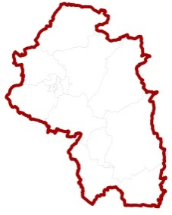
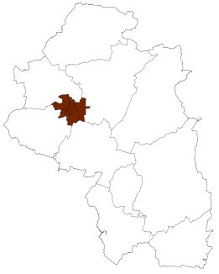
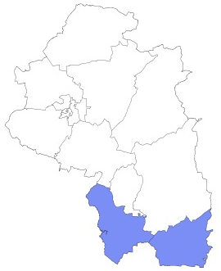
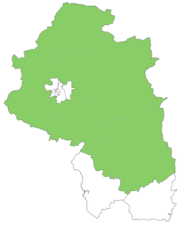
Demography – population and working age population
2
Winchester District (120,700)
Winchester District had a population of 120,700 in mid-2015. This accounted for approximately 8.9% of Hampshire County Council’s overall population. The district has a population density of approximately 1.8 persons per hectare, unchanged since 2011.
The district has a small proportion of working age individuals in comparison to the UK (63.3%) and the South East (62.2%) but is higher than the Hampshire average (60.9%). The elderly population (aged 65+) in Winchester district is larger than across the UK (17.8%) and the South East (18.8%) however is slightly lower than across Hampshire as a whole (20.7%).
In Mid 2015 Winchester Town accounted for 28.7% of the district population. Winchester Town has a much larger proportion of working age individuals than the district, the county and the other sub-areas at 66.1%; well above both the UK and South East comparators. The large student population in the city is a contributing factor.
Winchester South accounts for the smallest proportion of the total population at 17.1%. The working age population is slightly larger proportionally than for the district and the county as a whole, however is still slightly below the UK and the South East Region.
The Market Towns and Rural areas of Winchester account for over half of the district population at 54.1%. The Working age population is much smaller than in comparator areas at only 58.2%, whilst the elderly population is larger.
18.3%
61.1%
20.5%
0-15
16-64
65+
Winchester Town (34,700)
17.6%
66.1%
16.3%
0-15
16-64
65+
Winchester South (20,700)
18.7%
62.1%
19.1%
0-15
16-64
65+
Winchester Market Town and Rural (65,300)
18.6%
58.2%
23.2%
0-15
16-64
65+
Source: ONS, Mid Year Estimates,2015

Slide 12
Demography – population distribution by age
3
Winchester District
Winchester Town
Winchester District has a large but declining child population. There are peaks amongst those aged 16-25 as a result of the University population in the district. There is a smaller cohort in the youthful working ages with higher proportions of individuals who are progressing into the latter stages of their working lives. There is a large and growing elderly population in the district.
Winchester Town has a stable population in almost all age groups with little variation. The most prominent feature of this area is the marked bulge in the ages 16-25. This represents the University student population that is resident in the area. These age groups are also noticeably skewed towards females.
Winchester South much like Winchester Town, has a stable age structure. There are similar proportions of individuals in the young age groups as there are in the working ages with a slight increase in those aged 40-65. The elderly population is proportionally small.
Market Towns and Rural areas have a distinct age structure. They have a proportionally large child population. There is a dearth of individuals in the younger working ages, with a distinct bulge of individuals aged 40 and over and a large population aged 65+. The shape of this pyramid portrays an area in which high house prices may deter young people from living, with more professionally experienced and wealthy older individuals resident.
65+
65+
16-64
16-64
0-15
0-15
Male Female
Male Female
Winchester South
Winchester Market Towns and Rural
65+
65+
16-64
16-64
0-15
0-15
Male Female
Male Female
Source: ONS 2015,

Slide 13
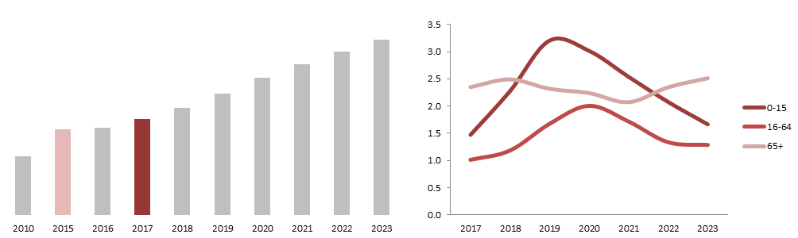
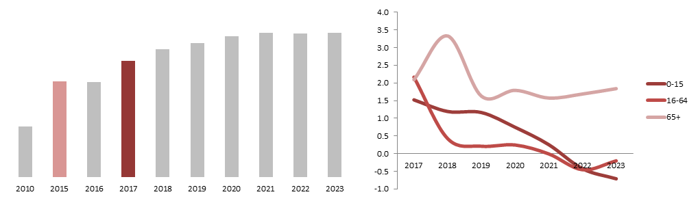
Demography – population projections
4
Winchester District
Winchester District grew by 0.8% per annum between 2010 and mid 2015. This is projected increased 0.8% p.a. over the next 2 years to 122,650 in 2017.
Hampshire County Council SAPF estimates growth of 14,500 individuals to reach a total population of 137,150 by 2023 (+1.9% p.a). England and the South East are forecast by the ONS to grow +0.8%/ +0.9% p.a to 2023.
The working age population (16-64) is expected to grow by 1.5% p.a (England/SE 0.3% p.a), with highest growth of 2.0% between 2019/2020. The number of working age individuals is forecast to grow by 7,030 between 2017 - 2023 to reach 80,620. The population aged 65+ is set to increase by 3,840 by 2023 at a rate of 2.3% p.a.(England/SE 1.9/2.0%).
Winchester Town grew by 0.9% p.a between 2010 and mid 2015. The population increased by a further 1% p.a over the next 2 years to 35,390 in 2017.
SAPF estimates a growth of 940 individuals to reach a total population of 36,330 by 2023 (0.4% p.a). England and the South East are forecast by the ONS to grow on average 0.8%/0.9% p.a.
The working age population is expected to remain stable with no growth projected between 2017 and 2023 (England/SE 0.3% p.a). The number of working age individuals is forecast to grow by 47 to reach 22,890 by 2023.
The population aged 65+ is set to increase by 750 by 2023 at a rate of 2.0% p. a. (England/SE 1.9/2.0%)
Total Population
Growth p.a. Population Sub Groups
137,150
120,700
122,650
Winchester Town
Total Population
Growth p.a. Population Sub Groups
36,330
35,390
34,690
Source: ONS 2015, HCC 2016

Slide 14
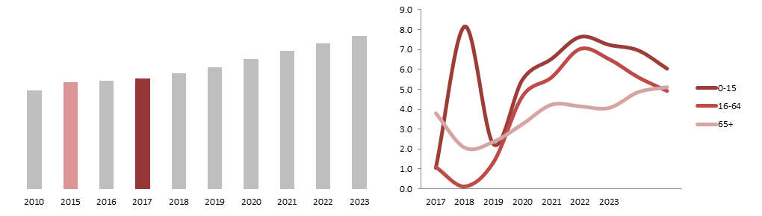
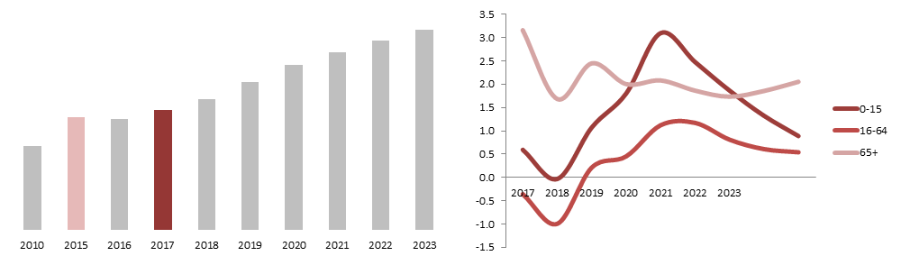
Demography – population projections
5
Winchester South
Winchester South grew by 1.6% per annum between 2010 - 2015. The population increased 1.9% p.a. over the next 2 years to 21,520 in 2017.
Hampshire County Council SAPF estimates growth of 8,390 individuals to reach a total population of 29,910 by 2023 (+5.6% p.a). England and the South East are forecast by the ONS to grow +0.8%/ +0.9% p.a to 2023.
The working age population (16-64) is expected to grow by 5.7% p.a (England/SE 0.3% p.a), with highest growth of 7.0% between 2019/2020. The number of working age individuals is forecast to increase by 5,180 between 2017 - 2023 to reach 18,260. The population aged 65+ is set to increase by 1,180 by 2023 at a rate of 4.3% p.a.(England/SE 1.9/2.0%).
Winchester market towns and rural grew by 0.6% p.a between 2010 and mid 2015. The population increased by a further 0.4% p.a over the next 2 years to 65,720 in 2017.
SAPF estimates a growth of 5,200 individuals to reach a total population of 70,920 by 2023 (1.3% p.a). England and the South East are forecast by the ONS to grow on average 0.8%/0.9% p.a.
The working age population is expected to grow at 0.9% growth p.a between 2017 and 2023, three times as fast as England and the South East. The number of working age individuals is forecast to increase by 1,810 to reach 39,470 by 2023.
The population aged 65+ is set to increase by 1,920 by 2023 at a rate of 1.9% p. a, similar to the England average.102
Total Population
Growth p.a. Population Sub Groups
29,910
20,750
21,520
Market Town and Rural
Total Population
Growth p.a. Population Sub Groups
70,920
65,260
65,720
Source: ONS 2015, HCC 2016

Slide 15
Labour Market - resident employment
6
Number of Residents in Employment in 2016
In 2016 the number of residents in employment in the Winchester District was 57,500 (76.5%), and approximately 9% of the Hampshire County Council total. By Winchester sub-area, the Market Town & Rural sub-area accounts for just over two thirds of all resident workers (39,200). This followed much smaller resident populations in the Winchester Town (13,900) and Winchester South (4,400) sub-areas.
All three sub-area employment rates are above the national average. Winchester Town has the highest of all the comparison areas at 80.9%, and while marginally above the county average is over 5.9 percentage points above the Market Town & Rural employment rate (75%). The South Winchester rate sits in the middle and marginally above the district average.
The higher employment rate in Winchester Town reflects employment opportunities within the sub-area, and also good road and rail connections to other employment centres.
Comparable data against 2010 levels is not available at the sub-area, but nonetheless district employment rates have improved since 2010, although at a much slower pace in Winchester (+1.5 percentage points) when compared to the county and national average, although from a relatively high baseline..
The Winchester Town sub-area employment rate would place it in the 25% highest local authority district/unitary rates in the UK. The Winchester South sub-area is above the median, while the Market Town & Rural sub-area sit just below the median value. Southampton (71.4%) is the only authority in the Hampshire Economic Area with an employment rate in the lowest 25% nationally.
4,400
13,900
39,200
57,500
659,800
30.30 million
Winchester
South
Winchester
Town
Market Town
& Rural
Winchester
District
Hampshire CC
UK
2016 Employment Rate
(% 16-64yrs)
Change on 2010
(percentage points)
2016 Employment Rate Distribution (Local Authority Districts/Unitary)
1st Quartile 71.9%
Median 75.5%
3rd Quartile 79.1%
Lowest61.3%
Highest 89.6%
UK
Market Town
& Rural
Winchester
District
Hampshire CC
Winchester
South
Winchester
Town
Source: ONS 2016

Slide 16
Labour Market - resident economic exclusion
7
2016 Economic Inactivity Rate
(% 16-64yrs)
Change on 2010
(percentage points)
The economic inactivity rates in Winchester District (20.7%) are lower than the national average (22.3%), but are above the county average (17.1%).
There is a large variation in economic inactivity across the sub-areas, ranging from 15.6% in Winchester Town to 22.1% and 22.5% in the market Town & Rural and South Winchester sub-areas respectively.
At the district and higher geographies there are also differences in the reasons given for economic inactivity. Winchester district has a higher proportion of economically inactive residents who are students or looking after children/family compared to Hampshire and UK, and in contrast proportionately fewer long term sick. Reasons at the sub-area are not available.
With a 1.6 percentage point increase between 2010 and 2016, economic inactivity in Winchester District is proportionately higher now. This is in stark contrast to both Hampshire and the UK where economic inactivity is lower than in 2010.This could be due to the growth in student numbers or more people looking after families/household.
Although a narrower measure of unemployment, the unemployed benefit claimant count shows very low levels of unemployment across all three sub-areas, although unsurprisingly it is highest in the urban Winchester Town sub-area where three wards have unemployment rates of 1.0% to 1.1% (St Barnabas, St Bartholomew and St John and All Saints). The steady low rates of unemployment in Winchester mean changes are smaller over time.
May 2017 Claimant Count
(% 16-64yrs)
Change on May 2010
(percentage points)
Source: ONS 2016

Slide 17
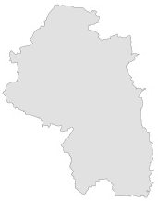


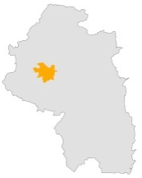


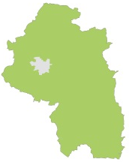


Labour Market - commuter flows and rural to urban flows
8
Winchester District
Winchester district gains more workers through in-commuting than it loses to other areas via out-commuters, to give a net worker population of over 18,000. This differs to Hampshire which is a net exporter of over 30,000 workers; mostly to Berkshire, Surrey and London.
Eastleigh and Southampton are both the primary destination for Winchester out-commuters and also the point of origin for in-commuters. Easy access to the M3 via the M27 and good rail links facilitates this two way movement, albeit skewed inward to Winchester. This is different to Hampshire’s mostly outward and north facing flows.
The large movements mean that Winchester is not a travel-to-work area where 75%¹ of residents both live and work in the area as a ratio of the resident and workplace populations. The larger in-commuter flows gives a workplace self-containment of 45% and relatively smaller out-commuter flows a resident self-containment of 59%.
Urban Winchester is effectively the Winchester Town sub-area, and the rural area (including market towns and villages) the other two sub-areas combined.
Although both the rural resident and workplace populations are larger than their urban counterpart, the latter has a much larger net worker population. However, this does mean that urban Winchester is more dependent on external labour pool to meet local demand. Furthermore, as only 21% of the rural population commutes to urban Winchester and 24% from urban to rural Winchester also mean that external flows are key to supplying labour.
18,362*
Net Worker population
57,793*
Resident Worker Population
76,154*
Workplace Worker population
Urban Winchester
13,002
Urban Net Worker population
15,703**
Urban Resident Population
28,705
Urban Workplace Worker population
Rural Winchester
5,328
Rural Net Worker population
42,047
Rural Resident Population
47,375
Rural Workplace Worker population
**excludes Badger’s Farm/Oliver’s Battery, Harestock and Littleton that for business and employment terms are classified as not urban.
Source: ONS 2011 Census. *The sum of the sub-areas and rural/urban will differ to the district due to changes made by ONS disclosure procedures that randomly alters small area data. ¹ Can be lowered to 67% for larger urban areas.

Slide 18
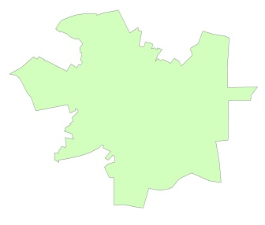
Labour Market - commuter flows (Winchester Town)
9
Out-commute
Basingstoke & Deane (467)
As the primary district employment centre, the Winchester Town sub-area has a strong pull factor for labour, with a net inflow of around 13,000 workers. This reflects significant private and especially public sector workplaces.
Winchester Town has a resident worker population of 15,700, of which just under 7,000 out-commute. The largest out-flow is to the Market Town & Rural sub-area, although a proportion of this will be from adjacent residential areas outside the sub-area definition. While there are northward flows to Basingstoke & Deane and to London, the flows are mostly southwards. Within the local area the main method of travel is by foot. The main method of travel outside the sub-area is by car.
The Winchester Town sub-area has a workplace based population of over 28,700, of which close to 20,000 are in-commuters. The largest in-flow is from the Market Town & Rural sub-area, although a proportion of this will be from adjacent residential areas. Eastleigh, Southampton and Test Valley are also significant places of origin. The main method of travel is by car (M27/M3), although there is a sizeable proportion that travel from Eastleigh and Southampton by train.
In terms of self-containment the resident ratio is 0.57 as there are more sub-area resident workers relative to out-commuters. The workplace ratio of 0.31 reflects far more in-commuters to the sub-area workforce than locals i.e. close to two thirds are in-commuters.
Westminster, City of London (480)
Resident Worker Population: 15,703
Live & Work Locally: 7,900
No fixed place: 1,060
Out-commute: 6,692
Resident Self-Containment Ratio: 0.57
Rest of London (519)
6,692
Test Valley (407)
Market Town & Rural
(1,514)
Key:
The map shows out-commuter flows to the sub-areas and to destinations with 400+ Out-commuters. The sum of destinations shown accounts for 4,683 out-commuters (70% of the total).
Eastleigh (547)
Southampton (749)
South Winchester sub-area
(122)
In-commute
Net inflow 13,002
Basingstoke & Deane (750)
Workplace Population: 28,705
Live & Work Locally: 7,900
No fixed place: 1,060
In-commute: 19,745
Workplace Self-Containment Ratio: 0.31
East
Hampshire (589)
Test Valley (2,075)
19,745
Key:
The map shows in-commuter flows from the sub-areas and origins with 400+ in-commuters. The sum of origins shown accounts for 16,412 in-commuters (83% of the total).
Market Town & Rural
(5,000)
Eastleigh (4,167)
New Forest (834)
South Winchester
(309)
Southampton (2,206)
Fareham (791)
Source: ONS 2011 Census

Slide 19
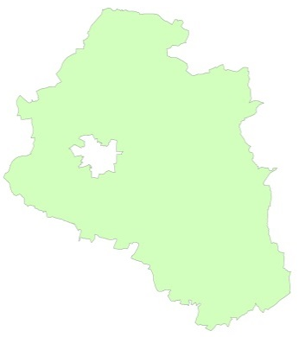
Labour Market - commuter flows (Market Town & Rural)
10
Basingstoke & Deane (1,044)
The Market Town & Rural sub-area is an exporter of labour with a net outflow of around 2,400 workers. This reflects fewer employment opportunities in the rural areas and demand from the urban area.
The Market Town & Rural sub-area has a resident worker population of approximately 31,900, of which just under 18,400 out-commute. The largest out-flow is to the Winchester Town sub-area, although a proportion of this will be from adjacent residential areas just outside the sub-area boundary. While there are northward flows to Basingstoke & Deane and to London, the flows are mostly southwards.
Within the local area the main method of travel is by car, which reflects the rural landscape. The main method of travel outside the sub-area is also by car.
The sub-area has a workplace based population of over 29,000, of which close to 16,000 are in-commuters. The largest in-flow is from Eastleigh, while Southampton and Test Valley are also significant places of origin. The Swindon figure looks anomalous as 2001 Census flow data does not show any significant connections with Winchester. In flows are mostly from the Solent LEP area to the south. The main method of travel is by car.
In self-containment terms there is a resident ratio of 0.42 i.e. there are more out-commuters in the resident worker population relative to local workers. The workplace ratio of 0.46 also means there are marginally more in-commuters relative to local workers. Overall, more than half or all labour in the sub-area commutes which places pressures on infrastructure.
Out-commute
Net outflow 2,412
Westminster, City of London (654)
Resident Worker Population: 31,853
Live & Work Locally: 10,999
No fixed place: 2,472
Out-commute: 18,382
Resident Self-Containment Ratio: 0.42
Winchester Town
(5,000)
Rest of London (524)
18,382
East
Hampshire (709)
Test Valley (1,039)
Key:
The map shows out-commuter flows to the sub-areas and to destinations with 400+ Out-commuters. The sum of destinations shown accounts for 14,818 out-commuters (81% of the total).
South Winchester
(734)
Eastleigh (1,891)
Portsmouth (746)
Southampton (1,661)
Fareham (816)
In-commute
Basingstoke & Deane (576)
Swindon (1,458)*
Workplace Population: 29,441
Live & Work Locally: 10,999
No fixed place: 2,472
In-commute: 15,970
Workplace Self-Containment Ratio: 0.46
Wiltshire (646)
East
Hampshire (716)
Winchester Town
(1,514)
Test Valley (1,662)
15,970
Key:
The map shows in-commuter flows from the sub-areas and origins with 400+ in-commuters. The sum of origins shown accounts for 13,108 in-commuters (82% of the total).
*A degree of uncertainty over the validity of this figure.
Eastleigh (3,147)
New Forest (547)
South Winchester
(419)
Southampton (1,670)
Fareham (753)
Source: ONS 2011 Census

Slide 20
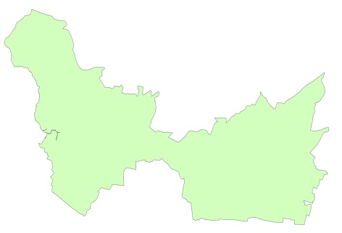
Labour Market – commuter flows (South Winchester)
11
Winchester Town (309)
The South Winchester sub-area has a medium sized pull factor for labour with a net inflow of over 7,000 workers. However, given the Market Town & Rural sub-area has a net loss of workers, the South Winchester sub-area provides 100% of the net inflows to rural Winchester. This will mostly be to Segensworth North and Solent Business Parks rather than the rural hinterland.
The South Winchester sub-area has a small resident worker population of approximately 10,000, of which over 6,000 out-commute. The largest out-flow is to Portsmouth. While there are some limited northward flows from the sub-area to Southampton and Winchester, the flows are predominantly southward-facing. Within the local area the main method of travel is by car, although travel by foot was also sizeable. The main method of travel outside the sub-area is overwhelmingly by car.
The South Winchester sub-area has a workplace based population of close to 18,000, of which over 14,000 are in-commuters. The largest in-flow is to the South Winchester is from Fareham. Eastleigh, Gosport, Havant and Portsmouth are also significant places of origin. The main method of travel is by car with good access to the business parks off the M27.
In terms of self-containment this gives a low resident ratio of 0.36 as there are far more out-commuters in the resident worker population relative to local workers. The workplace ratio of 0.20 is very low, with only one in five of the sub-area workforce locally based – due to a smaller resident population and large influx of labour to the sub-area e.g. to the Solent Business park
Out-commute
Southampton (513)
Market Town & Rural
(419)
Resident Worker Population: 10,194
Live & Work Locally: 2,821
No fixed place: 801
Out-commute: 6,572
Resident Self-Containment Ratio: 0.36
Eastleigh
(596)
6,572
Havant
(860)
Key:
The map shows out-commuter flows to the sub-areas and to destinations with 400+ Out-commuters. The sum of destinations shown accounts for 4,884 out-commuters (74% of the total).
Fareham (961)
Portsmouth (1,186)
In-commute
Net inflow 7,740
Winchester Town (122)
Workplace Population: 17,934
Live & Work Locally: 2,821
No fixed place: 801
In-commute: 14,312
Workplace Self-Containment Ratio: 0.20
Southampton (1,492)
Market Town & Rural
(734)
Eastleigh
(1,518)
East
Hampshire (589)
14,312
Havant
(1,141)
Key:
The map shows in-commuter flows from the sub-areas and origins with 400+ in-commuters. The sum of origins shown accounts for 11,880 in-commuters (83% of the total).
Fareham (3,399)
Gosport (1,186)
Portsmouth (1,840)
Source: ONS 2011 Census

Slide 21
Enterprise – stock, growth and share by sub-area
12
Business Growth p.a. (%) 2010 - 2016
In 2016 there were around 8,200 local business units in Winchester. This accounts for approximately one in eight businesses in the Hampshire County Council area.
Almost half of all businesses in Winchester are found in the Market Town and Rural sub-area (4,000 or 48.8%). With more than a quarter of all businesses (2,255 or 27.5%) Winchester Town sub-area has the second largest concentration. This is followed by 1,940 or nearly a quarter of all businesses located in South Winchester.
The period from 2010 to 2016 saw the number of Winchester businesses increase by nearly 1,200 or 2.6% per annum which is comparable with the national average. South Winchester experienced the fastest annual average growth in business stock amongst the sub-areas (4.2% or double the Hampshire average).
Business growth in the Winchester Town sub-area (2.8%) was above the Winchester district average, while the slowest growth was found in the Market Town and Rural sub-area (1.8%).
With 425 additional businesses since 2010 South Winchester accounted for about 36% of the overall increase in total business stock in Winchester District. Market Towns & Rural gained 415 additional businesses or about 35% of the increase in Winchester district between 2010 and 2016. Winchester Town accounted for about 29.1% or 345 businesses.
By 2016 Market Town & Rural saw its share of business stock reduced to 48,8%, from 51.1% but the share of South Winchester increased to 23.7%. The share of Winchester Town in the overall stock of Winchester district remained broadly unchanged at about 27.5%.
Share at Winchester district business stock (2010 and 2016, %)
Share of total business growth
by sub-area, 2016
Source: ONS 2016

Slide 22
Enterprise – distribution by size and sub-area
13
Businesses by Employment Size-Band (2016, %)
There are 30 large businesses (+250 employees) and 210 medium businesses (50-249 employees) in Winchester district which represents 0.4% and 2.6% respectively of all businesses in the area. These proportions are comparable both the Hampshire and the UK average.
With 15 large and 80 medium businesses sized Winchester Town has more large (0.7%) and medium businesses (3.5%) than other sub-area and the comparator areas (Hampshire and the UK).
Some 385 firms or one in four businesses in South Winchester are small businesses (10-49 employees), the largest share among the three sub-areas. With 1,485 firms (76.5%) South Winchester has the smallest proportion of micro-businesses.
The highest proportion of micro businesses (0-9 employees) is found in Market Towns & Rural sub-area (88.8% or 4,000 businesses). This sub-area has the lowest proportion of firms in the other three size-bands (+9 employees) in Winchester and its share is lower than in Hampshire or the UK.
In 2016 97.3% of all firms in the district were private firms compared to 95.5% in 2010. All sub-areas saw the share of private firms increase since 2010. The largest increase was in Winchester Town, from 90.6% in 2010 to 95.6% in 2016) than in South Winchester and Market Towns& Rural were the share of private firms was broadly unchanged.
In Market Towns & Rural significant private employers are found in information & communication while South Winchester has strong presence across the board.
Private and Public
sectors in Winchester (%)
2010
2016
Public sector (4.8)
Public sector (2.8)
Private sector (95.5)
Private sector (97.3)
Source: ONS 2016.

Slide 23
Enterprise – distribution by broad sector and sub-area
14
Broad Sector Share by sub-area (2016, %)
Business services is the largest broad sector in Winchester with 2,400 businesses or nearly 30% of all businesses in Winchester district. This is proportionally greater than in both Hampshire (26.4%) and in the UK (24.1%). Within this broad sector the professional, scientific & technical sub-sector accounts for around one in five businesses in Winchester. In Winchester Town this sub-sector accounts for a quarter of all business.
Distribution, transport, accommodation & food is the largest broad sector in Winchester South as it accounts for about 36% of all businesses in the area. Within this broad sector, retail accounts for two thirds of all businesses in this broad sector and retail accounts for 23.7% (460) of all businesses in this sub-area.
Business services account for just over a fifth of all businesses in South Winchester which is lower than in the other two sub-area but these tend to be high value added businesses and on average larger employers than elsewhere.
With some 1,200 local businesses (30% of all businesses in the sub-area) the broad business services sector is the largest sector in the Market Towns & Rural sub-area. These firms tend to be on average smaller than elsewhere in the area.
Construction (425 businesses), information & communication (360) and agriculture (350) are overrepresented in Market Town & Rural as they account for around one in 10 businesses respectively in Market Town & Rural.
Finance & insurance is relatively small but highly productive sector. The largest number of firms is in Winchester Town but the largest share is found in South Winchester (2.8%).
Source: ONS 2016

Slide 24
Enterprise - broad sector concentration
15
Information & communication and business services businesses are overrepresented in Winchester relative to the national average. Business in these two broad sectors are about 1.2 times as concentrated in Winchester as in the UK.
The largest urban area unsurprisingly has a concentration of the broad public sector (1.2 times the national average) and real estate (1.3 times the national average). This sub-are has a concentration of highly productive information & communication firms at about 1.3 times the national average and business services at about 1.4 time the national average (40% above the national average).
Agriculture, forestry & fishing is relatively small sector but in Market Towns & Rural sub-area it is about 1.7 times as concentrated as across the UK. The broad public sector is about 1.3 times as concentrated as the national average. This mostly includes education and health establishments. A major contributor to the rural economy is found in its relatively high concentration of information & communication businesses (1.3 times the national average or 30% above the national average).
The South Winchester sub-area has a business concentration in distribution, transport, accommodation & food sector of about 40% above the national average. Within this broad sector, retail is 2.5 times as concentrated in this sub-area as the national average.
Real estate is about 1.2 times as concentrated in South Winchester than in the UK. Finance & insurance is over-represented in the area (20% above the average) and this sector is a major contributor to its competitiveness.
Business (local business unit) concentrations relative to the national (UK) average, where 1.0 is equal to national concentration and values above this suggest a local employee
concentration.
Winchester Town
1.4
1.2
Public Admin, education & health
1.3
1.3
Market Towns & Rural
Distribution, transport, accommodation & food
1.3
1.3
1.7
Business services
Information & communications
Construction
Financial & insurance
Other services
Real estate
1.2
1.2
1.4
Agriculture, forestry & fishing
South Winchester
Source: ONS 2016

Slide 25
Enterprise – fastest growing sectors by sub-area
16
Fastest increase in the number of businesses* by sub-area (2010-2016)
Winchester had some 630 additional businesses in the broad business services sector in 2016 compared to 2010. This broad sector was the fastest growing sector in Winchester (5.2% p.a.) and this sector accounted for 53% of the overall growth in business stock since 2010.
High value added professional, scientific and technical firms accounted for 420 of the growth in business services. This is one of the factors that helps explain the strong growth in the economy since 2010.
Another strong performer was another highly productive sector – information and communication.
This broad sector was one of the top three best performing sectors in Winchester District and South Winchester (115 and 45 new businesses respectively since 2010).
Business services was the fastest growing sector in Market Town & Rural but this area saw strong growth in the broad public sector and the broad agriculture sector (45 new agricultural businesses in the sub-area).
The number of public sector establishments increased by 60 or 3.5% on average p.a.. Much of this growth was driven by health (45 additional establishments).
South Winchester saw strong growth in the broad distribution and business services sector (135 additional firms respectively). Retail was a strong performer with 115 additional firms. ICT was a strong performer.
Winchester Town had 55 fewer public sector establishments, South Winchester 10 fewer wholesale businesses while production, wholesale and motor trade weakened in Rural
Largest Change in Employee Numbers 2010-2016
Business services
Distribution Transport,
Accommodation & food
ICT
Winchester District
+630
+170
+115
Business services
ICT
Distribution Transport,
Accommodation & food
Winchester Town
+245
+45
+40
Business services
Public administration;
education; health
Agriculture, forestry
& fishing
Market Towns & Rural
+255
+60
+45
Distribution, Transport,
Accommodation & food/
Business services
Real Estate
Activities
ICT/Construction
South Winchester
+135
+35
+30
Growth in the number of businesses by sub-area (% p.a.)
Winchester District
Winchester Town
Market Towns & Rural
South Winchester
Source: ONS 2016 Note: Due to rounding the sub-area figures will not sum to the district total. *Excluding Agriculture, Forestry & Fishing.

Slide 26
Enterprise - high value added sectors by sub-area
17
2016 Sector Share (%)*
Enterprise M3 and Solent Local Enterprise Partnerships (LEPs) have a concentration of several high-value added sectors in their areas. These sectors are ‘based on a ‘narrower’ definition and not the broad official definition as used by ONS. The narrow sectoral definition is based on a set of Standard Industrial Classification (SIC) codes. In some instances the definition used in this paper is narrower than the LEP definition.
The financial & professional services sector (the high value added end of the broad business services and finance sectors) is the dominant high-value added sector in the Winchester economy. This sector accounts for about 17% of all high value added businesses in Winchester district (1,420 businesses). Winchester compares favourably with both the Hampshire average and the UK average.
One in five of all high-value added businesses in Winchester Town are found in this service sector but Market Towns & Rural also has a high proportion of firms in this sector (18%). South Winchester has a lower proportion of firms but a higher proportion of SMEs.
ICT & Digital Media sector accounts for one in 10 high-value added businesses in both Winchester Town and Market Towns & Rural.
Tourism and Visitor Economy is of strategic importance to the economy of Winchester Town and it is more important to Market Towns & Rural than South Winchester.
Aerospace & defence accounts for a relatively few number of firms (30) but they tend to be larger firms. This sector is of importance to South Hampshire and Market Towns & Rural (10 businesses respectively).
Source: ONS 2016. Note: sector definition is based on firms involved in higher-value added activities. The percentages need to be treated with a degree of caution as there is a small degree of double counting i.e. marine sector.

Slide 27







Enterprise - high value added sector growth
18
Number and Average Annual (%) Growth 2010 - 2016
The Financial & professional services sector has added the most businesses to the economy of Winchester since 2010 (365 businesses). Business growth in this high value added sector was 5.1% p.a.
Winchester Town and Market Town & Rural had 130 and 165 additional businesses in this sector in 2016 compared to 2010.
The broad ICT & Digital Media sector added 105 additional businesses to the Winchester economy since 2010 with 40 additional businesses in both Winchester Town and Market Towns & Rural and 25 additional ICT businesses in South Winchester.
These are relatively large sectors and it is not surprising that they have seen the largest increase in the absolute number of business.
The fastest relative increase in the number of businesses was in a number of smaller sectors.
Average annual growth in the marine sector was about 12% (10 new businesses since 2010). Business growth was registered in Winchester Town and market Towns & Rural.
Business growth in the aerospace & defence sector was robust, about 7% p.a. This sector had 10 additional businesses in 2016 compared to 2010. Business growth was mostly found in the South Winchester sub-area.
The broad engineering and marine sector had 75 additional businesses in 2016 compared to 2010. Business growth in this sector was also robust (about 4% on average p.a.).
Two thirds of business growth in tourism & visitor economy was in Winchester Town.
Logistics was the only sector that shrunk on 2010. Market Towns & Rural had 25 fewer businesses in 2016 compared to 2010.
Winchester District
Winchester Town
Market Towns & Rural
South Winchester
EM3 Sectors
Financial & Professional
365, +5.1%
130
165
70
ICT & Digital Media
105, +2.6%
40
40
25
Logistics*
-10, -0.4%
15
-25
0
Aerospace & Defence
10, +7%
0
0
5
Marine
10, +12.2%
5
5
0
Solent Sectors
Engineering & Marine
75, +4%
20
30
20
Tourism & Visitors
65, +2.3%
45
0
20
Source: ONS 2016

Slide 28
Enterprise - high value added sector concentration
19
High concentration of high-value added activities is one of the main factors that helps to explain relatively strong performance of the economy of Winchester and most of its sub-areas. This is in particular true in regard to several high value added services.
Winchester district has a business concentration in financial & professional services that is about 1.3 times the national average. Winchester Town sub-area has a business concentration of about 1.6 times the national average. South Winchester has fewer businesses but they tend to be on average larger businesses.
Businesses in ICT & digital media in are about 10% overrepresented in Winchester District relative to the national average. Winchester Town and Market Towns & Rural have business concentration that is about 1.2 times the national average (20% above the average)
Aerospace & defence is small but significant sector to the economy. Business concentration of this sector in Winchester district is almost double the national average with all sub-areas over-represented relative to the national average. The highest concentration is found in South Winchester, 2.7 times the average.
Marine is another sector that is over-represented in all sub-areas relative to the national average. Business concentration in this sector ranges from about 1.2 time the national average in Winchester Town to 1.4 in South Winchester.
The broad engineering & marine sector is as represented as in the UK but logistics is under-represented relative to the national average.
Sector employee concentrations relative to the national average, where 1.0 is equal to national concentration and values above this suggest a local employee
Concentration.
Winchester Town
1.6
1.2
1.2
1.2
Market Towns & Rural
1.3
1.2
1.3
1.3
1.4
2.7
South Winchester
Source: ONS 2016

Slide 29
Employment – distribution by broad sector
20
2015 Broad Sector Share (%)
The workplace data covers employees and will under estimate total employment numbers in Winchester. The latest data shows quite different employee profiles across the three sub-areas.
Winchester has approximately 81,000 employees. As with most major urban centres with multiple civic and shopping centres there is a natural concentration of public sector and retail employment, and the Winchester Town sub-area is no different. Over 70% work in these two broad sectors, with half of all workplace-based employees in the Winchester Town sub-area in the public sector (15,500), and further fifth in distribution, transport, accommodation and food (6,850); of which almost half is retail based (3,000). This makes the sub-area potentially more vulnerable to certain economic shocks, exposure to online shopping and consumer sentiment. In contrast, fewer than 1 in 10 South Winchester employees are employed in the public sector, although one third is in distribution/retail. The Market Town & Rural sub-area is closer to the district average (1 in 3 workers).
Proportionately, there is a much higher share of ICT sector employees (14%, 3,500) in the Market Towns & Rural sub-area, however, employee figures are skewed by the single large IBM premises at Hursley.
South Winchester is geared to private sector employment, notably in the distribution, transport, accommodation & food sector (36%, 8,800), followed by the business services (21%, 5,000) and financial and insurance (12%, 3,000) sectors facilitated by prime employment opportunities such as Solent Business Park.
72% in public sector & retail
57% in public sector & retail
The Real estate activities and Agriculture, Forestry & Fishing sectors combined vary between 1% (South Winchester) and 3% (Market Towns and Rural) of sector share across the areas.
Source: ONS 2016

Slide 30
Employment - fastest growing sectors by sub-area
21
Top Three Growth Sectors (2010-2015)
Employee growth since 2010 will be influenced by a number of factors e.g. demand factors, resilience to economic shocks, sectoral composition, new development opportunities, etc.
Overall, employee numbers across the district have grown by an estimated 10,100 workers between 2010 and 2015, or 2.7% per annum. Allowing for rounding, the data suggests South Winchester has been the main driver of employee growth since 2010 (+6,200, 6.1% per annum), accounting for three quarters of all employee growth. The location of business parks will have played an important part in this, with more land and space for development and job creation. The slowest growth has been in the Winchester Town sub-area (approx +800, 0.5% per annum) followed by Market Towns & Rural (approx +1,000, 0.8% per annum). In both areas growth was constrained by the public sector and perhaps by some natural barriers such as land.
In absolute term the broad distribution, transport, accommodation & food sector has performed well in most areas. This varies within the sub-sector with accommodation the largest driver in Market Towns & Rural, accommodation/food and beverages in Winchester Town and retail in South Winchester (Whiteley Village Shopping Centre development). Other services also saw strong growth in the Market Towns & Rural and in Winchester Town.
In relative terms ICT, other services, finance and insurance, construction, and real estate were the largest growth sectors. ICT has performed strongly in two sub-areas.
Largest Change in Employee Numbers 2010-2015
Distribution Transport,
Accommodation & food
ICT
Public admin/Other services
Winchester District
+4,250
+1,500
+2,000
Distribution Transport,
Accommodation & food
Business services
Other services
Winchester Town
+1,000
+250
+250
Distribution Transport,
Accommodation & food
Construction
Other services
Market Towns & Rural
+450
+250
+2,000
Distribution Transport,
Accommodation & food
Financial & insurance
ICT
South Winchester
+3,100
+1,000
+650
Largest Average Annual Growth Rates 2010-2015 (average % per annum)
Winchester District
Winchester Town
Market Towns & Rural
South Winchester
Source: ONS 2016
*Excluding Agriculture, Forestry & Fishing as the numbers are relatively small and covered more extensively under Land-based sectors

Slide 31
Employment - broad sector concentration
22
The Winchester Town sub-area has, unsurprisingly, a concentration in public sector employment that is almost two times larger than the national average. The sub-area is home to many public sector institutions, such as the University of Winchester, the Royal Hampshire County Hospital, HM Prison Winchester and two local authority headquarters.
The sub-area also has a smaller concentration in real estate that is 20% above the national average, and this might reflect a higher concentration of letting agents servicing the student/private rental population.
The Market Town & Rural sub-area has an employee concentration in ICT almost 3.5 times the national average; although the IBM premises at Hursley will be an underlying factor. There is a local concentration in agriculture and forestry that is ten times the national average.
Construction and other services are also above national average reflecting a prevalence of small construction businesses and also tourist attractions and businesses in semi and rural areas.
The South Winchester sub-area has employee concentrations in financial and insurance 3.5 times the national average (mostly explained by the Solent Business Park), followed by agriculture (50% higher, and possibly influenced by the Southwick Estate, and in distribution (retail) 30% higher with the presence of the Whiteley Shopping Centre. There are also smaller concentrations in business services and ICT.
Sector employee concentrations relative to the national (GB) average, where 1.0 is equal to national concentration and values above this suggest a local employee
concentration.
Winchester Town
Legend
1.9
1.2
Public Admin, education & health
Market Towns & Rural
Distribution, transport, accommodation & food
3.4
1.4
1.2
10.2
Business services
Information & communications
Construction
Financial & insurance
3.5
Other services
Real estate
1.2
1.2
1.3
1.5
Agriculture, forestry & fishing
South Winchester
Source: ONS 2016

Slide 32
Employment - high value added sectors by sub-area
23
2015 Sector Share (%)
The high value added sectors listed in the graphic (left) are based on sectors that have been identified as important by the Local Enterprise Partnerships to their respective local economies. As Winchester City Council is a member of both LEPs the two sets of priority sectors are considered. Employee numbers can be found in the appendix.
As with the broad sectors there are more sub-area variations in these sectors than between the Winchester, Hampshire and national profiles. Winchester Town has a smaller high value sector added share than comparison areas and down to the higher number of public sector employment.
The financial & professional services is an important employer in South Winchester with one in seven workers (3,500) employed in this sector compared to one in ten for Winchester as a whole (8,000).
Proportionately, the tourism and visitor economy is an important employer in the Winchester Town sub-area (3,000). The sub-area is home to many historic attractions, restaurants and hotels that support jobs. The same sector is an equally important employer to the Market Town & Rural sub-area (3,000).
The ICT and digital media sector is disproportionately represented in the market Town & Rural sub-area, and down to the IBM site at Hursley. While there is some overlap between the marine and advance engineering sectors the data suggests the South Winchester has marginally a stronger presence, albeit from a small number employed in boat building/repairs.
Source: ONS 2016

Slide 33
Employment - high value added sector growth
24
Number and Average Annual (%) Growth 2010-2015
Employment estimates for specific sectors aggregated from detailed business activity data are less reliable due to disclosure rounding. Therefore, any sub-area changes by high value added sector need to be treated with caution and read as indicative of the size and direction of employee growth.
In terms of employees gained and the average annual rate of growth since 2010 the tourism and visitor economy has seen the largest rise with an estimated 2,000 additional workers (7% growth per annum). This will be partly down to improved economic conditions and record employment driving spending, but may also be capturing an emerging trend in consumers purchasing experiences (meals, concerts, holidays etc.) rather than tangible material goods.
Financial & professional and ICT and digital media have both seen cumulative growth of approximately 1,000 employees and annual growth of 2.7% and 3.7% p.a. since 2010. Growth in financial & professional was mostly driven mostly by South Hampshire (Solent Business Park, Whiteley and Segensworth North). Winchester Town and South Winchester saw modest growth in ICT & digital media employment.
Aerospace & defence has seen a modest growth in South Winchester , but a decline in Market Towns & Rural but any small decline or increase at local level has to be treated with a caution. Employment in engineering & marine, logistics and marine have either seen no growth or marginal losses, which broadly reflect longer term trends in declining employment and rising productivity.
EM3 Sectors
Winchester District
Winchester Town
Market Towns & Rural
South Winchester
Financial & Professional
1,000, +2.7%
NC
-500
(-5.6%)
1,000
(+7%)
ICT & Digital Media
1,000, +3.7%
300
(+8.4%)
NC
250
(+3.7%)
Logistics*
500, + 3.1%
NC
NC
NC
Aerospace & Defence
250, +2.7%
5
(+4.6%)
-175
(-10.9%)
250
(+3.1%)
Marine
-25, -4.4%
NC
NC
NC
Solent Sectors
Engineering & Marine
NC
NC
NC
NC
Tourism & Visitors
2,000, +7%
1,250
(+11.4%)
750
(+5.9%)
500
(+8.4%)
NC – No change. Sub-area changes should be treated with caution due to ONS rounding methods at sectoral and sub-district geography level. The sum of changes will not square with the district totals. View sub-area sector growth with a degree of caution due to rounding by ONS at source. No low carbon sector values available.
Source: ONS 2016

Slide 34
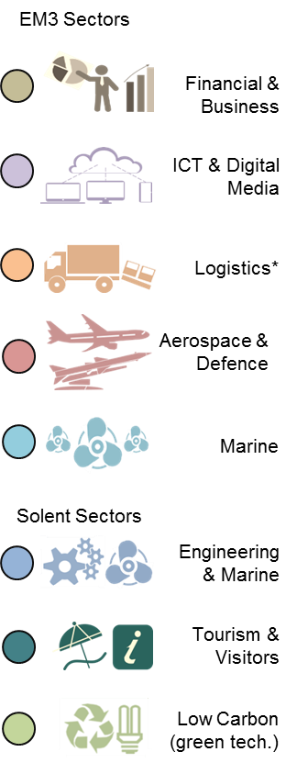
Employment - high value added sector concentrations
25
Employee concentrations in higher value added sectors are more mixed, and mainly due to lower employee estimates in some sectors and in other areas a greater concentrations in public sector employment ( as in the Winchester Town sub-area.
The Winchester Town sub-area does not have employee concentrations above the national average in any of the two LEP’s higher value added sectors. However, all of the high value added sectors are major employers in the sub-area, but with relative proportions similar to the national average.
The Market Town & Rural sub-area has an employee concentration in the ICT and Digital Media sector that is three times the national average.
While there will be other ICT businesses across the sub-area contributing to the overall concentration, the large IBM Hursley site (research and development laboratory) is a major employer in the Market Towns and Rural sub-area.
In the South Winchester sub-area employee concentrations in aerospace and defence is over seven times the national average (7.1).
This is followed by an employee concentration in financial and business services that is 70% times higher than the national average.
The sub-area also has an employee concentration of 40% higher in marine (boat building and repairs), but based on fewer employees, and 30% higher in the ICT sector.
Sector employee concentrations relative to the national average, where 1.0 is equal to national concentration and values above this suggest a local employee
Concentration.
Winchester Town
Market Towns & Rural
3.0
1.7
1.3
1.4
7.1
South Winchester
Source: ONS 2016

Slide 35







Land-based sector - overview
26
The land-based sector is an integral part of the Winchester landscape contributor to the local economy. The sector is wide ranging in scope going beyond ‘traditional’ agricultural activities to also cover inter alia; zoological parks, landscape services, veterinary services and for methodology), 1 in 5 of all Hampshire workers in this sector. By sub-area, the Market Towns & Rural unsurprisingly account for close to 3 in 4 land based workers (72%, 3,59) horticultural retail. The data should be read as indicative rather than precise estimates.
Current estimates suggest there 1,000 plus the land-based businesses, including 400 agricultural holdings (1 in 5 of all Hampshire businesses in this sector). Most of these will be micro-businesses that dominate the sector. Most businesses (78%, 800) are located in the Market Towns & Rural sub-area, while just 45 (4%) are in Winchester Town; mostly in landscape services and land-based related retail. South Winchester is home to almost one in five businesses (18%, 185). A few large land based businesses include Marwell, Vitacress and the Southwick and Tichborne estates.
Winchester has close to 5,000 land-based workers (see Appendix), reflecting the relative size of the predominantly rural sub-area. South Winchester is also mostly rural, but covering a smaller area has fewer workers. Winchester Town’s land-based employment is in related activities already described for businesses above, and while urban-based will operate mostly in rural areas. GVA 2015 estimates for the agricultural and forestry element are worth £43 million or 1% of Winchester economy, although the land-based sector as a whole will be a larger contributor.
Land-based Businesses
800
185
1,030
45
Businesses in Winchester (1 in 5 of Hampshire businesses)
Businesses in Winchester Town
Business in South Winchester
Business in Market Towns & Rural
100%
4%
18%
78%
Land-based employment
3,590
4,970
520
860
Workers in Winchester (1 in 5 of Hampshire workers)
Workers in South Winchester
Workers in Market Towns & Rural
Workers in Winchester Town
100%
11%
17%
72%
Winchester agricultural, forestry and fishing GVA = £43 million (2015). Up by £18 million on 2010, and average annual growth rate of 14.5% per annum.
Source: ONS 2016 and DEFRA 2016

Slide 36
Land-based sector - sub-sectors
27
Businesses sub-sector
By businesses and sub-sector there is little difference between Winchester as a whole and Hampshire, although Winchester has proportionately more businesses in crop and animal production and fewer land-based businesses in retail related activities.
Four fifths of Winchester businesses are either in crop and animal production (42%, 430 business) or farm holdings (38%, 394). The nature of these businesses dictate a rural base and located within the Market Towns & Rural and South Winchester sub-areas; mostly in the former based on 78% of all-land based businesses being located there. Of the remaining 20%, half of those businesses are landscape services (9%, 90) and a further quarter (5%, 55) in retail/wholesale.
Of the 5,000 land-based workers an estimated 1,300 (41%) are employed as farm labour (DEFRA source). The next largest sub-sector is botanical and zoological gardens and nature reserve activities (13%, 400), and three times the Hampshire average, with Marwell one of the larger employers in the sub-sector. Landscape services, wholesale and retail and veterinary services are also important sub-sector employers in Winchester.
Measuring growth is less robust because of mixed different sources, but data suggests an increase in the region of 100 additional land-based businesses and 500 more workers since 2010. For businesses this has mostly been in landscape services, growing of cereals and the raising of sheep/goats, but by employment almost half (46%) of growth is in veterinary and botanical/zoo/nature reserve activities.
Number of businesses in brackets
Employment sub-sector
Number of employees in brackets
Source: ONS 2016 and DEFRA 2016

Slide 37
Land-based sector - skills and drivers of change
28
UK Skills Issues
According to the Lantra national Skills Assessment (2014), the land-based sector has an aging workforce, with 30% of workers aged 55 or over, compared to 18% for all sectors. This rises to 54% when the threshold is lowered to include those aged 45 or over. Job creation through growth plays a relatively small part in the labour market – as suggested by just 500 additional workers in Winchester since 2010. Most activity is therefore down to replacement demand as older workers retire or people leave the sector.
The sector has heavy gender bias towards males, which further limits the potential pool of future workers.
Land-based workers are often highly skilled, but lack formally recognised qualifications, with one in six workers in the land-based and environmental sector failing to have any formal accredited qualifications. Locally, Winchester is home to Sparsholt College with graduate, post-graduate and apprenticeships in a wide range of disciplines, for example: agriculture, arboriculture, equine studies, veterinary nursing, horticulture and farm estates. In 2014 there were over 2,700 full-time students and over 3,000 part-time students.
There are numerous skills pressures on the land-based sector from consumer, environmental and technical (see Table left). The drivers are interdisciplinary with wide ranging and changing skillsets required. Current and future risks include economic shocks (prices), attracting labour, climate change, environmental costs, political uncertainty (e.g. Brexit) and crime.
30%
aged over 55yrs
477,000 replacements needed by 2020
68%
of workers are males compared to 54% all sector average
16%
No qualification compared to 6% all sector average
Recruitment crisis?
Gender bias
lack qualifications
Drivers for Consumer Skill Demands | Drivers for Environmental Skill Demands | Drivers for Economic and Technical Skill Demands
Business Planning (managing food price changes). | Regulation and Government (CAP/ CFP reforms). | Renewables, biofuels, carbon emission reductions, water resources
Leadership | Crop management | Raising capital
Marketing Skills | Pesticide application | IT skills
Market Analysis (niche market development) | Water Management | Scientific knowledge and understanding
Woodland Management (demand for wood fuel) | Species knowledge, understanding ecosystems | Risk management
Chainsaw Proficiency | Sustainable Forestry, Woodland Planning
Health and Safety | Livestock knowledge
Contract Negotiation
Source: LANTRA 2014 and HCC (Hampshire Rural Profile, 2017)

Slide 38




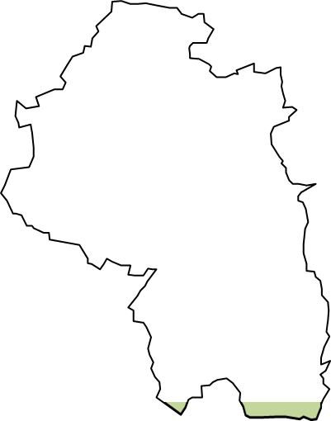
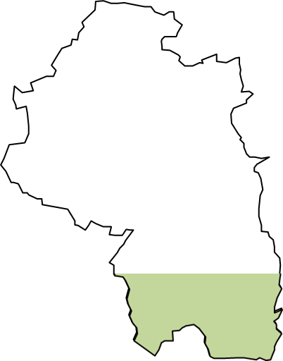
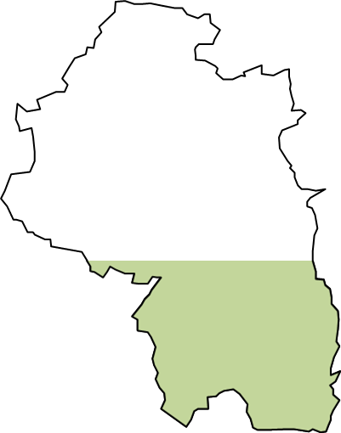
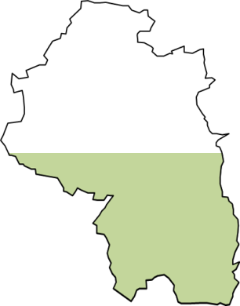
Land-based sector - challenges (Brexit & shift in use)
29
The scope of this report does not evaluate specific concerns or undertake SWOT analysis for the land-based sector in Winchester, but instead draws upon a number of studies to highlight issues concerning the sector, and more specifically agriculture and farming. The impact of Brexit is probably the most immanent and pertinent to Winchester.
A report by Savills¹ estimate a direct loss in direct EU CAP² subsidies to UK farming and agriculture from Brexit of £2.5 billion, although there is some commitment of funding under the UK Government agricultural policy until 2020⁴. Subsidy funding accounts for 57% of average UK farm income, with grazing livestock, mixed farms and cereals particularly reliant on subsidies. Almost half of Winchester’s farmland is specifically cereal production (46%) and a further 21% arable crops (non-cereal). A third is grassland (33%) and just 1% fruit and veg.
Subsidies also indirectly support the rural economy through employment – there are over 1,000+ farming based jobs and close to 400 farm holdings in Winchester alone, more in other land-based activities. Other challenges will be the nature of trade deals that impact on exports and imports, access to seasonal labour, and changes to regulation. For the broader rural economy see the Hampshire Rural Profile.
Changes to rural business estates at the UK level suggest a shift away from agriculture to commercial, residential housing and leisure use. The latter ties in with the tourism and visitor economy where Winchester has 7,000 employees and over 500 businesses.
Change in Subsidies/Trade
(impact on the number of…)
Shift in Use
(caused by growth in…)
Farm holdings
400 in Winchester
Farm labourers
1,000+ in Winchester
housing
commercial
leisure
impact on the amount land being farmed?
Hectares Farmed in Winchester
46%
33%
21%
1%
Fruit & Veg
Arable³
Grassland
Cereal
355 hectares
8,757 hectares
13,916 hectares
19,263 hectares
Source: ONS 2016 and DEFRA 2016
¹ Savills World Research, Food and Farming: subsidies and trade Brexit Briefing (2016). ² Common Agricultural Policy. ³ Other than cereal. ⁴ Pillar 1 of CAP until 2020 (HM Government February 2017 White Paper on Brexit 2017).

Slide 39
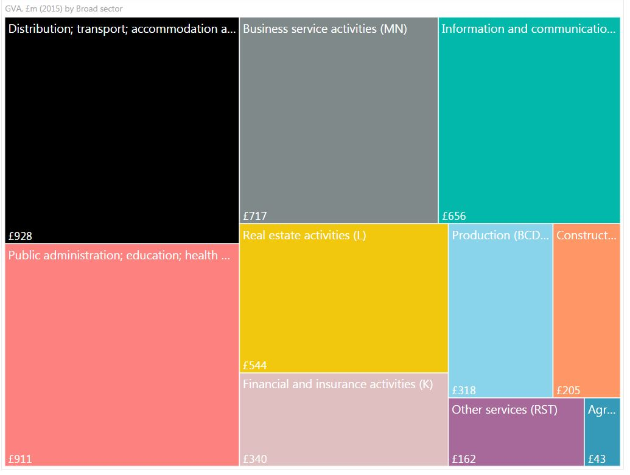
Economy – economic activity in Winchester district
30
With total economic output of around £4.8bn in 2015 Winchester was the second largest economy within the Hampshire County Council Area according to the latest official but experimental estimate of sub-national economic output from ONS.
Basingstoke & Deane was about 7% larger than Winchester but thanks to the superior growth rates in Winchester the gap has narrowed since the recession.
The economy of Winchester is characterised by a handful of large and broad service sectors: distribution, transport, accommodation & food, the broad public sectors, business service activities, information & communication and real estate.
The broad distribution, which in the case of Winchester is concentrated in accommodation & food and the broad public sector account for about 38% of total output (GVA) in Winchester.
The concentration of the broad distribution and public sectors in Winchester is similar to the national average.
What distinguishes Winchester from most other towns and cities is relatively high concentration of high value added services. Business services in Winchester comprises of mostly high productivity professional services and this sector alongside information & communication accounts for about 29% of total economic output in the area.
Business activity (output) in information & communication is about 1.3 times as concentrated in Winchester as in Hampshire and about twice as concentrated as in the UK as a whole. Output in business services is about 1.2 times as concentrated as in the UK.
Second largest economy in Hampshire with total economic output (GVA) of about £4.8bn in 2015
Business activity (output) in Winchester district driven by a handful of broad service sectors
Source: ONS 2016

Slide 40

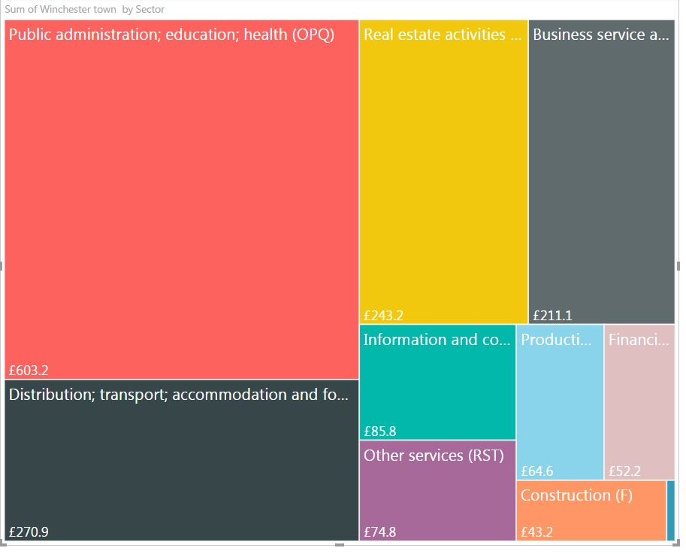
Economy – distribution of economic activity by sub-area
31
Official GVA estimates at sub-area level are not available. Our estimates are based on the most recent official district level GVA and confidential sub-area employment estimates. Methodology behind the approach is available in EBIS Policy & Research Note 05 (Economy Headlines).
The distribution of business activity as measured by GVA is pretty even by sub-area. The largest sub-area, Winchester Town, accounts for about 34% of total output while the smallest, Market Towns & Rural accounts for about a third of total output.
Given that the Market Towns and Rural sub-area definition includes some urban settlements on the outskirts of the City there is a small upward bias in the market Towns & Rural and a small downward bias in the Winchester Town estimate.
Whilst the overall distribution by sub-area looks similar there are stark differences in distributions of total output by sector and sub-area.
Our estimate primarily driven by the distribution of full-time equivalent employment (FTE) by sector suggests that the broad public sector is the dominant sector in Winchester town as it accounts for about 37% of total GVA in the town. This is share is almost double the average for Winchester district but hardly surprising given the concentration of large public-sector employers in the town.
The broad distribution sector with concentrations in accommodation & food accounts for about 16% of total GVA. Real estate and business services account for about 15% and 13% of total output respectively.
Sub-areas: sub-area economies are of similar size in terms of economic output (GVA), but …
…distribution of economic activity by sector and sub-area differs
Winchester Town sub-area:
large share of GVA in public administration, education, accommodation & food, real estate and business services
Source: HCC 2017

Slide 41
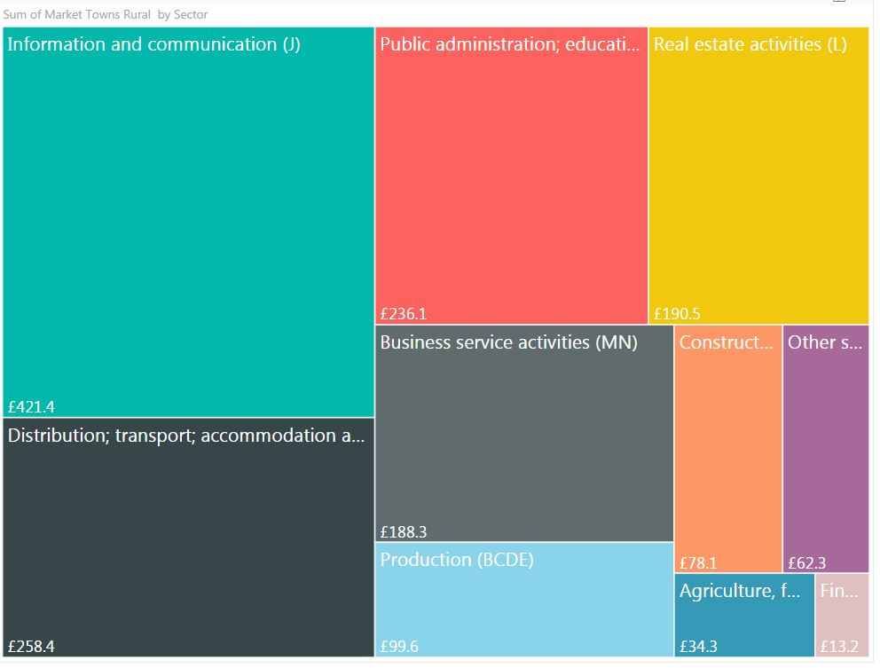
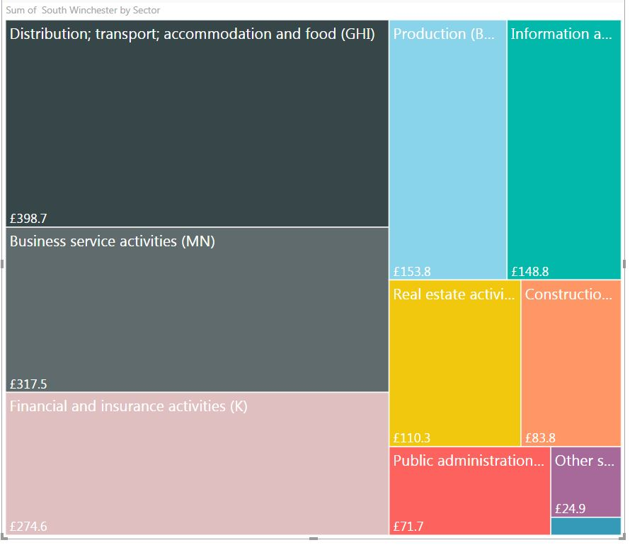
Economy – distribution of economic activity by sub-area
32
Information & communication (ICT) sector is the dominant sector in Market Towns & Rural sub-area as it accounts for over a quarter of total output in the sub-area compared to less than 14% in Winchester District. The concentration of this sector in the sub-area is almost double the Winchester average.
The broad distribution and public sectors accounts for about 16% and 15% of total GVA respectively. The dominant public administration activities I the sub-area are education and health. In terms of output (GVA) both of these broad sectors are underrepresented in the sub-area relative to Winchester average.
Real estate activities and business services account for about 12% of total output with business services underrepresented relative to Winchester average.
Agriculture is relatively small but important sector that is about 2.4 times as concentrated in this sub-area as in the district as a whole.
The broad distribution sector with concentrations in distribution and retail is the largest sector in South Winchester. This sector accounts for about a quarter of total GVA in the area and it is overrepresented in the area.
The location of a prime business park in South Winchester implies that business services and professional services in particular is a major contributor to growth. This sector accounts for a bout a fifth of total output in the area and this sector is over-represented in the area.
Finance and insurance is another important sector to the area as it accounts for about 17% of total output in the area. Manufacturing and construction are over-represented in the area.
Market Towns & Rural:
large share of GVA in ICT, accommodation & food, education & health, real estate and business services
South Winchester:
Distribution & transport, business services, insurance, production and ICT
Source: HCC 2017

Slide 42
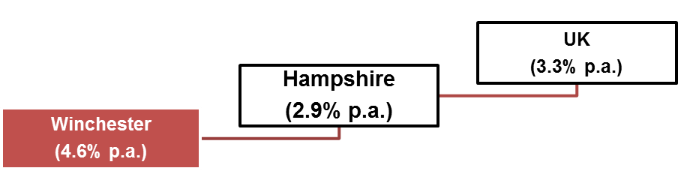
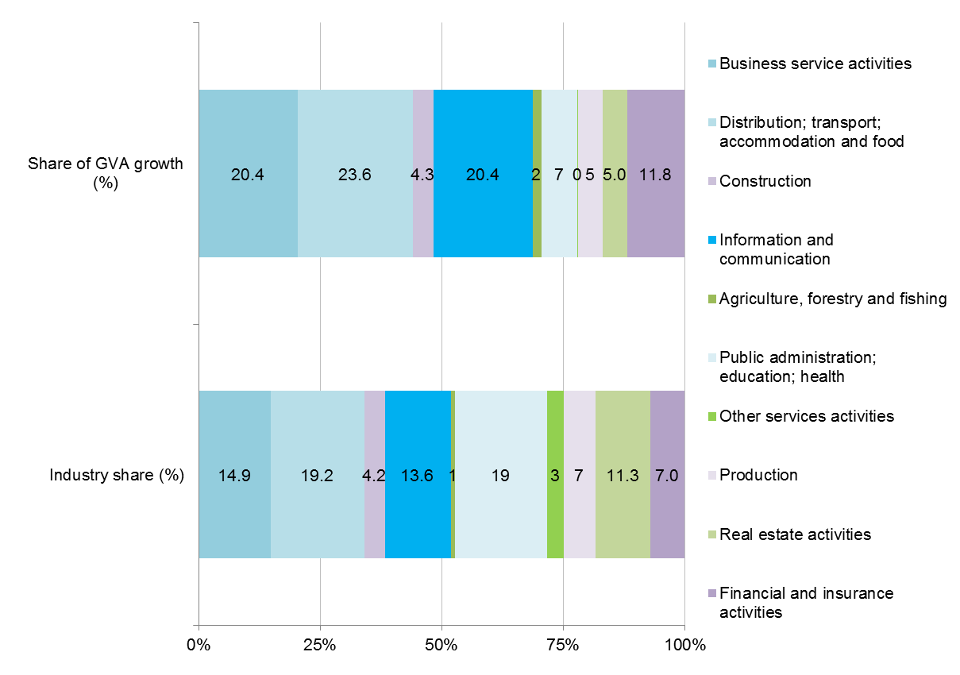

Economy – economic growth and contribution to growth
33
Economic growth well above comparator areas and fastest growth in Hampshire between 2010 and 2015
In nominal terms the economy of Winchester district expanded by 4.6% on average per annum between 2010 and 2016.
GVA growth in Winchester was slower than in the pre-recession decade but faster than in Hampshire or the UK and faster than in any other local economy within Hampshire.
Relatively strong growth in Winchester is explained by the strong performance of its main private services.
The largest sector, distribution transport, accommodation and food accounted for over a fifth of the overall growth in GVA since 2010.
High value added business services and information & communication accounted for about a fifth of total increase in GVA respectively.
Another high-productivity sector, finance & insurance accounted for about £12 in every £100 of additional nominal GVA generated between 2010 and 2015.
The contribution of broad distribution, information & communication, finance & insurance and business services sectors to the overall growth in the economy was above their industry share of total GVA.
The broad agriculture was another sector whose contribution to the overall growth in the economy was better than expected.
Faster growth in the economy (GVA) in Winchester district was held back several sector. The large public administration sector expanded by just 1.7% on average per annum and it accounted for less than 8% of the overall growth in the economy. Falling nominal output in real estate, production and other services constrained growth between 2010 and 2015.
Economic growth was driven by a handful of sectors
Source: ONS 2016 and HCC 2017

Slide 43
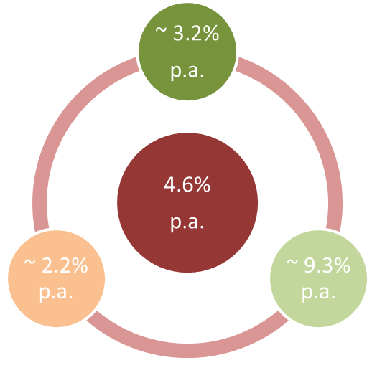
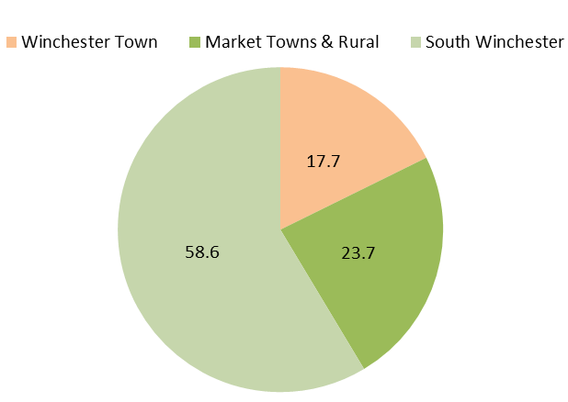
Economy – growth and contribution to growth by sub-area
34
Approximate rates of GVA growth by sub-area (2010 to 2015, % p.a.)
Official estimates of nominal growth in GVA at the sub-area level are not available. A proxy estimate of nominal economic (GVA) growth based on sub-area FTE employment and district level productivity by sector need to be treated with a degree of caution.
Nominal GVA in South Winchester on average expanded by about 9% per annum between 2010 and 2015. South Winchester was the fastest growing sub-area within Winchester District. The overall growth in Winchester district appears to be skewed by the strong growth in this sub-area.
GVA growth in Market Towns & Rural was slower than the Winchester average over the horizon. Market Towns & Rural sub-area expanded by about 3.2% on average per annum, faster than the Hampshire average and similar to the national average.
Growth in nominal GVA in Winchester Town sub-area appears to be considerably slower than in the other two sub-areas - approximately 2.2% per annum since 2010.
Nominal GVA growth in the South Winchester sub-area contributed about 58% of the overall growth in the economy of Winchester which is well above its share in total output (GVA).
Winchester Town and Market Towns & Rural contributed about 24% and 18% respectively to the overall growth in Winchester district.
As a result of the exceptionally strong growth in GVA since 2010 the share of South Winchester in the total economic output of Winchester district increased from about 27% in 2010 to a third in 2015. The share of Winchester Town decreased from 38% to about 34% and in the Market Towns & Rural from 35% to about 33%.
Share of total GVA growth (Winchester District) by sub-area
Source: HCC 2017

Slide 44
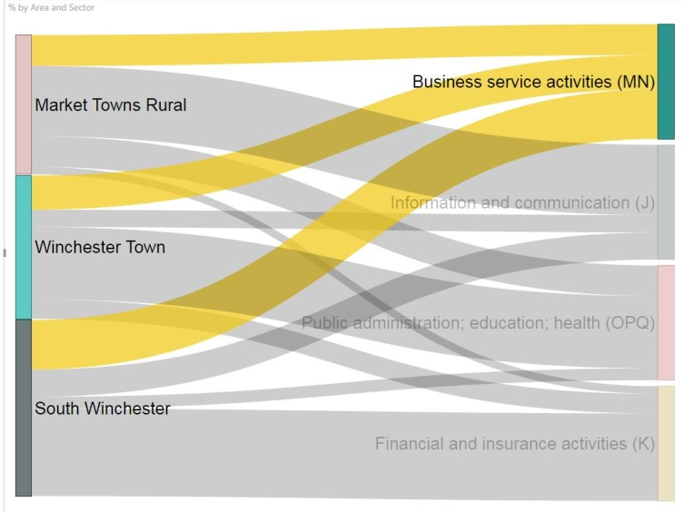
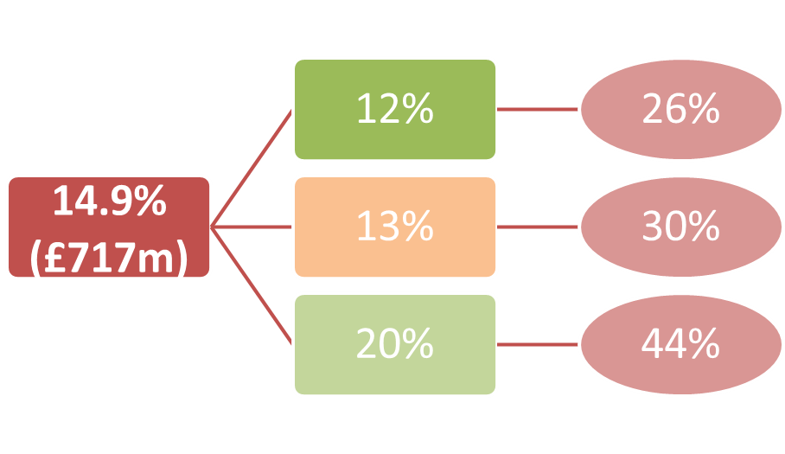
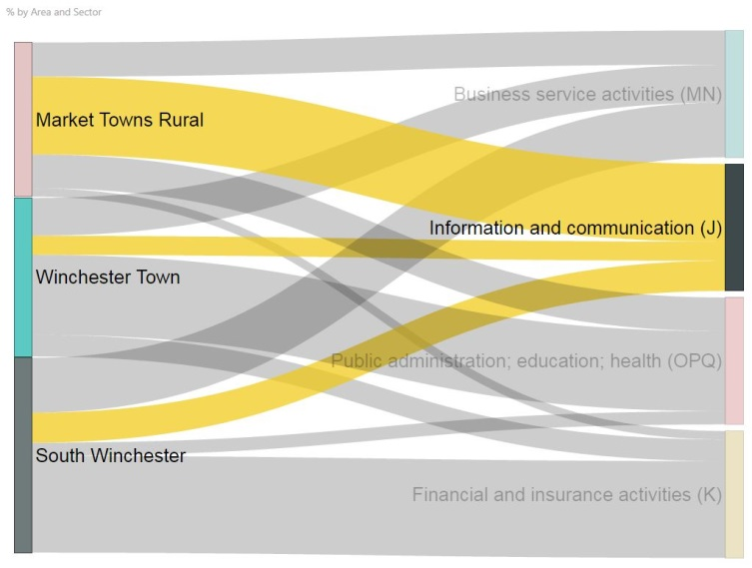
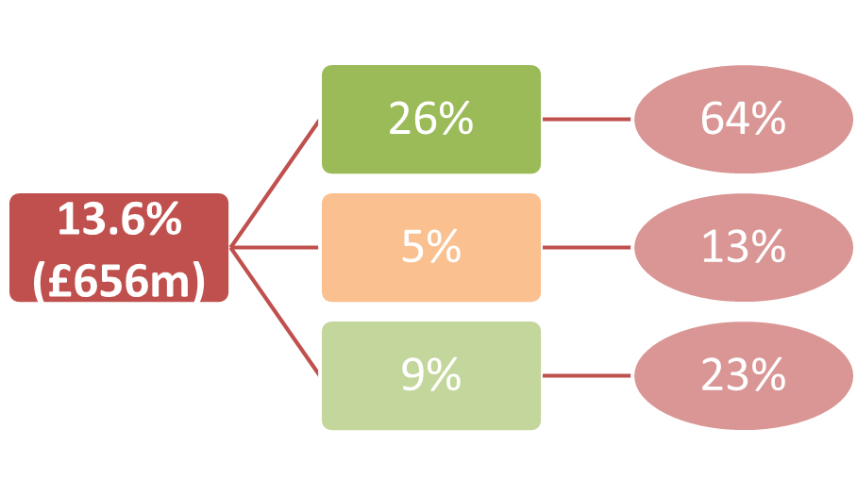
Economy – main factors behind divergence in growth rates
35
Main drivers of growth by sector and sub-area
The divergence in economic performance at the sub-area level is explained by the differences in sectoral composition and the performance of key sectors since 2010.
The broad distribution, transport accommodation & food sector was the main contributor to GVA growth in Winchester district. About a quarter of total GVA in South Winchester comes from this broad sector. Business activity is concentrated at Whiteley Village (retail & leisure) with logistics activities at Segensworth North Business Park.
Business services was another major contributor to growth across Winchester. This broad sector accounts for about a fifth of total GVA in South Winchester. About 44% of total business services output (GVA) in Winchester district is found in this sub-area. The concentration of business activity in the area is explained by the presence of the Solent Business Park and Segensworth North Business Park.
As shown in the previous section information & communication was another major driver of output (GVA) growth in Winchester. Since this sector accounts for more than a fifth of total GVA in Market Towns & Rural it was a major contributor to GVA growth in the sub-area.
Total output in the information & communication in Winchester District is heavily skewed toward the Market Towns & Rural sub-area. This sub-area accounts for almost two thirds of total GVA in this sector in Winchester district. Relatively high share of total ICT output in the area is explained by the presence of several large employers in the area such as IBM and Arqiva.
District Sub-area % of District
Source: HCC 2017

Slide 45
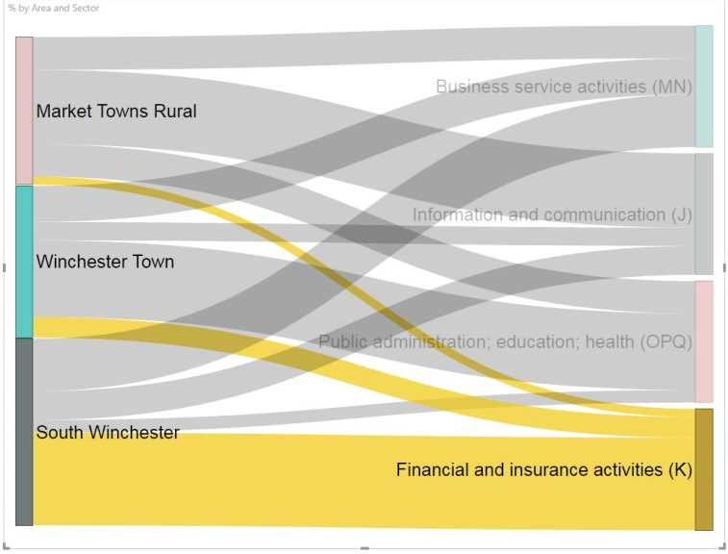
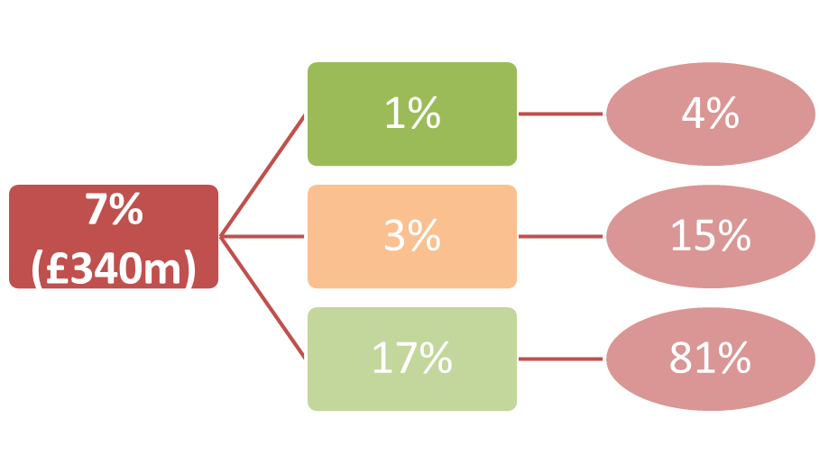
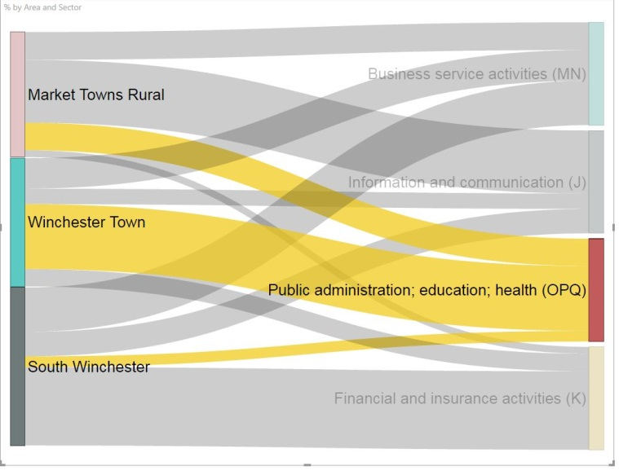

Economy – main factors behind divergence in growth rates
36
Main drivers of growth by sub-area
Finance & insurance was another major contributor to economic growth within Winchester district. In 2015 it accounted for about 7% of total GVA or about £340 million.
This sector accounted for about 17% of the economy of South Winchester. South Winchester accounted for about eight in every ten pounds of GVA generated by this sector in Winchester district.
Relatively high share of GVA and relatively high contribution to the overall finance & insurance GVA of Winchester district in the sub-area is explained by the presence of several large employers on the Solent Business Park such as Zurich Insurance.
This sector is underrepresented in Market Towns & Rural and in terms of nominal GVA it has contracted by about a third between 2010 and 2015.
Faster growth in GVA in Winchester town was held back by a handful of relatively large sectors the main of which was the broad public sector. Within this sector it is likely that faster growth was held back by public administration.
The broad public sector accounts for about 19% of the economy of Winchester district or about £900 million in 2015. This sector accounts for about 37% of the economy of Winchester town. About two thirds of the overall activity in the broad public sector in Winchester district is found in Winchester Town. With little growth in nominal GVA in Winchester Town, this sector has held back faster growth of the sub-area economy.
GVA growth in Winchester Town was held back by the fall in GVA in real estate activities and the sluggish growth of its financial sector.
District Sub-area % of District
Constraints on growth (2010-2015)
Source: HCC 2017

Slide 46
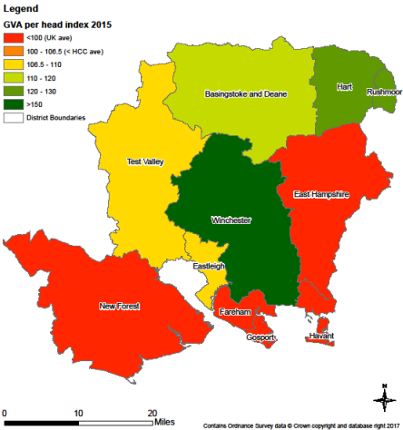
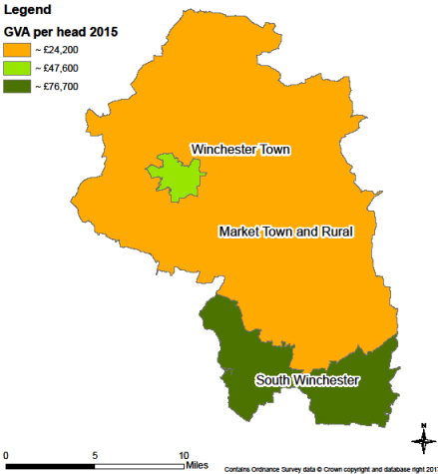
Economy – economic prosperity
37
Prosperity can be measured in number of ways but GVA per head is the most widely used measure of economic prosperity at sub-national level in the UK.
The exclusion of commuter income, differences in labour market participation and differences in economic activity at local level suggests that its use at sub-area level is somewhat misleading and needs to be treated with a high degree of caution.
With GVA per head of about £40,000 Winchester district was by far the most prosperous local authority district in the Hampshire County Council Area.
Winchester is about 48% more prosperous than Hampshire, 58% more prosperous than the UK and about 23% more prosperous than the second most prosperous local authority district in Hampshire (Rushmoor).
Between 2010 and 2015 economic prosperity as measured by GVA per head growth in Winchester district increased by 3.8% p.a. compared to 2.3% in Hampshire. Average growth in economic prosperity in Winchester was the second fastest in Hampshire (marginally below Rushmoor, 3.9% p.a.)
An estimate of GVA per head at sub-area level suggests that GVA per head in Winchester Town was about £47,600 in 2015 or about 19% above the Winchester average.
South Winchester had GVA per head of about £76,700 or almost double (92% above) the Winchester average while Market Towns & Rural had GVA per head of about £24,200 or about 61% of the Winchester average. Relative household incomes in rural areas are way above the level indicated by its GVA per head.
GVA per head relative to UK average (2015)
GVA per head by sub-area (2015)*
Source: ONS 2016 and HCC 2017

Slide 47
Economy – economic growth over the medium-term
38
Output (GVA) growth (1998-2015)
After Hart and Rushmoor, Winchester was the fastest growing economy in the Hampshire County Council area in the decade before the last recession (1997-2007).
In the post-recession period Winchester has been the fastest growing economy in Hampshire. In nominal terms the economy of Winchester expanded by 4.6% per annum.
GVA growth in Winchester was the fastest in Hampshire and the gap between the post-recession average and the pre-recession average in Winchester (-0.9 percentage points per annum) was the smallest in Hampshire.
Disparities in economic growth rates at sub-regional level are due to two factors: sector shape and regional/local competitiveness. The economy of Winchester is competitive in both areas and it has benefited from lose monetary policy since the recession.
GVA data at district level is experimental and there are large gaps in the availability of data at this level. This makes forecasting local GVA growth extremely challenging.
Medium-term forecasts/projections for the economy of Winchester are based on a simple autoregressive model and as such are indicative and need to be treated with a high degree of caution.
Total output (GVA) in Winchester district is forecast to expand by about 4.3% on average p.a. over the medium term (by 2023).
The economy is projected to continue to grow but in the early period there is a downside risk to growth. The green area implies that there is a 90% chance that GVA will be in this area over the forecast horizon while the darkest area corresponds to a 30% chance.
Output (GVA) forecast/projection to 2023
Source: ONS 2016 and HCC 2017

Slide 48
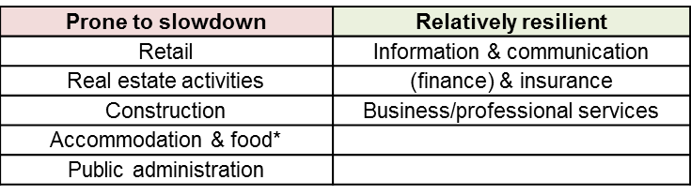
Economy – economic growth over the medium-term
39
There is a downside risk to output growth over the short term but this risk could extend over the medium term. The main sources of risks are:
Economic growth in Winchester was exceptionally strong in 2015 and a slowdown in 2016 was to be expected. However a downside risk to growth in the UK 2017 and possibly beyond this year is reflected in the latest official data from ONS.
Manufacturing growth and exports have so far failed to provide a significant boost to the economy but the main source of uncertainty is found in falling real (inflation adjusted) household incomes and high levels of debt which have constrained consumer spending and economic growth.
High incomes and employment, favourable sector shape (concentration of several high value added and resilient services) and its attractiveness to investors and visitors alike are some of the factors that make Winchester relatively resilient.
Nevertheless some sectors are more prone to a consumer lead slowdown. Retail and accommodation & food are more exposed than other sectors of the economy. Large currency depreciation through its impact on relative prices has made Winchester more attractive to both foreign and domestic visitors which might boost accommodation & food.
The real estate sector underperformed since 2010 and a slowdown in house price growth will most likely curb activity in this sector. Further restructuring in public administration will also constrain growth in Winchester.
Sector shape at sub-area level suggests that growth in Winchester Town is likely to remain subdued. GVA growth in South Winchester is likely to outperform both Market Towns & Rural and Winchester Town over the medium term.
Rising inflation and its impact on real disposable incomes, consumption and growth
Less scope for strong growth in employment
Uncertainty caused by Brexit through its impact on trade and investment
Monetary policy might be less accommodating in the future
External shocks
The economy of Winchester has been relatively resilient to shocks due to:
Highly competitive labour force
High household incomes and employment rates
Relatively high concentration of high value added services
Some sectors are more resilient than others
Sub-area growth driven by industry growth and industry concentration
Output growth in Winchester Town sub-area likely to be more constrained than in Market Towns & Rural and South Winchester

Slide 49



About the sub-area economic profile
40
The sub-area economic profile
(Winchester CC to add a brief summary e.g. scope, contact details etc.)
Data sources
Most data comes from the UK Office for National Statistics – Regional Accounts, Labour Force Survey (LFS), Business Register and Employment Survey (BRES), UK Business Counts, Mid-year Population Estimates, 2011 Census.
Population projections come from Hampshire County Council’s Small Area Population Model. Medium-term forecast/projections for Winchester District is based on a small model estimated in Eviews.
High value added sectors are based on Enterprise m3 and Solent LEP priorities but in places the sector definition used in this paper might be narrower than the one used by Solent LEP.
Sub-area GVA estimates are proxy estimates and as such need to be treated with a degree of caution. Additional information is contained in EBIS Policy & Research Notes (July 2017 - 03, 04, 05, 06, 07, 08)
Contact: EBIS
: ebis@hants.gov.uk
: 01962 847520
© Economic & Business Intelligence Service (EBIS)
Hampshire County Council 2017
The information and views set out in this report are those of the authors and do not necessarily reflect the opinion of Hampshire County Council. The Council nor any person acting on their behalf may not be held responsible for the use of the information contained therein. © Economic & Business Intelligence Service (EBIS), Hampshire County Council.

Slide 50
Winchester Sub-Area Economic Profile – July 2017
Data Appendix
Winchester Town
Market Towns & Rural
South Winchester

Slide 51
Enterprise - broad sector numbers
A1
2016 Broad Sector Business Count
For the following analysis it is necessary to take in account the number of businesses into Market Towns & Rural is around twice the number found in the South Winchester and Winchester Town sub areas.
Business services broad sector is the major sector by business numbers in Winchester district with around 2,400 businesses. The dominance of this sector are due to the considerable number of businesses in the professional, scientific & technical sub-sector (1,695), especially in Market Towns & sub-area (875, around three times the number of businesses found in Winchester South) and Winchester Town (545).
Retail sub-sector (within of the distribution, transport, accommodation & food broad sector) with 460 businesses in South Winchester is double the number of businesses found in this sub-sector in Market Towns & Rural (235) and Winchester Town sub-area (245).
Market Town & Rural has around 340 firms classed in the businesses administration & support services sub-sector (which is whitin the business services broad sector) which is more than twice the number of firms in South Winchester and higher than in Winchester Town (225).
Construction with 425 businesses in Market Towns & Rural sub-area is around 3 times larger than in Winchester Town (140) and more than double in South Winchester (190).
The number of businesses in the ICT sector in Market Towns & Rural (325) is more than double than in South Winchester (115) and considerable higher those in Winchester Town (205).
Winchester District
Winchester Town
Market Towns & Rural
South Winchester
Public Admin, education & health
670
240
325
105
Distribution, transport, accommodation & food
1,920
525
700
695
Business services
2,400
770
1,215
420
Information & communications
680
205
360
115
Production
350
65
190
100
Construction
755
140
425
190
Financial & insurance
160
40
65
55
Other services
470
160
230
75
Real estate
325
100
145
80
Agriculture, forestry & fishing*
465
15
350
100
All sectors
8,195
2,255
4,000
1,940
Change since 2010
1,185
345
415
425
Source: ONS 2016 and HCC 2017. Note: Due to rounding the sub-area figures will not sum to the district total and the sub-areas total.

Slide 52
Employees: broad sector numbers
A2
2015 Broad Sector Employee Numbers
The large differences in sub-area resident worker populations does not translate to the workplace based employee population. Winchester Town has the largest workplace-based population (30,830), but the Market Towns & Rural and South Winchester are not far behind with about 24,000 workers each.
The closer workplace population is down to significant net in-commuting to both Winchester Town and South Winchester, while the Market Towns & Rural sub-area is a small net exporter of labour
With 24,500 employees, the Public admin, education and health sector by far the largest employer in the district. Disaggregating that number and almost two thirds of all employees are based in the Winchester Town (15,500), twice that of the Market Towns & Rural sub-area (6,700) and over seven times the size of South Winchester (2,025).
While Distribution, transport, accommodation and food is the second largest sector employer in the district and Winchester Town and Market Towns & Rural sub-area, it is by far the largest employer in South Winchester (8,800).
Business services represent 12,000 employees or which the majority are in South Winchester and likely to be employed on the Solent Business Park. Production (4,600), of which manufacturing is the main component is also over represented in South Winchester.
Other services and real estate employees are more likely to work in Winchester Town, while agriculture employment is in Market Towns & Rural.
Winchester District
Winchester Town
Market Towns & Rural
South Winchester
Public Admin, education & health
24,500
15,500
6,700
2,025
Distribution, transport, accommodation & food
21,750
6,850
5,900
8,800
Business services
12,000
3,500
3,000
5,000
Information & communications
6,000
700
3,500
1,250
Production
4,600
950
1,500
2,075
Construction
3,500
700
1,500
1,250
Financial & insurance
3,500
500
150
3,000
Other services
3,500
1,500
1,250
500
Real estate
1,250
600
450
300
Agriculture, forestry & fishing*
450
30
350
50
All sectors
81,050
30,830
24,300
24,250
Change since 2010
10,100*
770
985
6,215
Source: ONS 2016 and HCC 2017
*excludes farm workers SIC 0100 – see Land-based section . Due to rounding the sub-area figures will not sum to the district total.

Slide 53
Enterprise - high value added sector numbers
A3
2016 Business Count
Of the Solent high valued added sectors the number of businesses in the tourism sector has the greatest number of businesses (515) in Winchester district and is fairly balanced between Winchester Town (200) and Market Towns & Rural sub-areas (230).
Of the EM3 high valued sectors, financial & business and ICT & digital media sectors are the dominant sectors with 1,420 and 725 businesses in the district respectively. The number of businesses in these sectors in Market Towns & Rural (720 and 380) are three times higher than in South Winchester (230 and 130) and higher than in Winchester Town (470 and 215).
A small number of businesses are found in the aerospace & defence and marine sectors. However the numbers are relatively balanced amongst sub-areas with a range of approximately between 5 to10 businesses in each sub-area in each of these sub-sectors.
The 365 businesses in the high valued added sector classified by EM3 and Solent LEPs, Logistic, have a similar number of businesses between Winchester Town and South Winchester (around 100) which is twice than the number of businesses found in Market Towns & Rural from this sector (180).
Winchester District
Winchester Town
Market Towns & Rural
South Winchester
EM3 Sectors
Financial & Business
1,420
470
720
230
ICT & Digital Media
725
215
380
130
Logistics*
365
85
180
100
Aerospace & Defence
30
5
10
10
Marine
20
5
10
5
Solent Sectors
Engineering & Marine
355
80
190
85
Tourism & Visitors
515
200
230
85
*high value sector for both LEPs.
Source: ONS 2016 and HCC 2017. Note: Due to rounding the sub-area figures will not sum to the district total.

Slide 54

Employees: high value added sector numbers
A4
2015 Employee Numbers
Of the EM3 high value added sectors, financial and business is the largest with 8,000 in Winchester. All three areas employ over 1,000 worker in this sector, but South Winchester (3,500) has the largest number. Although a small number will be employed across the sub-area the majority are likely to be based in the Solent Business Park.
ICT employs 6,000 with over half in the Market Towns & Rural sub-area, and while there will be sector employment across the sub-area, a larger proportion are likely to be based at IBM Hursley. Logistics is important to both LEPs, and employed 3,500 workers, mostly in South Winchester.
Aerospace and defence (2,000) is almost wholly concentrated in South Winchester.
Marine is a small sector and while important to the EM3, is less of a major employer in Winchester.
Of the Solent high value added sectors Tourism and the Visitor economy employs approximately 7,000 workers and second only to financial and business sector. There is an even split between Winchester Town and the Town & Rural sub-areas, but a sizeable number are based in South Winchester.
Engineering and marine with 2,250 will mostly be in engineering given only 100 work in marine. This is concentrated in South Winchester.
Low carbon is hard to define, but according to a Winchester study¹ there are between 2,400 – 4,700 jobs. The study also suggests a route map that could see growth of 450 jobs.
Winchester District
Winchester Town
Market Towns & Rural
South Winchester
EM3 Sectors
Financial & Professional
8,000
2,250
1,500
3,500
ICT & Digital Media
6,000
900
3,500
1,500
Logistics*
3,500
600
1,250
1,500
Aerospace & Defence
2,000
25
225
1,750
Marine
100
None**
10
100
Solent Sectors
Engineering & Marine
2,250
600
600
1,000
Tourism & Visitors
7,000
3,000
3,000
1,500
Low Carbon (green tech.)
2,400 to
4,700
~
~
~
*high value sector for both LEPs. **No data recorded for employees, but could also be down to rounding and <10
Source: ONS 2016 and HCC 2017
**No recorded employees. Due to rounding the sub-area figures will not sum to the district total. ¹ CAG Consultants in association with Roger Tym& Partners (2014) A Low Carbon Route Map for Winchester District

Slide 55
Economy – output (GVA) estimates
A5
Proxy estimates (£ million, %) | Winchester District | Market Towns & Rural | South Winchester | Winchester Town |  | Winchester District | Market Towns & Rural | South Winchester | Winchester Town
Agriculture, forestry and fishing (A) | £43 | £34.3 | £6.3 | £2.4 |  | 0.9 | 2.2 | 0.4 | 0.1
Production (BCDE) | £318 | £99.6 | £153.8 | £64.6 |  | 6.6 | 6.3 | 9.7 | 3.9
Construction (F) | £205 | £78.1 | £83.8 | £43.2 |  | 4.2 | 4.9 | 5.3 | 2.6
Distribution; transport; accommodation and food (GHI) | £928 | £258.4 | £398.7 | £270.9 |  | 19.2 | 16.3 | 25.1 | 16.4
Information and communication (J) | £656 | £421.4 | £148.8 | £85.8 |  | 13.6 | 26.6 | 9.4 | 5.2
Financial and insurance activities (K) | £340 | £13.2 | £274.6 | £52.2 |  | 7.0 | 0.8 | 17.3 | 3.2
Real estate activities (L) | £544 | £190.5 | £110.3 | £243.2 |  | 11.3 | 12.0 | 6.9 | 14.7
Business service activities (MN) | £717 | £188.3 | £317.5 | £211.1 |  | 14.9 | 11.9 | 20.0 | 12.8
Public administration; education; health (OPQ) | £911 | £236.1 | £71.7 | £603.2 |  | 18.9 | 14.9 | 4.5 | 36.5
Other services (RST) | £162 | £62.3 | £24.9 | £74.8 |  | 3.4 | 3.9 | 1.6 | 4.5
Total GVA | £4,824 | £1,582 | £1,590 | £1,651 |  | 100 | 100.0 | 100.0 | 100.0
Source: ONS (2016) and HCC (2017) estimate
Sub-area proxy estimates need to be treated with a degree of caution

Slide 56
Economy – nominal growth rates by sector and sub-area
A6
 | cumulative % change (2010-2015) |  |  |  |  | % change p.a. (2010-2015)
Proxy estimates | Winchester District | Market Towns & Rural | South Winchester | Winchester Town |  | Winchester District | Market Towns & Rural | South Winchester | Winchester Town
Agriculture, forestry and fishing (A) | 72.0 | 79.4 | 112.8 | -16.7 |  | 11.5 | 12.4 | 16.3 | -3.6
Production (BCDE) | 18.7 | -1.0 | 27.3 | 38.8 |  | 3.5 | -0.2 | 4.9 | 6.8
Construction (F) | 25.8 | 2.1 | 48.3 | 43.5 |  | 4.7 | 0.4 | 8.2 | 7.5
Distribution; transport; accommodation and food (GHI) | 33.0 | 14.2 | 60.4 | 21.4 |  | 5.9 | 2.7 | 9.9 | 4.0
Information and communication (J) | 43.5 | 23.1 | 128.7 | 73.0 |  | 7.5 | 4.2 | 18.0 | 11.6
Financial and insurance activities (K) | 51.1 | -33.4 | 72.7 | 13.0 |  | 8.6 | -7.8 | 11.5 | 2.5
Real estate activities (L) | 9.9 | 49.1 | 75.4 | -20.1 |  | 1.9 | 8.3 | 11.9 | -4.4
Business service activities (MN) | 38.4 | 17.3 | 45.3 | 52.0 |  | 6.7 | 3.2 | 7.8 | 8.7
Public administration; education; health (OPQ) | 8.6 | 10.5 | 15.1 | 7.1 |  | 1.7 | 2.0 | 2.9 | 1.4
Other services (RST) | 1.3 | -3.6 | 17.1 | 0.9 |  | 0.2 | -0.7 | 3.2 | 0.2
Total GVA | 25.4 | 17.1 | 56.2 | 11.7 |  | 4.6 | 3.2 | 9.3 | 2.2
Source: ONS (2016) and HCC (2017) estimate
Sub-area proxy estimates need to be treated with a degree of caution

Slide 57
Economy – district level share (GVA by industry and sub-area)
A7
Proxy estimates | Winchester District | Market Towns & Rural | South Winchester | Winchester Town
Agriculture, forestry and fishing (A) | 100.0 | 79.7 | 14.6 | 5.7
Production (BCDE) | 100.0 | 31.3 | 48.4 | 20.3
Construction (F) | 100.0 | 38.1 | 40.9 | 21.1
Distribution; transport; accommodation and food (GHI) | 100.0 | 27.8 | 43.0 | 29.2
Information and communication (J) | 100.0 | 64.2 | 22.7 | 13.1
Financial and insurance activities (K) | 100.0 | 3.9 | 80.8 | 15.3
Real estate activities (L) | 100.0 | 35.0 | 20.3 | 44.7
Business service activities (MN) | 100.0 | 26.3 | 44.3 | 29.4
Public administration; education; health (OPQ) | 100.0 | 25.9 | 7.9 | 66.2
Other services (RST) | 100.0 | 38.5 | 15.4 | 46.2
Source: ONS (2016) and HCC (2017) estimate
Sub-area proxy shares need to be treated with a degree of caution

Slide 58
Land-based sector - sector definition
A9
SIC (2007) – 4 digit
0111 : Growing of cereals (except rice), leguminous crops and oil seeds
0112 : Growing of rice
0113 : Growing of vegetables and melons, roots and tubers
0114 : Growing of sugar cane
0115 : Growing of tobacco
0116 : Growing of fibre crops
0119 : Growing of other non-perennial crops
0121 : Growing of grapes
0122 : Growing of tropical and subtropical fruits
0123 : Growing of citrus fruits
0124 : Growing of pome fruits and stone fruits
0125 : Growing of other tree and bush fruits and nuts
0126 : Growing of oleaginous fruits
0127 : Growing of beverage crops
0128 : Growing of spices, aromatic, drug and pharmaceutical crops
0129 : Growing of other perennial crops
0130 : Plant propagation
0141 : Raising of dairy cattle
0142 : Raising of other cattle and buffaloes
0143 : Raising of horses and other equines
0144 : Raising of camels and camelids
0145 : Raising of sheep and goats
0146 : Raising of swine/pigs
0147 : Raising of poultry
0149 : Raising of other animals
0150 : Mixed farming
SIC (2007) – 4 digit
0161 : Support activities for crop production
0162 : Support activities for animal production
0163 : Post-harvest crop activities
0164 : Seed processing for propagation
0170 : Hunting, trapping and related service activities
0210 : Silviculture and other forestry activities
0220 : Logging
0230 : Gathering of wild growing non-wood products
0240 : Support services to forestry
0322 : Freshwater aquaculture
2830 : Manufacture of agricultural and forestry machinery
4611 : Agents involved in the sale of agricultural raw materials, live animals, textile raw materials and semi-finished goods
4613 : Agents involved in the sale of timber and building materials
4621 : Wholesale of grain, unmanufactured tobacco, seeds and animal feeds
4622 : Wholesale of flowers and plants
4623 : Wholesale of live animals
4631 : Wholesale of fruit and vegetables
4632 : Wholesale of meat and meat products
4633 : Wholesale of dairy products, eggs and edible oils and fats
4661 : Wholesale of agricultural machinery, equipment and supplies
4776 : Retail sale of flowers, plants, seeds, fertilisers, pet animals and pet food in specialised stores
7500 : Veterinary activities
8130 : Landscape service activities
9104 : Botanical and zoological gardens and nature reserve activities
+ DEFRA farm labourers to cover SIC 0100.
Source: ONS 2016 and DEFRA 2016 based on a broad LANTRA definition

Slide 59
Land-based sector – sources and numbers
A10
Definition split by source
The land-based data is incomplete and to produce an overall estimate requires multiple sources and in the case of sub-areas an element of apportionment. As such, the statistics need to be read as indicative rather than precise estimates of land-based business numbers and employment.
In defining the land-based sector three sources are used. The ONS 2015 BRES data for employees (excludes SIC 0100 farm labours), 2013 DEFRA farm labour data (to cover SIC 0100) and ONS Annual Population workplace data to determine the agricultural self-employment multiplier. In the graph (left) SIC 0100 is included in the BRES data and the reason for the absence of DEFRA data.
In the case of Winchester Town the DEFRA data is only published at the local authority geography and for the sub-areas the ONS business count is used to apportion the numbers. In this case 90% is given to the Market Towns & Rural sub-area and 10% to Winchester South. As no DEFRA data is apportioned to Winchester Town it will not show in the definition.
If only BRES data is used for land-based then close to two thirds of the Market Towns and Rural sub-area workforce would be potentially lost.
The land-based sector does not specifically include the tourism and visitor economy, although in many cases the two have a close relationship e.g. Avington House near Winchester as an events business.
%
Winchester District
Winchester Town
Market Towns & Rural
South Winchester
Hampshire
Employee estimates
2,000
350
1,250
450
10,000
DEFRA
farm labour
1,290
0
1,160
130
6,770
Agricultural self-employment
1,680
170
1,180
280
8,190
Total
4,970
520
3,590
860
24,960
Source: ONS 2016 and DEFRA 2016

Slide 60
About the sub-area economic profile
40
The sub-area economic profile
(Winchester CC to add a brief summary e.g. scope, contact details etc.)
Data sources
Most data comes from the UK Office for National Statistics – Regional Accounts, Labour Force Survey (LFS), Business Register and Employment Survey (BRES), UK Business Counts, Mid-year Population Estimates, 2011 Census.
Population projections come from Hampshire County Council’s Small Area Population Model. Medium-term forecast/projections for Winchester District is based on a small model estimated in Eviews.
High value added sectors are based on Enterprise m3 and Solent LEP priorities but in places the sector definition used in this paper might be narrower than the one used by Solent LEP.
Sub-area GVA estimates are proxy estimates and as such need to be treated with a degree of caution. Additional information is contained in EBIS Policy & Research Notes (July 2017 - 03, 04, 05, 06, 07, 08)
Contact: EBIS
: ebis@hants.gov.uk
: 01962 847520
© Economic & Business Intelligence Service (EBIS)
Hampshire County Council 2017
The information and views set out in this report are those of the authors and do not necessarily reflect the opinion of Hampshire County Council. The Council nor any person acting on their behalf may not be held responsible for the use of the information contained therein. © Economic & Business Intelligence Service (EBIS), Hampshire County Council.

