Slide 1
Central Winchester Regeneration Informal Policy Group Monday 25 September The Bapsy Hall, The Guildhall, Winchester

Slide 2
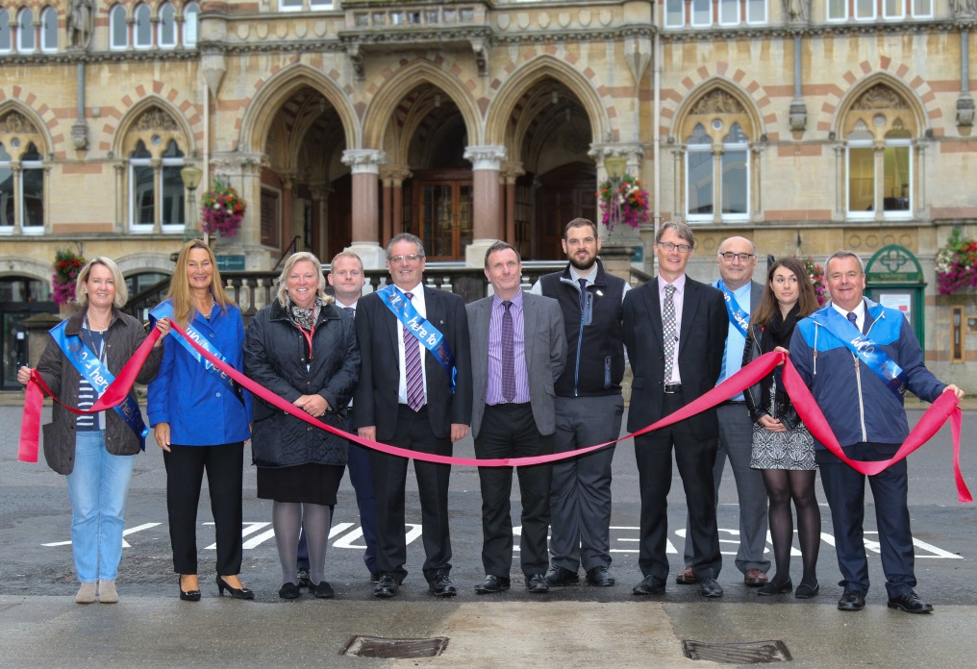
Announcements
Bus Station
Notes:
Photos of bus station and flooding scheme will be added in

Slide 3
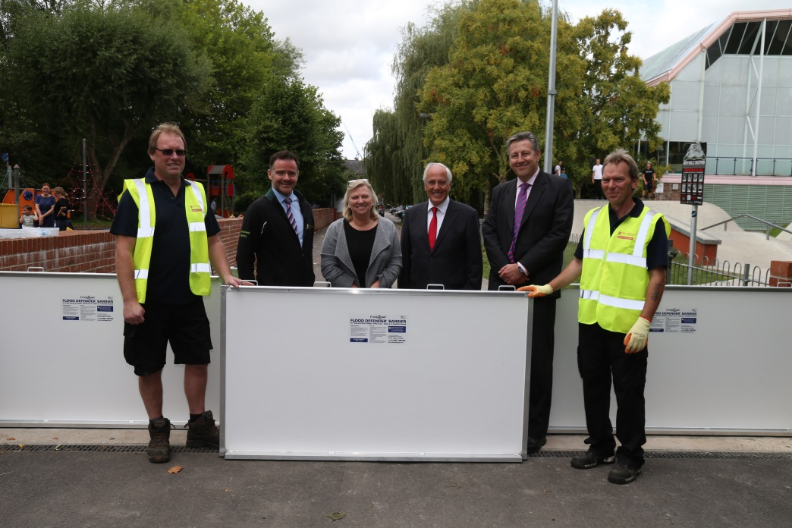
Announcements
Flooding scheme
Notes:
Photos of bus station and flooding scheme will be added in

Slide 4
Timetable for Adoption of SPD

Slide 5
Progressing the SPD
Technical Issues
Movement Strategy
Parking
Archaeology
Housing

Slide 6
Movement Strategy

Slide 7
Movement Strategy
Public Involvement
In the coming months, there will be three way local people can their on say on transport issues as part of the Movement Strategy:
An online survey at www.hants.gov.uk, open to all, will run for six weeks. Details of how to take part will be promoted by both councils through websites and social media channels
A telephone survey, managed by an independent provider, aims to gather detailed, qualitative responses from a representative sample of local people. If you receive a call, we would be grateful for your full participation in order to derive maximum value from the exercise
Targeted workshop-based engagement with a range of local interest groups and delivery partners

Slide 8
Parking
THREE-RING APPROACH TO PARKING
‘Centre’ Ring Car Parks - The Brooks, Middle Brook Street, Colebrook Street, Cossack Lane, Upper Brook Street, Friarsgate (which re-opened in May), St Peter’s, Jewry Street, Tower Street and Gladstone Street.
‘Inner’ Ring Car Parks - Chesil multi-storey, Durngate, Worthy Lane, Coach Park and Cattle Market.
‘Outer’ Ring Car Parks - Park & Ride: Barfield, St Catherine’s, Pitt and South.

Slide 9
Parking
Recent changes – capacity and charges
Car parking strategy review / surveys completed in the Autumn
Consider city centre parking integrated with residential and retail parking

Slide 10
Archaeology
Established an Advisory Panel
Brief to advise on:
approach to further assessment
sites to be explored
likely costs and opportunities
within the context of the planning policy
Completed in the Autumn

Slide 11
Affordable Housing
40% affordable incorporated in Local Plan
Viability implications
Identify innovative solutions
Getting the mix right

Slide 12
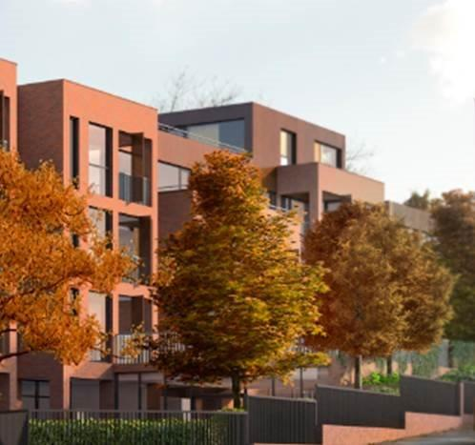
Redefining a ‘Nice Home’

Slide 13
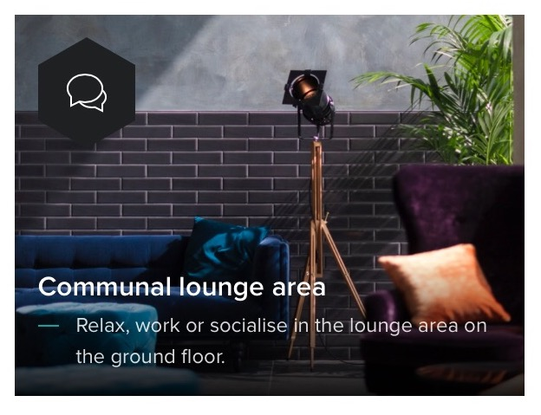
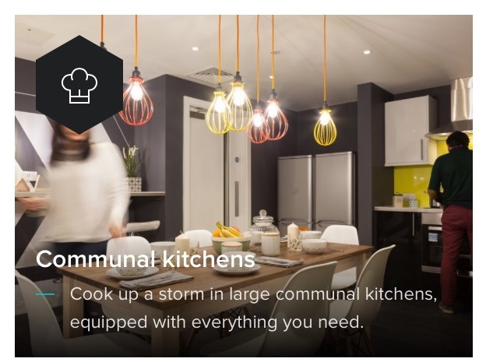
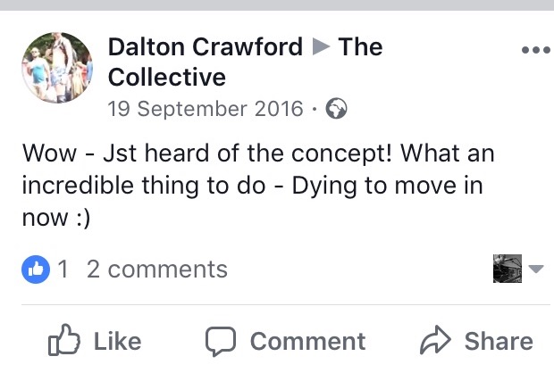

Slide 14
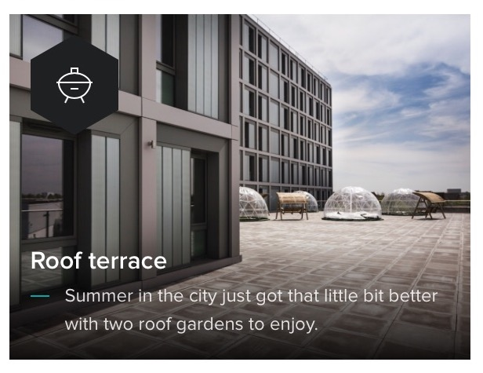
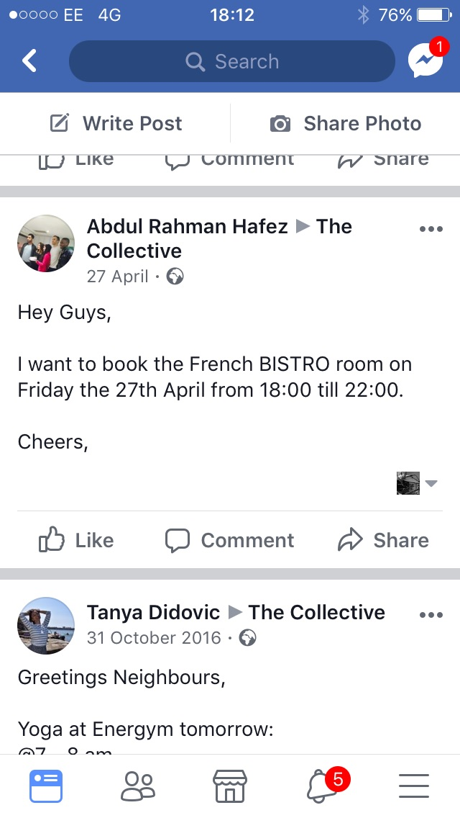
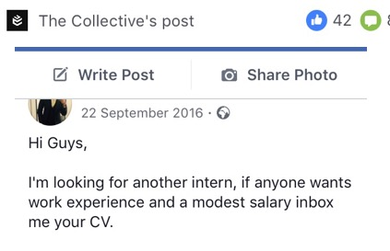

Slide 15
Emerging Supplementary Planning Document (SPD) and Vision
Presentation by JTP
Notes:
Presentation to add from JTP

Slide 21
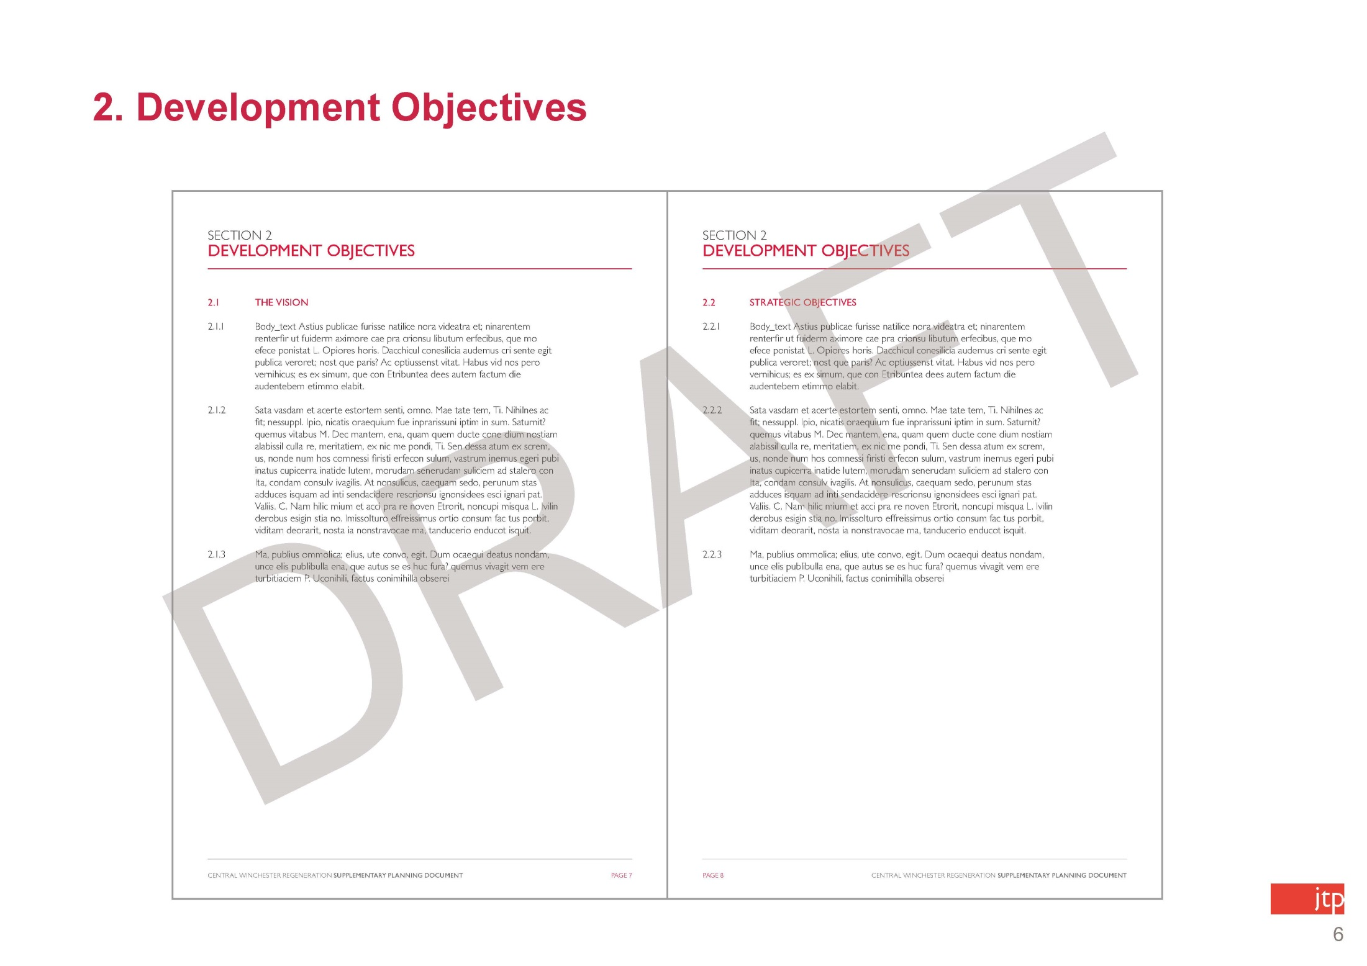

Slide 33
Making the SPD a reality
Testing viability of SPD to ensure that it is deliverable
Identifying potential delivery models
Being clear about levels of risks and pros and cons of approaches
Notes:
Bullets points to add from Ian

Slide 34
Making the SPD a reality
Work in progress:
Commercial Viability: Deloitte
CWR Scheme Costs: Mace
Delivery Options: both Commercial and Legal perspectives
Future Developer Workshop in October
This work will be reflected in the draft SPD presented on 30 October
Notes:
Bullets points to add from Ian

Slide 35
Public Participation

