Slide 1
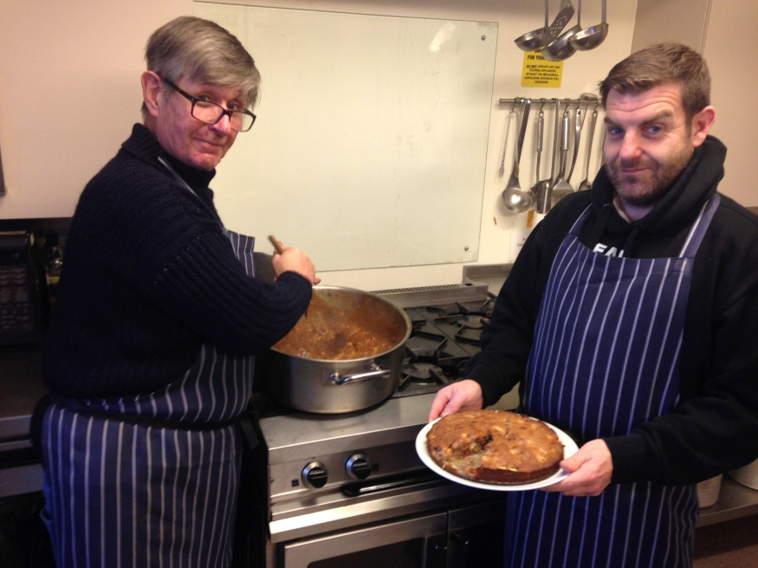
Nightshelter Healthy Eating Project
Presentation – December 2014
Production of a budget recipe book/nutritional guide for residents (and wider use by charities/agencies)
Cooking sessions for
Nightshelter residents

Slide 2
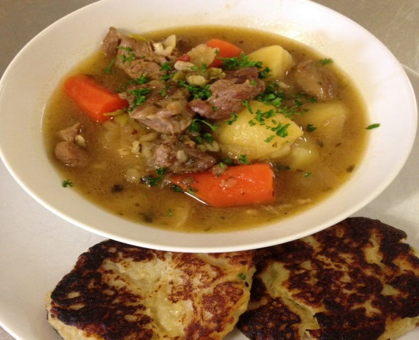
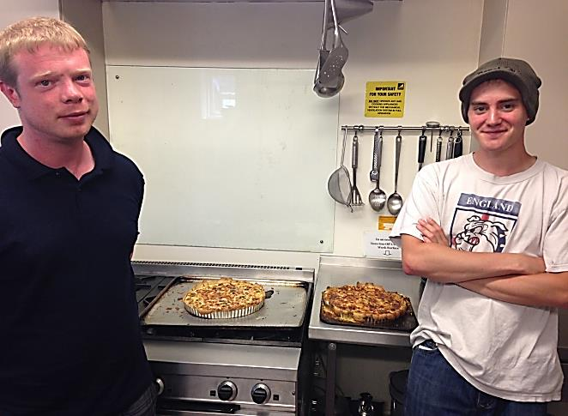
The aim of our cooking sessions is
for our residents to:
Gain hands-on cooking experience and skills
Learn about nutrition and healthy eating
Learn about budgeting for food and food shopping
Cook their own food using recipes from the cook book
Gain confidence from working in a group
Enjoy a sociable, productive activity
Work towards a food hygiene certificate if appropriate/desired

Slide 3
Resident feedback on our cooking sessions:
“Contributing to everybody's dinner.”
“Something productive to do.”
“I have an eating disorder and doing this course I now eat 3 meals [a day] and puddings.”
“I enjoy cooking and don’t really get a chance to do it that often right now, and it fills me with confidence.”
“Working as part of a team and getting to know people more.”
“Everyone got on well as a team. Slicing onion and mixing was very therapeutic.”
“I’ve learned more understanding of recipes, cooking and preparation, more influence over what I eat.”
“Confidence boost.”
“To cook fresh food for my family and housemates.”

Slide 4
Evaluation of cooking sessions:
Cooking sessions have been held weekly since beginning of June
(bi-monthly or monthly prior to this):
Since June 1st 2014
Total number of cooking sessions: 25
Total attendees of these sessions: 109
Number of individuals attending at least one session: 63
Number of individuals attending 3 or more sessions: 21 (incl. above)
Number of Cook Books distributed to residents since June 2014: 65

Slide 5
Cooking workshop outcomes – cooking skills
(Outcomes measured using questionnaire based on the Cook and Eat Evaluation.)

Slide 6
Cooking workshop outcomes – food safety and hygiene

Slide 7
Cooking workshop outcomes – balanced diet

Slide 8
Outcomes – changes in eating habits (specific foods)

Slide 9
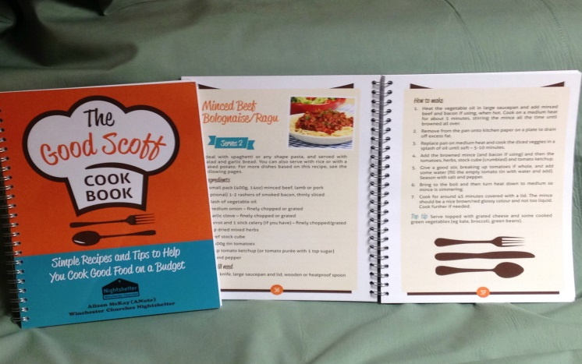
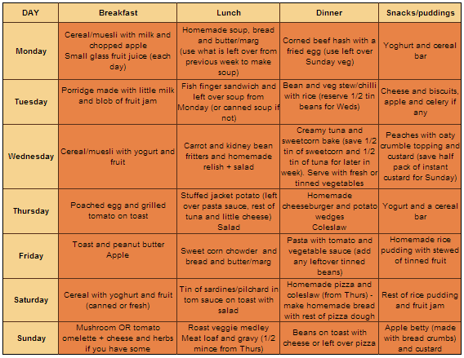
The Good Scoff Cook Book contains nutritional information, recipes,
information on avoiding food waste, budget shopping list, food storage & more

Slide 10
Why did we produce the cook book?
The cook book was developed to as a resource tool for our residents’ cooking sessions
It contains basic nutritional information, cooking and shopping advice, a range of healthy budget recipes, tips on how to make food go further, and a week’s menu planner with a shopping list costing just over £20
It has been written and designed to be easy to read and understand
It is given out free to every resident, along with a food parcel, when they move on from the Nightshelter
We feel that the book is also a fantastic resource for anyone wanting to eat healthy food on a budget (particularly other agencies and organisations with similar service users)

Slide 11
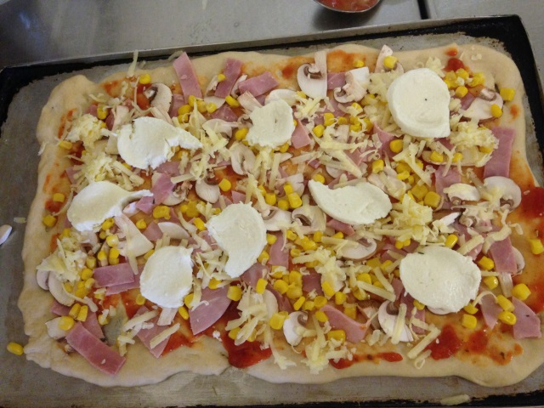
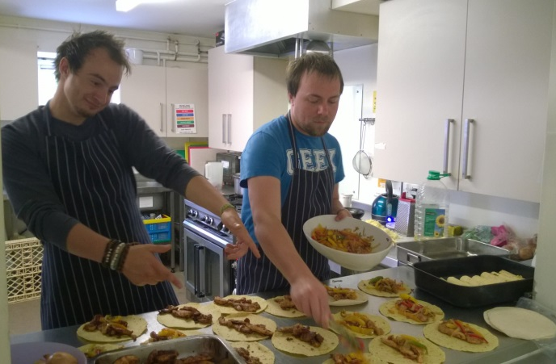
Sales figures for the Good Scoff Cook Book 2014
The funding has enabled us to professionally design and print the cook book in an easy-to-use and accessible format. It has also enabled us to sell the cook book to other organisations at cost price.
Total sales to-date: 600
Breakdown
Individuals: 100
Charities: 250
Agencies: 160
Retailers: 30
Corporate partners: 60
We have also distributed over 50 cook books to charities, agencies and other organisations as ‘taster copies’ free of charge.

Slide 12
Residents’ outcomes –
Physical Health
(averages from 15 residents)
Residents’ outcomes –
Training and Education
(average from 15 residents)

Slide 13
Residents’ outcomes –
Maximise income and budgeting
(averages from 15 residents)
Residents’ outcomes –
Self care and life skills
(averages from 15 residents)

Slide 14
Feedback we’ve received on the Good Scoff Cook Book:
Solent Mind
“The Good Scoff Cook Book was an excellent find. It is a well laid out and easy to use book. It is clearly written in easy to understand language, which I think will appeal to a wide range of people.
I like the bit about food labelling - how confusing that is for all of us. The book really simplifies this, and makes it much easier to understand than some of the leaflets I have used in my groups.
Budgeting, menus, shopping lists, food storage, and
more, all that information in one book, and that’s before you get to the tasty, nutritious and easy recipes.
Finally, I think Good Scoff is a fun book…..sort of ‘try cooking and enjoy it.”

Slide 15
Feedback we’ve received on the Good Scoff Cook Book:
Winchester Basics Bank
“We love the Cook Book and the young families that we have given the book to have been thrilled to receive it. Some have been amazed at how easy it is to create nutritious meals with simple, inexpensive ingredients. This is certainly a bonus for struggling in limited incomes.”

Slide 16
Feedback we’ve received on the Good Scoff Cook Book:
Gosport Borough Council
“I received the Good Scoff Cook Book a couple of weeks ago and wanted to let you know how impressed myself, and others that I have shared it with, are. We would like to place an order for 100 copies. The books will be distributed through the Council’s homelessness accommodation, Two Saints who provide services for homeless people under 25, and a community project addressing healthy weights in Gosport.”

