Slide 1

Why mental health is important in west Hampshire
Spotlight on mental health
23rd June 2015
Dr Katrina Webster
Clinical director for mental health & learning disabilities
West Hampshire CCG

Slide 2
Why mental health is important in Hampshire
1 in 6 of the adult population experience mental ill health at any one time
1 in 10 children have a mental health problem; half of lifetime mental illness is present by the age of 14
1% of the population has a serious mental health problem (13,200 across Hampshire)

Slide 3

Provision - Southern Health Foundation Trust
Adult Mental Health:
  Community Mental Health Teams
  Acute Mental Health Teams (urgent and higher intensity support)
  Recovery College
Older People’s Mental Health:
  Community Mental Health Teams
For both:
  around 125 beds
  Talking therapy services

Slide 4


Provision - Wellbeing Centres
(In partnership with Hampshire County Council)
Andover Mind
  Andover
  Romsey
  Solent Mind
  Eastleigh
  Winchester
  Hythe and New Milton

Slide 5
Third sector and other services
Alzheimer's Society & Andover Mind – Dementia Advisers
Surrey and Borders Partnership Trust for autism diagnostic assessment
Chronic fatigue services – South coast fatigue
Rape Crisis and support services
Independent Advocacy
Independent consultants for adults with ADHD

Slide 6
What we are doing
Helping People in a Crisis
  Mental health professionals offering support in acute hospitals (Psychiatric liaison services)
  Making sure there are safe places, rather than police cells
  Putting mental health workers into police, ambulance, 111 and 999 call centres

Slide 7
What we are doing
Parity of Esteem – national programme to address inequality: local actions
  Making sure people with a mental health need are treated in the same away as those with a physical health need
  Making sure people get both their mental and physical wellbeing looked after, whatever service supports them
  People with a mental illness can die up to twenty years earlier, we are working to address this inequality
Notes:
e.g. waiting times
Working to improve physical health of people with mental health problems
Working to identify and treat MH problems in people with chronic physical health conditions

Slide 8
Improving mental health services
Reducing waiting times for the very unwell
Expanding the talking therapy service
Identifying and supporting more people with Dementia
Improving services for people who are ill as a result of bad experiences as a younger person
Working to develop well-being centres
Making sure people with psychosis are treated quickly
Making sure people with learning disabilities don’t have to live away from their families in private hospitals

Slide 9

Recovery College
Open to people who are using mental health services or have been discharged in the last year and their carers
Aims to rebuild lives, not just reduce symptoms
Range of courses available in many areas
Courses are led by a mental health professional working alongside a person with lived experience
Notes:
People are coached, developed and trained to grow their own strengths and resources
Students and Tutors work together to develop goals and plans important to them
People move on from the college as courses are completed

Slide 10
Hampshire Primary Care
Psychological Therapy Service
‘Talking Therapy’ services are available to help people with mild to moderate depression and anxiety disorders
Available to everyone over 16
The Hampshire service is called italk and has been in place since 2010
The service is provided by Southern Health NHS Foundation Trust who deliver the service in partnership with Solent Mind
Notes:
Services were originally developed through the national Improving Access to Psychological Therapies (IAPT) initiative
1 in 10 children have a mental health problem (around 31,000 in Hampshire), and half of all lifetime mental illness is present by the age of 14.
1 in 10 new mothers suffer from postnatal depression (around 1500 women each year in Hampshire).
1 in 5 of working-age women and 17% of working-age men are affected by depression or anxiety at any one time.
Half of all women and a quarter of all men will be affected by depression at some time in their life and 15% experience a disabling depression

Slide 11
Tel:
023 8038 3920
www.italk.org.uk

Slide 12
Wellbeing Centres
Wellbeing is about feeling good on the inside and on the outside
Wellbeing centres were set up in 2012 and jointly funded between Health and Hampshire County Council
Wellbeing centres have been used by thousands of people since they were set up
Anybody can refer themselves to the centres, but many will be referred from health and social care services
Notes:
Wellbeing centres help people to achieve their individual potential and participate in their community
As mentioned previously we have 5 wellbeing centres in WH. In eastleigh, Winchester, Romsey, Andover and New Forest - split over 2 sites in New Milton and Hythe

Slide 13
Wellbeing Centres
Wellbeing centres host groups that including help with work, life skills and therapeutic activity like music-making
Other mental health services rely on the centres to provide space for groups and therapies
The service will need to expand in coming years as more services are delivered closer to home

Slide 14
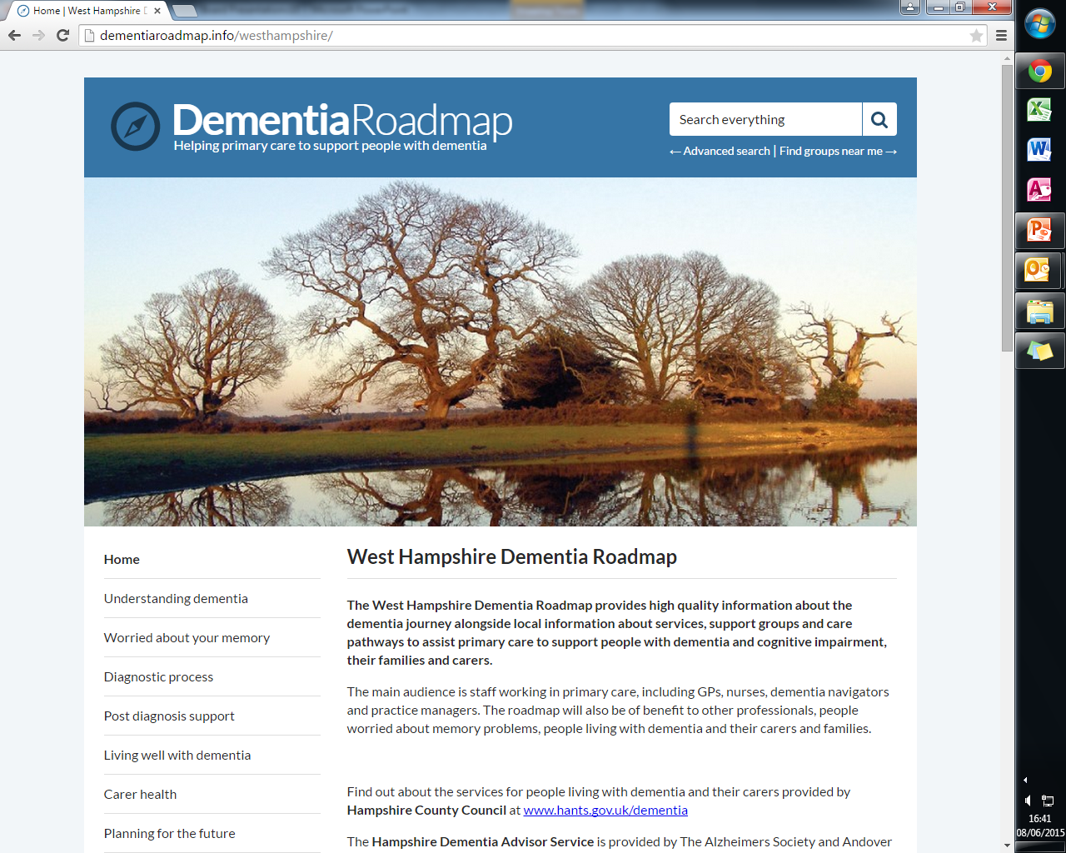
Dementia Roadmap
Resources for professionals, carers and people with dementia
One stop shop for links to everything about dementia including local services
http://dementiaroadmap.info/westhampshire/

Slide 15
Summary
West Hampshire CCG is investing in improving mental health services
Mental health services focussed on community support, with beds when needed
Services are joining up better between different health settings and social care
Helping people to recover from illness, develop their own goals and stay well

